Slide 1


Augmented Reality Implementation Framework
Example Pack
May 2022
Kristen Phan
MSc Business Information Technology
Supervisor: Ilia Shakitko
January 2023

Slide 2

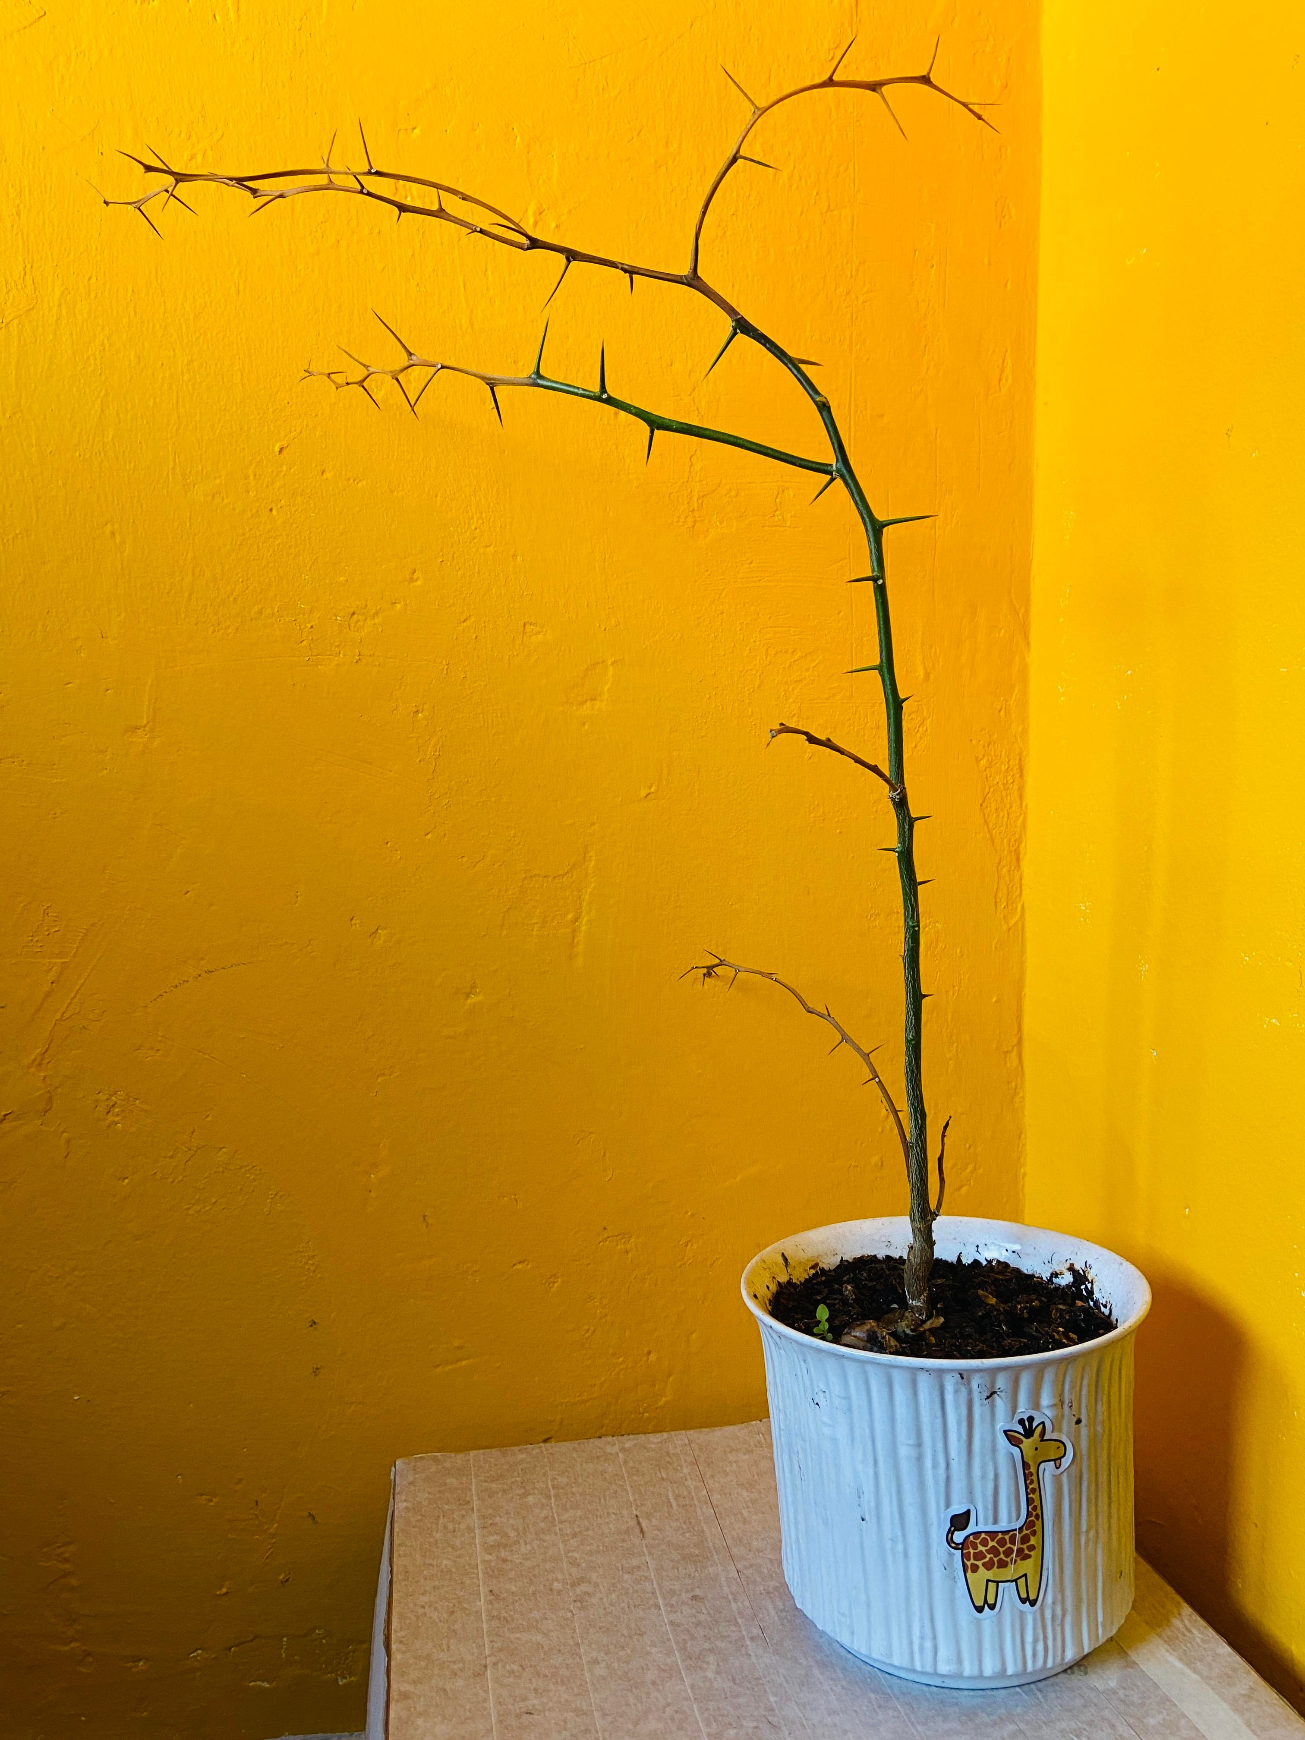
Introduction
AR 101
WebAR Prototype
AR Implementation Framework
Key Takeaways
What Can We Do About Kristen’s Green Thumb Problem?
Before
Now: Dead

Slide 3
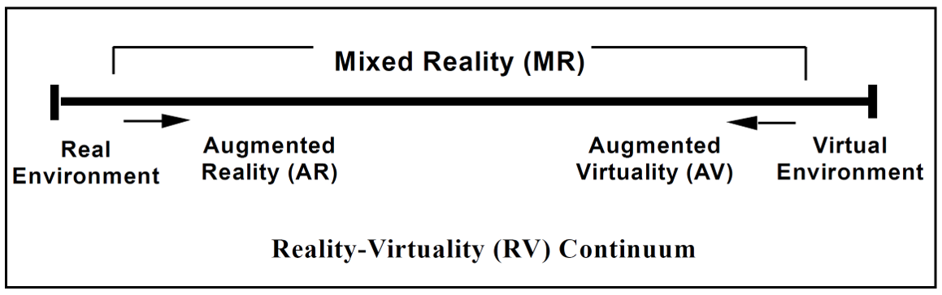

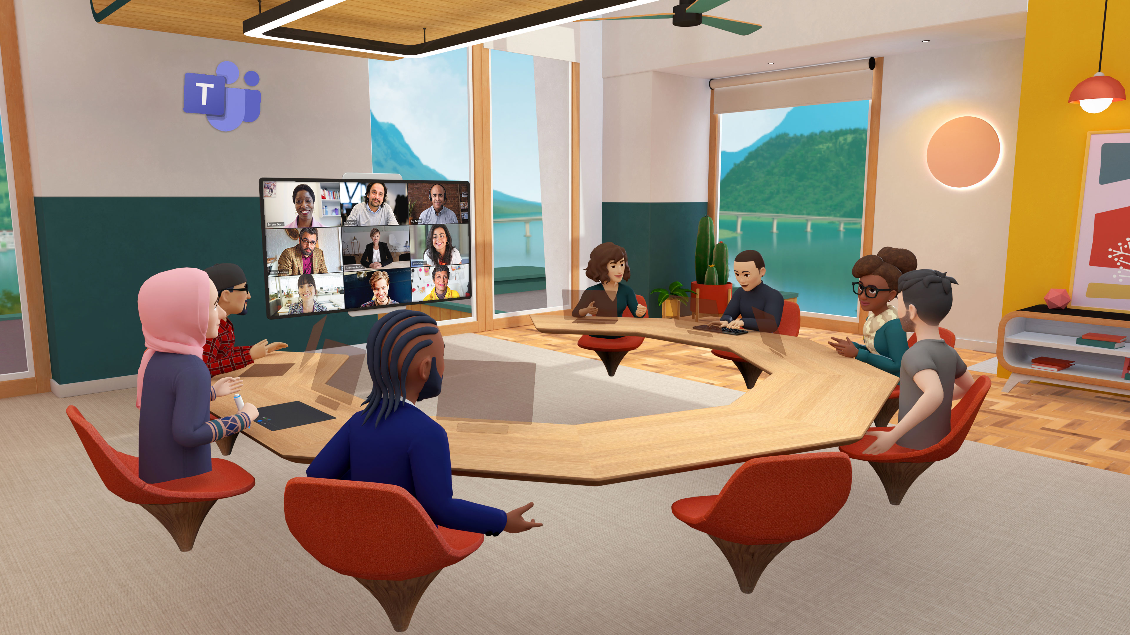
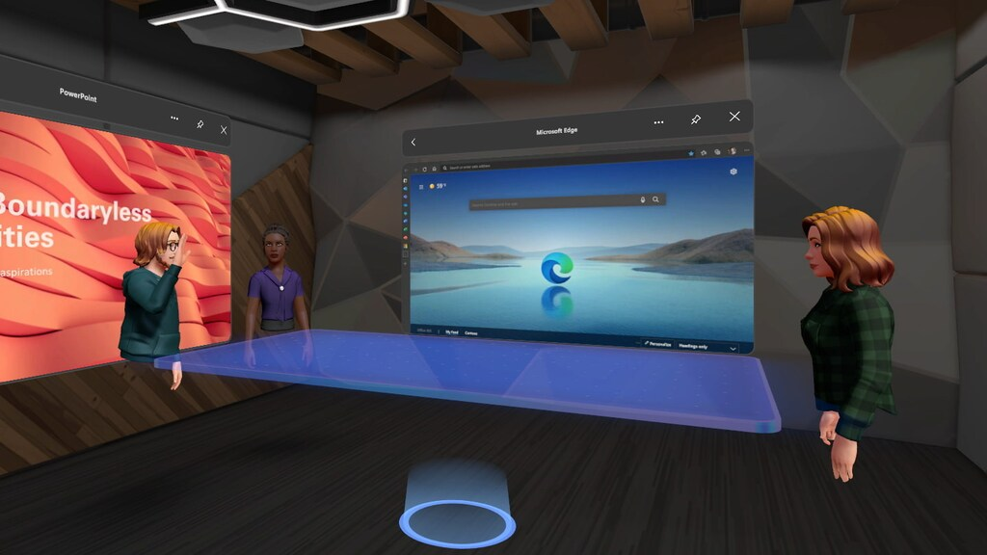
Introduction
AR 101
WebAR Prototype
AR Implementation Framework
Key Takeaways
Augmented Reality (AR) 101: Mixed Reality Spectrum
Source: P. Milgram, H. Takemura, A. Utsumi, and F. Kishino, "Augmented reality: A class of displays on the reality-virtuality continuum," in Telemanipulator and telepresence technologies, 1995, vol. 2351: Spie, pp. 282-292.
Photo credits:
https://gfycat.com/animatedmadbobcat
https://observer.com/2022/10/microsoft-teams-goes-virtual-and-avatars-finally-get-legs-as-mark-zuckerberg-announces-new-metaverse-developments/
https://www.rtlnieuws.nl/tech/artikel/5264551/microsoft-stort-zich-op-metaverse-teams-krijgt-live-3d-avatars

Slide 4
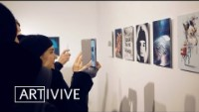
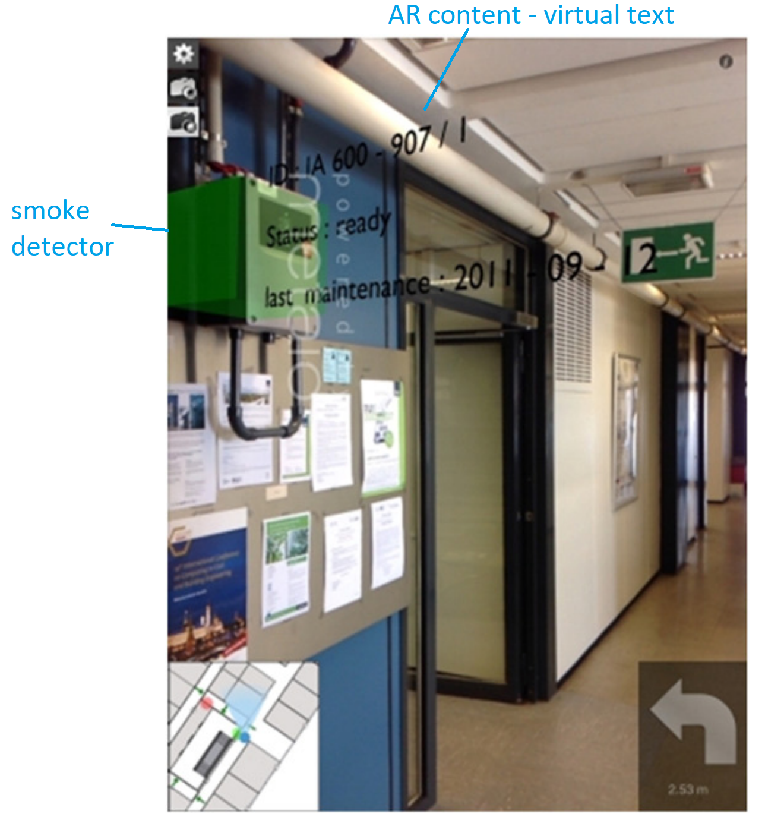
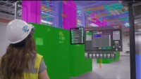

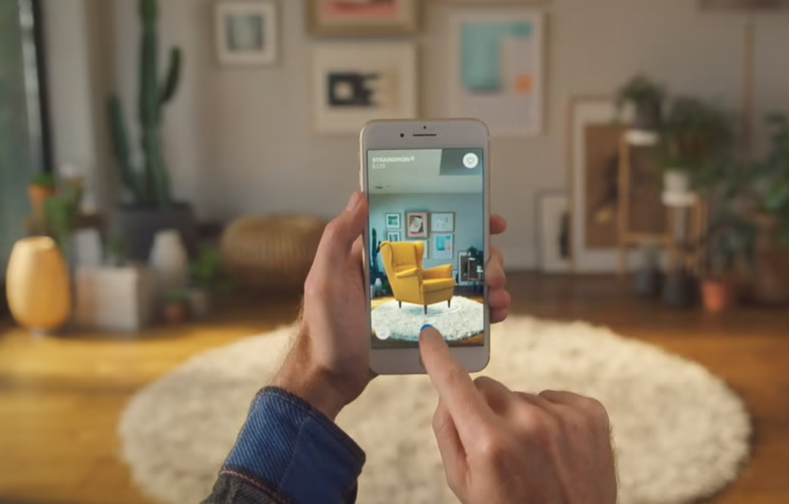
Introduction
AR 101
WebAR Prototype
AR Implementation Framework
Key Takeaways
AR: How Does It Work?
Two technologies underpin AR:
Tracking engine = Tracking the location + orientation of a physical object/ environment from live camera feed.
Rendering engine = Displaying a virtual object as anchored to the physical object/ environment
Common tracking techniques:
1. Fiducial/ image marker: 2D images
1
2
2. Object: 3D objects
3. Face: Snapchat filters
4. Location
5. Surface: planar surface
6. Spatial: 3D mesh of an environment
7. Others: Depth, hand, eye, body, head, controller tracking
4
6
5
https://www.ikea.com/au/en/customer-service/mobile-apps/say-hej-to-ikea-place-pub1f8af050
Notes:
https://www.ultraleap.com/tracking/gemini-hand-tracking-platform/#:~:text=The%20fifth%20generation%20of%20the,different%20platforms%20and%20camera%20hardware.

Slide 5
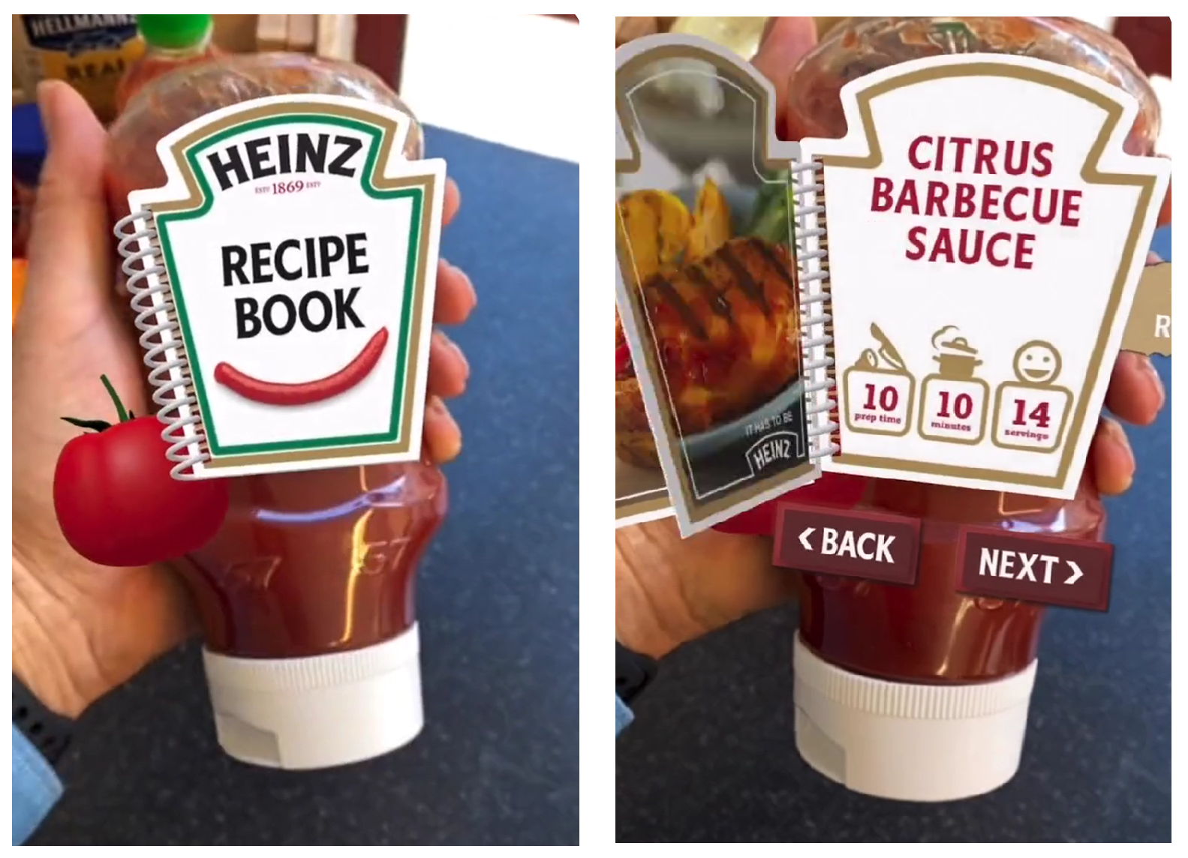
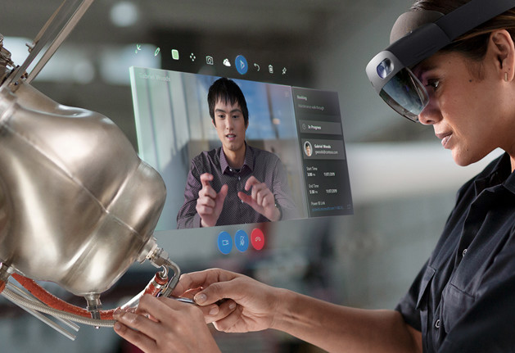
Introduction
AR 101
WebAR Prototype
AR Implementation Framework
Key Takeaways
AR 101: AR Platforms – Native AR v. WebAR v. AR Headset
Each AR platform has its capabilities and limitations.
Native AR + WebAR
AR Headset
> Native AR apps: Downloaded to and installed on user device.
> WebAR apps: Run directly from web browser; Sharable through an URL.
> Requires dedicated hardware: HoloLens, Magic Leap, etc.
> Has built-in tracking capabilities (hand, eye, head, hand-held controller tracking) + can integrate external tracking engine.
A virtual recipe book rendered on the physical label of a Heinz ketchup bottle.
Colleagues collaborate remotely via video call
on a HoloLens headset.
Source: https://www.blippar.com/ar-studio; https://dynamics.microsoft.com/en-gb/mixed-reality/remote-assist/

Slide 6
Introduction
AR 101
WebAR Prototype
AR Implementation Framework
Key Takeaways
AR 101: AR Platforms – Native AR v. WebAR v. AR Headset
Each AR platform has its capabilities and limitations.
Native AR + WebAR
AR Headset
> Native AR apps: Downloaded to and installed on user device.
> WebAR apps: Run directly from web browser; Sharable through an URL.
> Requires dedicated hardware: HoloLens, Magic Leap, etc.
> Has built-in tracking capabilities (hand, eye, head, hand-held controller tracking) + can integrate external tracking engine.
A virtual recipe book rendered on the physical label of a Heinz ketchup bottle.
Colleagues collaborate remotely via video call
on a HoloLens headset.
Source: https://www.blippar.com/ar-studio; https://dynamics.microsoft.com/en-gb/mixed-reality/remote-assist/

Slide 7
Introduction
AR 101
WebAR Prototype
AR Implementation Framework
Key Takeaways
AR 101: AR Platforms – Native AR v. WebAR v. AR Headset
Each AR platform has its capabilities and limitations.
Native AR + WebAR
AR Headset
> Native AR apps: Downloaded to and installed on user device.
> WebAR apps: Run directly from web browser; Sharable through an URL.
> Requires dedicated hardware: HoloLens, Magic Leap, etc.
> Has built-in tracking capabilities (hand, eye, head, hand-held controller tracking) + can integrate external tracking engine.
A virtual recipe book rendered on the physical label of a Heinz ketchup bottle.
Colleagues collaborate remotely via video call
on a HoloLens headset.
Source: https://www.blippar.com/ar-studio; https://dynamics.microsoft.com/en-gb/mixed-reality/remote-assist/

Slide 8
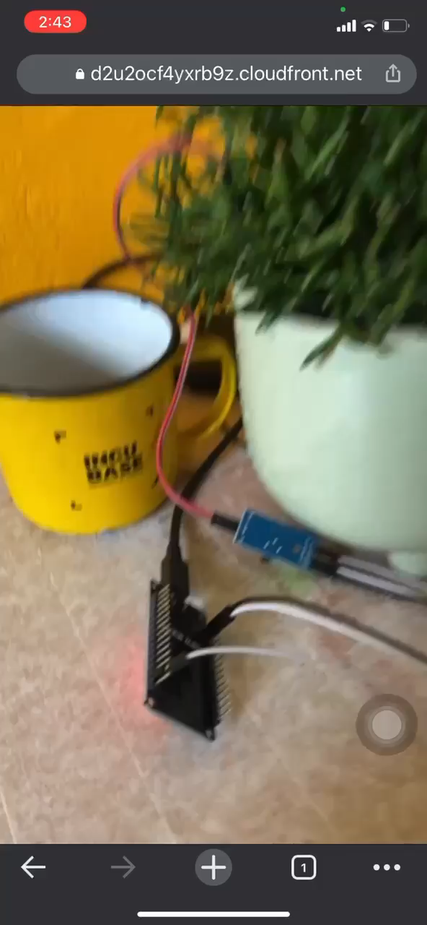
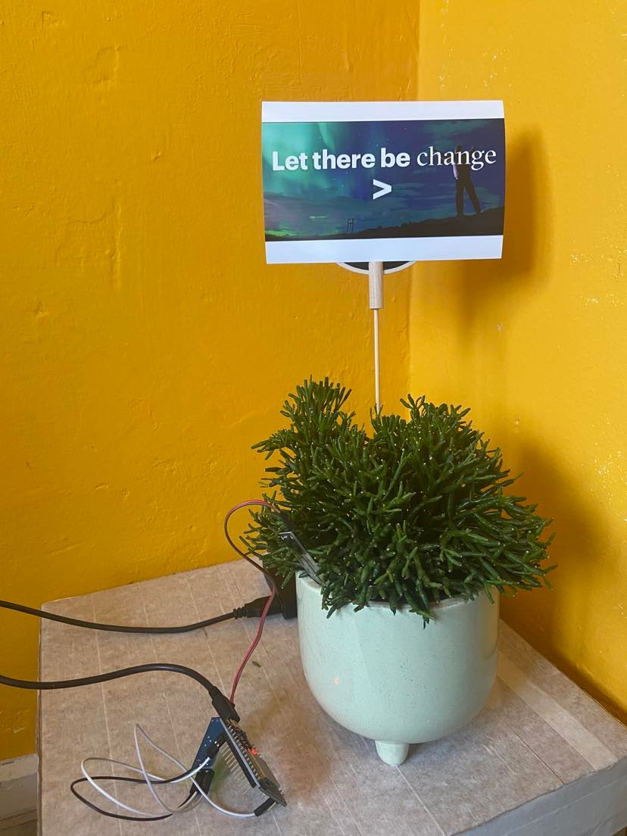
Introduction
AR 101
WebAR Prototype
AR Implementation Framework
Key Takeaways
WebAR Prototype: Show Don’t Tell
Image marker
Soil moisture sensor
Microcontroller connected to sensor
Repo: https://dev.azure.com/liquidstudio-nl/WebAR
Notes:
Desired outcome/ Goal vs. value drivers vs. KPIs:
Desired outcome = operational excellence
Value driver = worker productivity (under “talent”)
KPI = time it takes for workers to complete a task
Desired outcome = help potential investors/ professionals/ future residents explore and invest in NEOM
Value driver = an engaging way to immersively experience what the future of living at The Line is like
---from Accenture 360degree value meter: financial, experience (customer, ee, partner), sustainability, talent, inclusion & diversity, custom (e.g., innovation)
KPI = user feedback on the VR experience; how many investment potentials NEOM’s received.

Slide 9


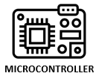









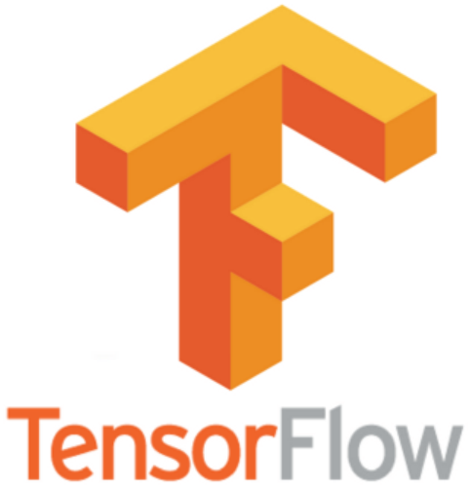





Introduction
AR 101
WebAR Prototype
AR Implementation Framework
Key Takeaways
WebAR Prototype: Serverless Architecture
AWS Virtual Private Cloud (VPC)
Sends sensor readings
Uses sensor’s device certificate to authenticate + publish to AWS IoT’s MQTTS broker
Writes sensor data
Device gateway
Sensor mgmt
& sensor data ingestion
Physical plant
Browser hits CloudFront’s endpoint. CloudFront returns static assets via HTTPS
Queries front-end assets (HTML, CSS, JS, media) and cache them at edge nodes
CDN
Front-end
static asset hosting
Browser invokes AWS Lambda function URL (isolating read/ write traffic)
Reads sensor data
User’s browser
Serverless function
Sensor data
(NoSQL database)
Writes watering record
Developer’s device
CI/ CD
Build artifacts storage
Serverless function
Infra-as-Code (IaC)
Watering history
WebAR dev. tools
Reads watering record
Deploys AWS resources
Serverless function
Notes:
MindAR + three.js + Tensorflow model all run in the browser, on the frontend. No live camera feed stays on user’s device, not transmitted elsewhere.
3 lambdas instead of a nodejs app handling all api calls = isolating read/ write traffic = lambda to scale independently.
MQTTS + ddb configuration = data encrypted in transit + at rest. E.g., ASML don’t want anyone to know the running status of their factory machines.
Time-to-live config: cost optimization in addition to performance + security

Slide 10
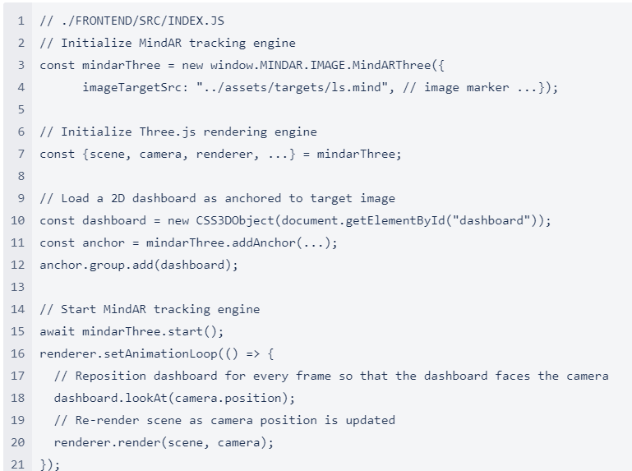
Introduction
AR 101
WebAR Prototype
AR Implementation Framework
Key Takeaways
Frontend Code Deep Dive: Tracking + Rendering + TensorFlow (1/2)
The tracking engine (MindAR), rendering engine (three.js), and TensorFlow pre-trained gesture recognition model (fingerpose) all run in the browser.
Notes:
Desired outcome/ Goal vs. value drivers vs. KPIs:
Desired outcome = operational excellence
Value driver = worker productivity (under “talent”)
KPI = time it takes for workers to complete a task
Desired outcome = help potential investors/ professionals/ future residents explore and invest in NEOM
Value driver = an engaging way to immersively experience what the future of living at The Line is like
---from Accenture 360degree value meter: financial, experience (customer, ee, partner), sustainability, talent, inclusion & diversity, custom (e.g., innovation)
KPI = user feedback on the VR experience; how many investment potentials NEOM’s received.

Slide 11
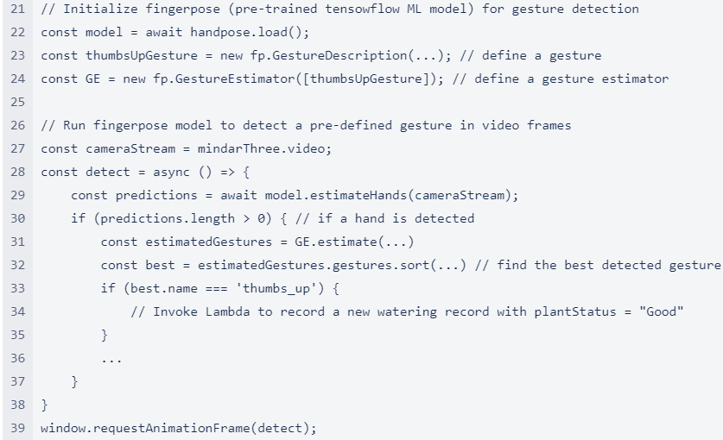
Introduction
AR 101
WebAR Prototype
AR Implementation Framework
Key Takeaways
Frontend Code Deep Dive: Tracking + Rendering + TensorFlow (2/2)
The tracking engine (MindAR), rendering engine (three.js), and TensorFlow pre-trained gesture recognition model (fingerpose) all run in the browser.
Notes:
Desired outcome/ Goal vs. value drivers vs. KPIs:
Desired outcome = operational excellence
Value driver = worker productivity (under “talent”)
KPI = time it takes for workers to complete a task
Desired outcome = help potential investors/ professionals/ future residents explore and invest in NEOM
Value driver = an engaging way to immersively experience what the future of living at The Line is like
---from Accenture 360degree value meter: financial, experience (customer, ee, partner), sustainability, talent, inclusion & diversity, custom (e.g., innovation)
KPI = user feedback on the VR experience; how many investment potentials NEOM’s received.

Slide 12
Introduction
AR 101
WebAR Prototype
AR Implementation Framework
Key Takeaways
AR Implementation Framework: 3 Key Questions to Answer
PROCESS SUITABILITY FOR AR
AR PLATFORM SUITABILITY
AR DEV. TOOL SUITABILITY
Can and should a business process be enhanced with the use of AR?
Which AR platform (WebAR v. native AR v. AR headset) is most suitable for the process?
Which tracking + rendering engines are suitable for the select process and AR platform?
Notes:
Desired outcome/ Goal vs. value drivers vs. KPIs:
Desired outcome = operational excellence
Value driver = worker productivity (under “talent”)
KPI = time it takes for workers to complete a task
Desired outcome = help potential investors/ professionals/ future residents explore and invest in NEOM
Value driver = an engaging way to immersively experience what the future of living at The Line is like
---from Accenture 360degree value meter: financial, experience (customer, ee, partner), sustainability, talent, inclusion & diversity, custom (e.g., innovation)
KPI = user feedback on the VR experience; how many investment potentials NEOM’s received.

Slide 13
Introduction
AR 101
WebAR Prototype
AR Implementation Framework
Key Takeaways
AR Implementation Framework: 3 Key Questions to Answer
PROCESS SUITABILITY FOR AR
AR PLATFORM SUITABILITY
AR DEV. TOOL SUITABILITY
Can and should a business process be enhanced with the use of AR?
Which AR platform (WebAR v. native AR v. AR headset) is most suitable for the process?
Which tracking + rendering engines are suitable for the select process and AR platform?
Notes:
Desired outcome/ Goal vs. value drivers vs. KPIs:
Desired outcome = operational excellence
Value driver = worker productivity (under “talent”)
KPI = time it takes for workers to complete a task
Desired outcome = help potential investors/ professionals/ future residents explore and invest in NEOM
Value driver = an engaging way to immersively experience what the future of living at The Line is like
---from Accenture 360degree value meter: financial, experience (customer, ee, partner), sustainability, talent, inclusion & diversity, custom (e.g., innovation)
KPI = user feedback on the VR experience; how many investment potentials NEOM’s received.

Slide 14
Introduction
AR 101
WebAR Prototype
AR Implementation Framework
Key Takeaways
AR Implementation Framework: 3 Key Questions to Answer
PROCESS SUITABILITY FOR AR
AR PLATFORM SUITABILITY
AR DEV. TOOL SUITABILITY
Can and should a business process be enhanced with the use of AR?
Which AR platform (WebAR v. native AR v. AR headset) is most suitable for the select process?
Which tracking + rendering engines are suitable for the select process and AR platform?
Notes:
Desired outcome/ Goal vs. value drivers vs. KPIs:
Desired outcome = operational excellence
Value driver = worker productivity (under “talent”)
KPI = time it takes for workers to complete a task
Desired outcome = help potential investors/ professionals/ future residents explore and invest in NEOM
Value driver = an engaging way to immersively experience what the future of living at The Line is like
---from Accenture 360degree value meter: financial, experience (customer, ee, partner), sustainability, talent, inclusion & diversity, custom (e.g., innovation)
KPI = user feedback on the VR experience; how many investment potentials NEOM’s received.

Slide 15
Introduction
AR 101
WebAR Prototype
AR Implementation Framework
Key Takeaways
AR Implementation Framework: 3 Key Questions to Answer
PROCESS SUITABILITY FOR AR
AR PLATFORM SUITABILITY
AR DEV. TOOL SUITABILITY
Can and should a business process be enhanced with the use of AR?
Which AR platform (WebAR v. native AR v. AR headset) is most suitable for the process?
Which tracking + rendering engines are suitable for the select process and AR platform?
Notes:
Desired outcome/ Goal vs. value drivers vs. KPIs:
Desired outcome = operational excellence
Value driver = worker productivity (under “talent”)
KPI = time it takes for workers to complete a task
Desired outcome = help potential investors/ professionals/ future residents explore and invest in NEOM
Value driver = an engaging way to immersively experience what the future of living at The Line is like
---from Accenture 360degree value meter: financial, experience (customer, ee, partner), sustainability, talent, inclusion & diversity, custom (e.g., innovation)
KPI = user feedback on the VR experience; how many investment potentials NEOM’s received.

Slide 16
Introduction
AR 101
WebAR Prototype
AR Implementation Framework
Key Takeaways
AR Implementation Framework
AR IMPLEMENTATION FRAMEWORK: GUIDING AR USE CASE ASSESSMENT
ACTIVITY
Assess process suitability
for AR
Assess AR platform suitability**:
WebAR vs. Native AR vs. AR-on-headset
Assess AR dev. tool suitability**:
Tracking + Rendering Engine
Refine process requirements
DISCOVERY*
AGILE*:
DESIGN > DEVELOP > DEPLOY > VALIDATE
Produces ARIF’s inputs:
User personas
User journeys
List of potential AR use cases to be validated using ARIF
Preliminary process requirements (i.e., use case requirements): incl. ergonomics, health and safety standards, privacy and data protection
Risk assessment: (non)-psychological risks
Receives ARIF’s outputs:
Validation if AR is suitable for target use cases
If yes, AR platform selection, AR development tools selection, refined process requirements, and a high-level roadmap of prioritized AR use cases
* Accenture’s existing frameworks
** Supplemented with Definition Tables + Decision Matrices
Photo credit: https://www.youtube.com/watch?v=4Vjajj7ZggA
Notes:
Desired outcome/ Goal vs. value drivers vs. KPIs:
Desired outcome = operational excellence
Value driver = worker productivity (under “talent”)
KPI = time it takes for workers to complete a task
Desired outcome = help potential investors/ professionals/ future residents explore and invest in NEOM
Value driver = an engaging way to immersively experience what the future of living at The Line is like
---from Accenture 360degree value meter: financial, experience (customer, ee, partner), sustainability, talent, inclusion & diversity, custom (e.g., innovation)
KPI = user feedback on the VR experience; how many investment potentials NEOM’s received.

Slide 17
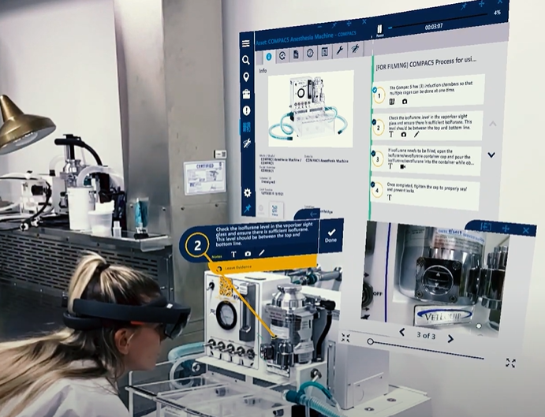
Introduction
AR 101
WebAR Prototype
AR Implementation Framework
Key Takeaways
AR Implementation Framework
AR IMPLEMENTATION FRAMEWORK: GUIDING AR USE CASE ASSESSMENT
ACTIVITY
Assess process suitability
for AR
Assess AR platform suitability**:
WebAR vs. Native AR vs. AR-on-headset
Assess AR dev. tool suitability**:
Tracking + Rendering Engine
Refine process requirements
Characteristics which make a process ideal for AR:
1. Location-based context
E.g., AR dashboard for machine status monitoring, AR-guided work instructions anchored to a machine
2. Hard-to-simulate environment
E.g., 3D mesh of crime scene, 3D patient anatomy for pre-surgical planning, virtual product prototyping
3. Hands-free access to content
E.g., surgeons viewing patient data during surgery, nuclear power plant workers can access contents hands-free while operating a glovebox
4. Remote assist
E.g., Remote workers visually guide and collaborate with local workers without geographical constraints.
5. Navigation
E.g., AR-guided emergency & rescue
DISCOVERY*
AGILE*:
DESIGN > DEVELOP > DEPLOY > VALIDATE
Produces ARIF’s inputs:
User personas
User journeys
List of potential AR use cases to be validated using ARIF
Preliminary process requirements (i.e., use case requirements): incl. ergonomics, health and safety standards, privacy and data protection
Risk assessment: (non)-psychological risks
Receives ARIF’s outputs:
Validation if AR is suitable for target use cases
If yes, AR platform selection, AR development tools selection, refined process requirements, and a high-level roadmap of prioritized AR use cases
ACTIVITY GUIDANCE
* Accenture’s existing frameworks
** Supplemented with Definition Tables + Decision Matrices
Photo credit: https://www.youtube.com/watch?v=4Vjajj7ZggA
Notes:
Desired outcome/ Goal vs. value drivers vs. KPIs:
Desired outcome = operational excellence
Value driver = worker productivity (under “talent”)
KPI = time it takes for workers to complete a task
Desired outcome = help potential investors/ professionals/ future residents explore and invest in NEOM
Value driver = an engaging way to immersively experience what the future of living at The Line is like
---from Accenture 360degree value meter: financial, experience (customer, ee, partner), sustainability, talent, inclusion & diversity, custom (e.g., innovation)
KPI = user feedback on the VR experience; how many investment potentials NEOM’s received.

Slide 18

Introduction
AR 101
WebAR Prototype
AR Implementation Framework
Key Takeaways
AR Implementation Framework
AR IMPLEMENTATION FRAMEWORK: GUIDING AR USE CASE ASSESSMENT
ACTIVITY
Assess process suitability
for AR
Assess AR platform suitability**:
WebAR vs. Native AR vs. AR-on-headset
Assess AR dev. tool suitability**:
Tracking + Rendering Engine
Refine process requirements
Characteristics which make a process ideal for AR:
1. Location-based context
E.g., AR dashboard for machine status monitoring, AR-guided work instructions anchored to a machine
2. Hard-to-simulate environment
E.g., 3D mesh of crime scene, 3D patient anatomy for pre-surgical planning, virtual product prototyping
3. Hands-free access to content
E.g., surgeons viewing patient data during surgery, nuclear power plant workers can access contents hands-free while operating a glovebox
4. Remote assist
E.g., Remote workers visually guide and collaborate with local workers without geographical constraints.
5. Navigation
E.g., AR-guided emergency & rescue
DISCOVERY*
AGILE*:
DESIGN > DEVELOP > DEPLOY > VALIDATE
Produces ARIF’s inputs:
User personas
User journeys
List of potential AR use cases to be validated using ARIF
Preliminary process requirements (i.e., use case requirements): incl. ergonomics, health and safety standards, privacy and data protection
Risk assessment: (non)-psychological risks
Receives ARIF’s outputs:
Validation if AR is suitable for target use cases
If yes, AR platform selection, AR development tools selection, refined process requirements, and a high-level roadmap of prioritized AR use cases
ACTIVITY GUIDANCE
* Accenture’s existing frameworks
** Supplemented with Definition Tables + Decision Matrices
Notes:
Desired outcome/ Goal vs. value drivers vs. KPIs:
Desired outcome = operational excellence
Value driver = worker productivity (under “talent”)
KPI = time it takes for workers to complete a task
Desired outcome = help potential investors/ professionals/ future residents explore and invest in NEOM
Value driver = an engaging way to immersively experience what the future of living at The Line is like
---from Accenture 360degree value meter: financial, experience (customer, ee, partner), sustainability, talent, inclusion & diversity, custom (e.g., innovation)
KPI = user feedback on the VR experience; how many investment potentials NEOM’s received.

Slide 19
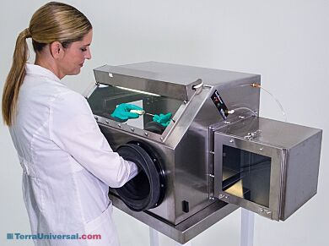
Introduction
AR 101
WebAR Prototype
AR Implementation Framework
Key Takeaways
AR Implementation Framework
AR IMPLEMENTATION FRAMEWORK: GUIDING AR USE CASE ASSESSMENT
ACTIVITY
Assess process suitability
for AR
Assess AR platform suitability**:
WebAR vs. Native AR vs. AR-on-headset
Assess AR dev. tool suitability**:
Tracking + Rendering Engine
Refine process requirements
Characteristics which make a process ideal for AR:
1. Location-based context
E.g., AR dashboard for machine status monitoring, AR-guided work instructions anchored to a machine
2. Hard-to-simulate environment
E.g., 3D mesh of crime scene, 3D patient anatomy for pre-surgical planning, virtual product prototyping
3. Hands-free access to content
E.g., surgeons viewing patient data during surgery, nuclear power plant workers can access contents hands-free while operating a glovebox
4. Remote assist
E.g., Remote workers visually guide and collaborate with local workers without geographical constraints.
5. Navigation
E.g., AR-guided emergency & rescue
DISCOVERY*
AGILE*:
DESIGN > DEVELOP > DEPLOY > VALIDATE
Produces ARIF’s inputs:
User personas
User journeys
List of potential AR use cases to be validated using ARIF
Preliminary process requirements (i.e., use case requirements): incl. ergonomics, health and safety standards, privacy and data protection
Risk assessment: (non)-psychological risks
Receives ARIF’s outputs:
Validation if AR is suitable for target use cases
If yes, AR platform selection, AR development tools selection, refined process requirements, and a high-level roadmap of prioritized AR use cases
ACTIVITY GUIDANCE
* Accenture’s existing frameworks
** Supplemented with Definition Tables + Decision Matrices
Photo credit: https://www.terrauniversal.com/smart-gas-purged-glove-boxes.html
Notes:
Desired outcome/ Goal vs. value drivers vs. KPIs:
Desired outcome = operational excellence
Value driver = worker productivity (under “talent”)
KPI = time it takes for workers to complete a task
Desired outcome = help potential investors/ professionals/ future residents explore and invest in NEOM
Value driver = an engaging way to immersively experience what the future of living at The Line is like
---from Accenture 360degree value meter: financial, experience (customer, ee, partner), sustainability, talent, inclusion & diversity, custom (e.g., innovation)
KPI = user feedback on the VR experience; how many investment potentials NEOM’s received.

Slide 20
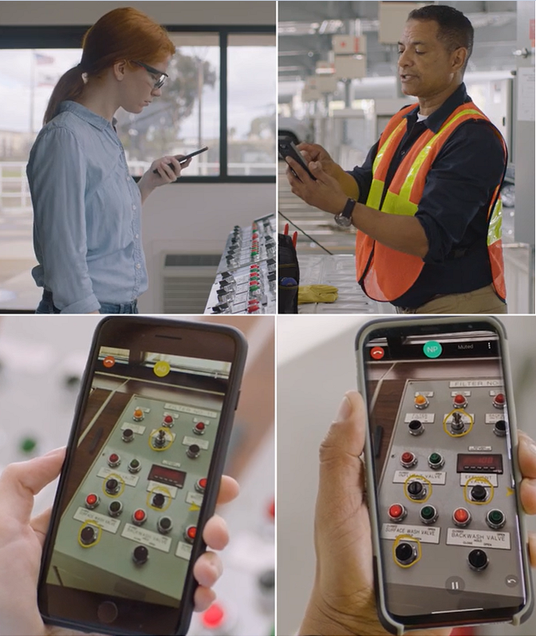
Introduction
AR 101
WebAR Prototype
AR Implementation Framework
Key Takeaways
AR Implementation Framework
AR IMPLEMENTATION FRAMEWORK: GUIDING AR USE CASE ASSESSMENT
ACTIVITY
Assess process suitability
for AR
Assess AR platform suitability**:
WebAR vs. Native AR vs. AR-on-headset
Assess AR dev. tool suitability**:
Tracking + Rendering Engine
Refine process requirements
Characteristics which make a process ideal for AR:
1. Location-based context
E.g., AR dashboard for machine status monitoring, AR-guided work instructions anchored to a machine
2. Hard-to-simulate environment
E.g., 3D mesh of crime scene, 3D patient anatomy for pre-surgical planning, virtual product prototyping
3. Hands-free access to content
E.g., surgeons viewing patient data during surgery, nuclear power plant workers can access contents hands-free while operating a glovebox
4. Remote assist
E.g., Remote workers visually guide and collaborate with local workers without geographical constraints.
5. Navigation
E.g., AR-guided emergency & rescue
DISCOVERY*
AGILE*:
DESIGN > DEVELOP > DEPLOY > VALIDATE
Produces ARIF’s inputs:
User personas
User journeys
List of potential AR use cases to be validated using ARIF
Preliminary process requirements (i.e., use case requirements): incl. ergonomics, health and safety standards, privacy and data protection
Risk assessment: (non)-psychological risks
Receives ARIF’s outputs:
Validation if AR is suitable for target use cases
If yes, AR platform selection, AR development tools selection, refined process requirements, and a high-level roadmap of prioritized AR use cases
ACTIVITY GUIDANCE
* Accenture’s existing frameworks
** Supplemented with Definition Tables + Decision Matrices
Photo credit: https://www.ptc.com/en/products/vuforia/vuforia-chalk
Notes:
Desired outcome/ Goal vs. value drivers vs. KPIs:
Desired outcome = operational excellence
Value driver = worker productivity (under “talent”)
KPI = time it takes for workers to complete a task
Desired outcome = help potential investors/ professionals/ future residents explore and invest in NEOM
Value driver = an engaging way to immersively experience what the future of living at The Line is like
---from Accenture 360degree value meter: financial, experience (customer, ee, partner), sustainability, talent, inclusion & diversity, custom (e.g., innovation)
KPI = user feedback on the VR experience; how many investment potentials NEOM’s received.

Slide 21
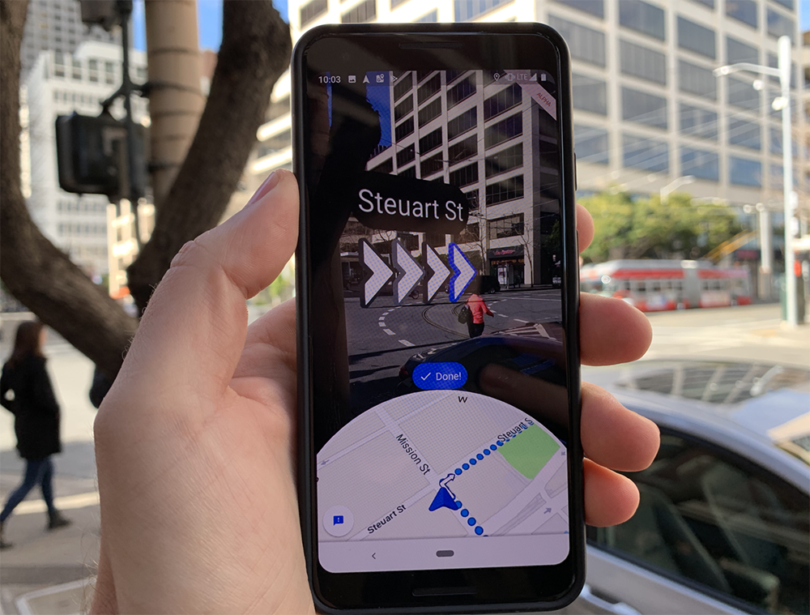
Introduction
AR 101
WebAR Prototype
AR Implementation Framework
Key Takeaways
AR Implementation Framework
AR IMPLEMENTATION FRAMEWORK: GUIDING AR USE CASE ASSESSMENT
ACTIVITY
Assess process suitability
for AR
Assess AR platform suitability**:
WebAR vs. Native AR vs. AR-on-headset
Assess AR dev. tool suitability**:
Tracking + Rendering Engine
Refine process requirements
Characteristics which make a process ideal for AR:
1. Location-based context
E.g., AR dashboard for machine status monitoring, AR-guided work instructions anchored to a machine
2. Hard-to-simulate environment
E.g., 3D mesh of crime scene, 3D patient anatomy for pre-surgical planning, virtual product prototyping
3. Hands-free access to content
E.g., surgeons viewing patient data during surgery, nuclear power plant workers can access contents hands-free while operating a glovebox
4. Remote assist
E.g., Remote workers visually guide and collaborate with local workers without geographical constraints.
5. Navigation
E.g., AR-guided emergency & rescue
DISCOVERY*
AGILE*:
DESIGN > DEVELOP > DEPLOY > VALIDATE
Produces ARIF’s inputs:
User personas
User journeys
List of potential AR use cases to be validated using ARIF
Preliminary process requirements (i.e., use case requirements): incl. ergonomics, health and safety standards, privacy and data protection
Risk assessment: (non)-psychological risks
Receives ARIF’s outputs:
Validation if AR is suitable for target use cases
If yes, AR platform selection, AR development tools selection, refined process requirements, and a high-level roadmap of prioritized AR use cases
ACTIVITY GUIDANCE
* Accenture’s existing frameworks
** Supplemented with Definition Tables + Decision Matrices
Photo credit: https://techcrunch.com/2020/10/01/google-maps-gets-improved-live-view-ar-directions
Notes:
Desired outcome/ Goal vs. value drivers vs. KPIs:
Desired outcome = operational excellence
Value driver = worker productivity (under “talent”)
KPI = time it takes for workers to complete a task
Desired outcome = help potential investors/ professionals/ future residents explore and invest in NEOM
Value driver = an engaging way to immersively experience what the future of living at The Line is like
---from Accenture 360degree value meter: financial, experience (customer, ee, partner), sustainability, talent, inclusion & diversity, custom (e.g., innovation)
KPI = user feedback on the VR experience; how many investment potentials NEOM’s received.

Slide 22
Introduction
AR 101
WebAR Prototype
AR Implementation Framework
Key Takeaways
AR Implementation Framework
AR IMPLEMENTATION FRAMEWORK: GUIDING AR USE CASE ASSESSMENT
ACTIVITY
Assess process suitability
for AR
Assess AR platform suitability**:
WebAR vs. Native AR vs. AR-on-headset
Assess AR dev. tool suitability**:
Tracking + Rendering Engine
Refine process requirements
Characteristics which make a process ideal for AR:
1. Location-based context
E.g., AR dashboard for machine status monitoring, AR-guided work instructions anchored to a machine
2. Hard-to-simulate environment
E.g., 3D mesh of crime scene, 3D patient anatomy for pre-surgical planning, virtual product prototyping
3. Hands-free access to content
E.g., surgeons viewing patient data during surgery, nuclear power plant workers can access contents hands-free while operating a glovebox
4. Remote assist
E.g., Remote workers visually guide and collaborate with local workers without geographical constraints.
5. Navigation
E.g., AR-guided emergency & rescue
Selection criteria:
1. Usage conditions-specific:
1. Lighting conditions
2. Network connectivity: offline mode support yes/ no
3. Noise
4-5. Temperature + humidity
6-7. Drop-safe + water/dust-proof
8. Health/ safety compliance
9. Hand usage
10. User interactions: hand, eye, headset tracking; voice commands
11. Movement restrictions: e.g., tethered AR headsets cause more restrictions than a phone/ tablet/ non-tethered AR headsets
2. Hardware-specific:
1-2. Battery life + device weight
3. Field-of-view
4-5. Camera + display resolution
6. Refresh rate
7-9. Storage + computation + remote rendering
10. Cross-device development
11. App download required
12. Heat distribution
13. Cost: hardware + subscription
DISCOVERY*
AGILE*:
DESIGN > DEVELOP > DEPLOY > VALIDATE
Produces ARIF’s inputs:
User personas
User journeys
List of potential AR use cases to be validated using ARIF
Preliminary process requirements (i.e., use case requirements): incl. ergonomics, health and safety standards, privacy and data protection
Risk assessment: (non)-psychological risks
Receives ARIF’s outputs:
Validation if AR is suitable for target use cases
If yes, AR platform selection, AR development tools selection, refined process requirements, and a high-level roadmap of prioritized AR use cases
ACTIVITY GUIDANCE
* Accenture’s existing frameworks
** Supplemented with Definition Tables + Decision Matrices
Notes:
Desired outcome/ Goal vs. value drivers vs. KPIs:
Desired outcome = operational excellence
Value driver = worker productivity (under “talent”)
KPI = time it takes for workers to complete a task
Desired outcome = help potential investors/ professionals/ future residents explore and invest in NEOM
Value driver = an engaging way to immersively experience what the future of living at The Line is like
---from Accenture 360degree value meter: financial, experience (customer, ee, partner), sustainability, talent, inclusion & diversity, custom (e.g., innovation)
KPI = user feedback on the VR experience; how many investment potentials NEOM’s received.

Slide 23
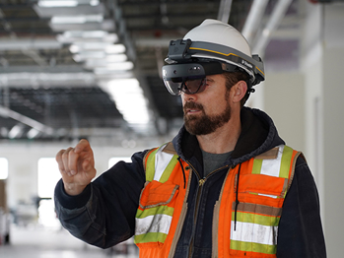
Introduction
AR 101
WebAR Prototype
AR Implementation Framework
Key Takeaways
AR Implementation Framework
AR IMPLEMENTATION FRAMEWORK: GUIDING AR USE CASE ASSESSMENT
ACTIVITY
Assess process suitability
for AR
Assess AR platform suitability**:
WebAR vs. Native AR vs. AR-on-headset
Assess AR dev. tool suitability**:
Tracking + Rendering Engine
Refine process requirements
Characteristics which make a process ideal for AR:
1. Location-based context
E.g., AR dashboard for machine status monitoring, AR-guided work instructions anchored to a machine
2. Hard-to-simulate environment
E.g., 3D mesh of crime scene, 3D patient anatomy for pre-surgical planning, virtual product prototyping
3. Hands-free access to content
E.g., surgeons viewing patient data during surgery, nuclear power plant workers can access contents hands-free while operating a glovebox
4. Remote assist
E.g., Remote workers visually guide and collaborate with local workers without geographical constraints.
5. Navigation
E.g., AR-guided emergency & rescue
Selection criteria:
1. Usage conditions-specific:
1. Lighting conditions
2. Network connectivity: offline mode support yes/ no
3. Noise
4-5. Temperature + humidity
6-7. Drop-safe + water/dust-proof
8. Health/ safety compliance
9. Hand usage
10. User interactions: hand, eye, headset tracking; voice commands
11. Movement restrictions: e.g., tethered AR headsets cause more restrictions than a phone/ tablet/ non-tethered AR headsets
2. Hardware-specific:
1-2. Battery life + device weight
3. Field-of-view
4-5. Camera + display resolution
6. Refresh rate
7-9. Storage + computation + remote rendering
10. Cross-device development
11. App download required
12. Heat distribution
13. Cost: hardware + subscription
DISCOVERY*
AGILE*:
DESIGN > DEVELOP > DEPLOY > VALIDATE
Produces ARIF’s inputs:
User personas
User journeys
List of potential AR use cases to be validated using ARIF
Preliminary process requirements (i.e., use case requirements): incl. ergonomics, health and safety standards, privacy and data protection
Risk assessment: (non)-psychological risks
Receives ARIF’s outputs:
Validation if AR is suitable for target use cases
If yes, AR platform selection, AR development tools selection, refined process requirements, and a high-level roadmap of prioritized AR use cases
ACTIVITY GUIDANCE
* Accenture’s existing frameworks
** Supplemented with Definition Tables + Decision Matrices
Photo credit: https://pchubshop.com/product/microsoft-hololens-2-smart-glass-ar/
Notes:
Desired outcome/ Goal vs. value drivers vs. KPIs:
Desired outcome = operational excellence
Value driver = worker productivity (under “talent”)
KPI = time it takes for workers to complete a task
Desired outcome = help potential investors/ professionals/ future residents explore and invest in NEOM
Value driver = an engaging way to immersively experience what the future of living at The Line is like
---from Accenture 360degree value meter: financial, experience (customer, ee, partner), sustainability, talent, inclusion & diversity, custom (e.g., innovation)
KPI = user feedback on the VR experience; how many investment potentials NEOM’s received.

Slide 24
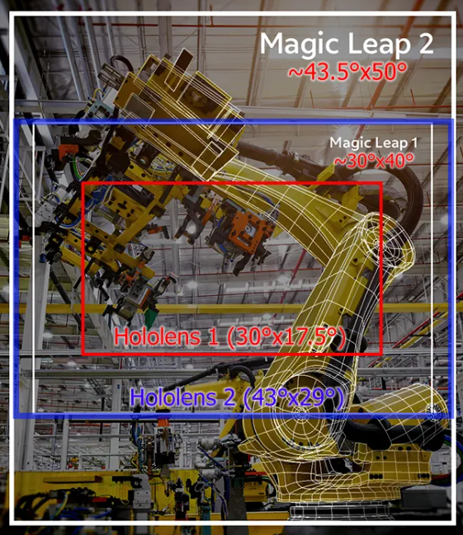
Introduction
AR 101
WebAR Prototype
AR Implementation Framework
Key Takeaways
AR Implementation Framework
AR IMPLEMENTATION FRAMEWORK: GUIDING AR USE CASE ASSESSMENT
ACTIVITY
Assess process suitability
for AR
Assess AR platform suitability**:
WebAR vs. Native AR vs. AR-on-headset
Assess AR dev. tool suitability**:
Tracking + Rendering Engine
Refine process requirements
Characteristics which make a process ideal for AR:
1. Location-based context
E.g., AR dashboard for machine status monitoring, AR-guided work instructions anchored to a machine
2. Hard-to-simulate environment
E.g., 3D mesh of crime scene, 3D patient anatomy for pre-surgical planning, virtual product prototyping
3. Hands-free access to content
E.g., surgeons viewing patient data during surgery, nuclear power plant workers can access contents hands-free while operating a glovebox
4. Remote assist
E.g., Remote workers visually guide and collaborate with local workers without geographical constraints.
5. Navigation
E.g., AR-guided emergency & rescue
Selection criteria:
1. Usage conditions-specific:
1. Lighting conditions
2. Network connectivity: offline mode support yes/ no
3. Noise
4-5. Temperature + humidity
6-7. Drop-safe + water/dust-proof
8. Health/ safety compliance
9. Hand usage
10. User interactions: hand, eye, headset tracking; voice commands
11. Movement restrictions: e.g., tethered AR headsets cause more restrictions than a phone/ tablet/ non-tethered AR headsets
2. Hardware-specific:
1-2. Battery life + device weight
3. Field-of-view
4-5. Camera + display resolution
6. Refresh rate
7-9. Storage + computation + remote rendering
10. Cross-device development
11. App download required
12. Heat distribution
13. Cost: hardware + subscription
DISCOVERY*
AGILE*:
DESIGN > DEVELOP > DEPLOY > VALIDATE
Produces ARIF’s inputs:
User personas
User journeys
List of potential AR use cases to be validated using ARIF
Preliminary process requirements (i.e., use case requirements): incl. ergonomics, health and safety standards, privacy and data protection
Risk assessment: (non)-psychological risks
Receives ARIF’s outputs:
Validation if AR is suitable for target use cases
If yes, AR platform selection, AR development tools selection, refined process requirements, and a high-level roadmap of prioritized AR use cases
ACTIVITY GUIDANCE
* Accenture’s existing frameworks
** Supplemented with Definition Tables + Decision Matrices
Photo credit: https://kguttag.com/2021/10/13/magic-leap-2-for-enterprise-really-plus-another-500m/
Notes:
Desired outcome/ Goal vs. value drivers vs. KPIs:
Desired outcome = operational excellence
Value driver = worker productivity (under “talent”)
KPI = time it takes for workers to complete a task
Desired outcome = help potential investors/ professionals/ future residents explore and invest in NEOM
Value driver = an engaging way to immersively experience what the future of living at The Line is like
---from Accenture 360degree value meter: financial, experience (customer, ee, partner), sustainability, talent, inclusion & diversity, custom (e.g., innovation)
KPI = user feedback on the VR experience; how many investment potentials NEOM’s received.

Slide 25
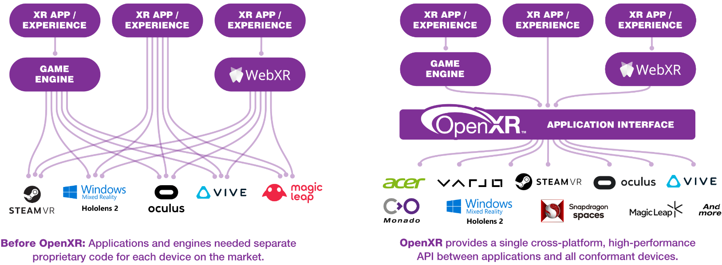
Introduction
AR 101
WebAR Prototype
AR Implementation Framework
Key Takeaways
AR Implementation Framework
AR IMPLEMENTATION FRAMEWORK: GUIDING AR USE CASE ASSESSMENT
ACTIVITY
Assess process suitability
for AR
Assess AR platform suitability**:
WebAR vs. Native AR vs. AR-on-headset
Assess AR dev. tool suitability**:
Tracking + Rendering Engine
Refine process requirements
Characteristics which make a process ideal for AR:
1. Location-based context
E.g., AR dashboard for machine status monitoring, AR-guided work instructions anchored to a machine
2. Hard-to-simulate environment
E.g., 3D mesh of crime scene, 3D patient anatomy for pre-surgical planning, virtual product prototyping
3. Hands-free access to content
E.g., surgeons viewing patient data during surgery, nuclear power plant workers can access contents hands-free while operating a glovebox
4. Remote assist
E.g., Remote workers visually guide and collaborate with local workers without geographical constraints.
5. Navigation
E.g., AR-guided emergency & rescue
Selection criteria:
1. Usage conditions-specific:
1. Lighting conditions
2. Network connectivity: offline mode support yes/ no
3. Noise
4-5. Temperature + humidity
6-7. Drop-safe + water/dust-proof
8. Health/ safety compliance
9. Hand usage
10. User interactions: hand, eye, headset tracking; voice commands
11. Movement restrictions: e.g., tethered AR headsets cause more restrictions than a phone/ tablet/ non-tethered AR headsets
2. Hardware-specific:
1-2. Battery life + device weight
3. Field-of-view
4-5. Camera + display resolution
6. Refresh rate
7-9. Storage + computation + remote rendering
10. Cross-device development
11. App download required
12. Heat distribution
13. Cost: hardware + subscription
DISCOVERY*
AGILE*:
DESIGN > DEVELOP > DEPLOY > VALIDATE
Produces ARIF’s inputs:
User personas
User journeys
List of potential AR use cases to be validated using ARIF
Preliminary process requirements (i.e., use case requirements): incl. ergonomics, health and safety standards, privacy and data protection
Risk assessment: (non)-psychological risks
Receives ARIF’s outputs:
Validation if AR is suitable for target use cases
If yes, AR platform selection, AR development tools selection, refined process requirements, and a high-level roadmap of prioritized AR use cases
ACTIVITY GUIDANCE
* Accenture’s existing frameworks
** Supplemented with Definition Tables + Decision Matrices
Photo credit: https://www.khronos.org/openxr/
Notes:
Desired outcome/ Goal vs. value drivers vs. KPIs:
Desired outcome = operational excellence
Value driver = worker productivity (under “talent”)
KPI = time it takes for workers to complete a task
Desired outcome = help potential investors/ professionals/ future residents explore and invest in NEOM
Value driver = an engaging way to immersively experience what the future of living at The Line is like
---from Accenture 360degree value meter: financial, experience (customer, ee, partner), sustainability, talent, inclusion & diversity, custom (e.g., innovation)
KPI = user feedback on the VR experience; how many investment potentials NEOM’s received.

Slide 26
Introduction
AR 101
WebAR Prototype
AR Implementation Framework
Key Takeaways
AR Implementation Framework
AR IMPLEMENTATION FRAMEWORK: GUIDING AR USE CASE ASSESSMENT
ACTIVITY
Assess process suitability
for AR
Assess AR platform suitability**:
WebAR vs. Native AR vs. AR-on-headset
Assess AR dev. tool suitability**:
Tracking + Rendering Engine
Refine process requirements
Characteristics which make a process ideal for AR:
1. Location-based context
E.g., AR dashboard for machine status monitoring, AR-guided work instructions anchored to a machine
2. Hard-to-simulate environment
E.g., 3D mesh of crime scene, 3D patient anatomy for pre-surgical planning, virtual product prototyping
3. Hands-free access to content
E.g., surgeons viewing patient data during surgery, nuclear power plant workers can access contents hands-free while operating a glovebox
4. Remote assist
E.g., Remote workers visually guide and collaborate with local workers without geographical constraints.
5. Navigation
E.g., AR-guided emergency & rescue
Selection criteria:
1. Usage conditions-specific:
1. Lighting conditions
2. Network connectivity: offline mode support yes/ no
3. Noise
4-5. Temperature + humidity
6-7. Drop-safe + water/dust-proof
8. Health/ safety compliance
9. Hand usage
10. User interactions: hand, eye, headset tracking; voice commands
11. Movement restrictions: e.g., tethered AR headsets cause more restrictions than a phone/ tablet/ non-tethered AR headsets
2. Hardware-specific:
1-2. Battery life + device weight
3. Field-of-view
4-5. Camera + display resolution
6. Refresh rate
7-9. Storage + computation + remote rendering
10. Cross-device development
11. App download required
12. Heat distribution
13. Cost: hardware + subscription
Tracking and rendering engines are benchmarked using the following criteria.
1. Tracking capabilities: Different use cases require different tracking capabilities
1-2. Fiducial + image tracking
3. Object tracking
4. Face tracking
5. Location tracking
6. Surface tracking
7. Spatial tracking
8. Other tracking techniques
9. Multi-marker tracking
10. Multi-user AR session
11. Depth tracking
12. Light effects
2. Rendering capabilities: Rendering speed is affected by network connection + rendering engine’s design + hardware capabilities, and therefore not assessed here.
1. Light estimation: more realistic rendering
2. Occlusion: more realistic rendering
3. Ease of development:
1. Integration with other AR dev. tools: checks which tracking engine integrates with which rendering engine
2. Simulation/ remote testing:
3. No-code/ low-code development
4. Licensing cost
1. Open-source: yes/ no
Activities:
1. Refine process requirements collected from Discovery phase
> Functional requirements are captured as user stories
> Non-functional requirements are used as part of acceptance criteria for relevant user stories
DISCOVERY*
AGILE*:
DESIGN > DEVELOP > DEPLOY > VALIDATE
Produces ARIF’s inputs:
User personas
User journeys
List of potential AR use cases to be validated using ARIF
Preliminary process requirements (i.e., use case requirements): incl. ergonomics, health and safety standards, privacy and data protection
Risk assessment: (non)-psychological risks
Receives ARIF’s outputs:
Validation if AR is suitable for target use cases
If yes, AR platform selection, AR development tools selection, refined process requirements, and a high-level roadmap of prioritized AR use cases
ACTIVITY GUIDANCE
* Accenture’s existing frameworks
** Supplemented with Definition Tables + Decision Matrices
Notes:
Non-functional = ergonomics; can’t wear hololens of 600 grams for 8 hour shift.

Slide 27
Introduction
AR 101
WebAR Prototype
AR Implementation Framework
Key Takeaways
AR Implementation Framework
AR IMPLEMENTATION METHODOLOGY: GUIDING AR USE CASE ASSESSMENT
ACTIVITY
Assess process suitability
for AR
Assess AR platform suitability**:
WebAR vs. Native AR vs. AR-on-headset
Assess AR dev. tool suitability**:
Tracking + Rendering Engine
Refine process requirements
Characteristics which make a process ideal for AR:
1. Location-based context
E.g., AR dashboard for machine status monitoring, AR-guided work instructions anchored to a machine
2. Hard-to-simulate environment
E.g., 3D mesh of crime scene, 3D patient anatomy for pre-surgical planning, virtual product prototyping
3. Hands-free access to content
E.g., surgeons viewing patient data during surgery, nuclear power plant workers can access contents hands-free while operating a glovebox
4. Remote assist
E.g., Remote workers visually guide and collaborate with local workers without geographical constraints.
5. Navigation
E.g., AR-guided emergency & rescue
Selection criteria:
1. Usage conditions-specific:
1. Lighting conditions
2. Network connectivity: offline mode support yes/ no
3. Noise
4-5. Temperature + humidity
6-7. Drop-safe + water/dust-proof
8. Health/ safety compliance
9. Hand usage
10. User interactions: hand, eye, headset tracking; voice commands
11. Movement restrictions: e.g., tethered AR headsets cause more restrictions than a phone/ tablet/ non-tethered AR headsets
2. Hardware-specific:
1-2. Battery life + device weight
3. Field-of-view
4-5. Camera + display resolution
6. Refresh rate
7-9. Storage + computation + remote rendering
10. Cross-device development
11. App download required
12. Heat distribution
13. Cost: hardware + subscription
Tracking and rendering engines are benchmarked using the following criteria.
1. Tracking capabilities: Different use cases require different tracking capabilities
1-2. Fiducial + image tracking
3. Object tracking
4. Face tracking
5. Location tracking
6. Surface tracking
7. Spatial tracking
8. Other tracking techniques
9. Multi-marker tracking
10. Multi-user AR session
11. Depth tracking
12. Light effects
2. Rendering capabilities: Rendering speed is affected by network connection + rendering engine’s design + hardware capabilities, and therefore not assessed here.
1. Light estimation: more realistic rendering
2. Occlusion: more realistic rendering
3. Ease of development:
1. Integration with other AR dev. tools: checks which tracking engine integrates with which rendering engine
2. Simulation/ remote testing:
3. No-code/ low-code development
4. Licensing cost
1. Open-source: yes/ no
Activities:
1. Refine process requirements collected from Discovery phase
> Functional requirements are captured as user stories
> Non-functional requirements are used as part of acceptance criteria for relevant user stories
DISCOVERY*
AGILE*:
DESIGN > DEVELOP > DEPLOY > VALIDATE
Produces ARIF’s inputs:
User personas
User journeys
List of potential AR use cases to be validated using ARIF
Preliminary process requirements (i.e., use case requirements): incl. ergonomics, health and safety standards, privacy and data protection
Risk assessment: (non)-psychological risks
Receives ARIF’s outputs:
Validation if AR is suitable for target use cases
If yes, AR platform selection, AR development tools selection, refined process requirements, and a high-level roadmap of prioritized AR use cases
ACTIVITY GUIDANCE
* Accenture’s existing frameworks
** Supplemented with Definition Tables + Decision Matrices
Notes:
Non-functional = ergonomics; can’t wear hololens of 600 grams for 8 hour shift.

Slide 28

Introduction
AR 101
WebAR Prototype
AR Implementation Framework
Key Takeaways
Key Takeaways
AR by itself = cool…
But AR when combined with the right technologies (IoT, AI, etc.) for the right use cases = superpower.
First times are beautiful. So are second’s and third’s.
AR as uncharted territory.
Transitioning from GCP to AWS.
First time setting up CI/CD + IaC templates.
There are always better ways to do things.
Notes:
Desired outcome/ Goal vs. value drivers vs. KPIs:
Desired outcome = operational excellence
Value driver = worker productivity (under “talent”)
KPI = time it takes for workers to complete a task
Desired outcome = help potential investors/ professionals/ future residents explore and invest in NEOM
Value driver = an engaging way to immersively experience what the future of living at The Line is like
---from Accenture 360degree value meter: financial, experience (customer, ee, partner), sustainability, talent, inclusion & diversity, custom (e.g., innovation)
KPI = user feedback on the VR experience; how many investment potentials NEOM’s received.

Slide 29
Appendix: Definition Table of Characteristics of Ideal Process for AR
# | Process Characteristic | Definition
1 | Location-based context | A process is ideal for AR when worker productivity is improved when provided location-based context i.e., (real-time) information as anchored to a physical object or environment. For example, a shopfloor manager can view an AR dashboard with real-time sensor data as anchored to a physical equipment to quickly inspect the current status of the equipment. Another example is an AR-guided work instructions anchored to a physical machine which allows workers to approach the machine and access the work instructions on demand as the worker carry out a complex task (video).
2 | Hard-to-simulate environment | A process is ideal for AR when worker productivity is improved when allowed to interact with AR contents which are hard to be simulated otherwise in real life. For example, instead of relying on 2D medical scan images, surgeons can view a 3D model of a patient anatomy for pre-surgical planning. In this case, patient anatomy is considered a hard-to-simulate environment. Additional examples are AR-enabled product prototyping (experimenting with different design before actual product fabrication), 3D mesh of a crime scene (video), construction planning (video), layout planning (video), and bridge inspection (video).
3 | Hands-free access to content | A process is ideal for AR when worker productivity is improved when provided access to content without having to use their hands. For example, surgeons can view patient’s medical records during surgeries using voice commands (video).
4 | Remote assist | A process is ideal for AR when worker productivity is improved when remote workers can guide and collaborate without geographical constraints. For example, through live camera streaming, a remote worker can share the same view as the local worker and makes live, virtual annotations on the view to guide the local worker through a task (video).
5 | Navigation | A process is ideal when worker productivity is improved when guided to a target destination by virtual AR contents. For example, a traveler can be guided to their gate at an unfamiliar airport by following virtual arrows for directions (photo).

Slide 30
Appendix: Definition Table of AR Platform Selection Criteria 1/2
# | Category | Selection Criteria | Definition
1 | Usage conditions-specific | Lighting conditions | Harsh lighting conditions (too dim or too bright) will require AR platforms whose tracking engine must be robust enough to process live camera feed of degrading quality and detect a marker.
2 |  | Network connectivity | When deployed in environments without stable internet connection like shopfloors, ideal AR platforms are the ones with offline mode support.
3 |  | Noise | When deployed in loud environments like shopfloors, ideal AR platforms are those with noise-cancelling microphones.
4-7 |  | Temperature + Humidity + Drop-safe + Water/dust-proof | When deployed in rugged conditions, ideal AR platforms are those built for extreme temperature, humidity, drop-safe, waterproof, and dustproof.
8 |  | Health/ safety compliance | Some use cases will require AR platforms to comply with specific health and safety standards e.g., hardhat integration, medical certifications for clean room usage, eye safety.
9 |  | Hand usage | Some tasks require users to use both of their hands e.g., surgeons carrying out a surgery (making AR headsets most ideal) while some tasks occupy only one hand, allowing users to use their other hand to hold a mobile device (making it possible to use webAR or native AR).
10 |  | 10. User interactions | Different AR platforms support different built-in user interactions e.g., voice/ gesture/ gaze controls for an intuitive and enhanced user experience.
11 |  | 11. Movement restrictions | Some tasks require users to have a full range of movement (e.g., shopfloor operators), making non-tethered AR headsets, webAR, and native AR ideal options. Some other tasks require only a limited range of movements, making tethered AR headsets an acceptable option in exchange for better tracking and rendering performance and lower latency since the tethered headset usually is connected to a powerful computer.

Slide 31
Appendix: Definition Table of AR Platform Selection Criteria 2/2
# | Category | Selection Criteria | Definition
1 | Hardware-specific | Battery life | The longer the battery life, the fewer charges are required between usage.
2 |  | Device weight | The heavier the device, the more fatigue it causes, especially head fatigue when using AR headsets.
3 |  | Field-of-view (FoV) | The wider the FoV, the bigger virtual contents users can view and the more immersive the AR experience feels. For virtual product prototyping, a big FOV is preferable while for other use cases such as an AR monitoring dashboard for factory equipment, an average sized FoV might be acceptable.
4 |  | Camera resolution | The higher the camera resolution, the higher quality video the camera can capture. It is valuable, for example, when the live camera is streamed to a remote worker for the use case of AR-guided remote assistance.
5 |  | Display resolution | The higher the display resolution, the higher fidelity the virtual contents are.
6 |  | Refresh rate | The higher refresh rate, the smoother the virtual contents appear.
7-9 |  | Storage + computation + remote rendering | Storage, computation, and remote rendering dictate how much tracking and rendering can be performed locally on the AR device (no latency) or remotely in the cloud (requiring less powerful AR devices but results in higher latency).
10 |  | Cross-device development | Allows developers to develop a WebAR, native AR, and AR-on-headset application once and deploy the application on multiple browsers, Android/ iOS devices, and AR headsets, respectively.
11 |  | App download required | Refers to if a user needs to download and install the AR app to their device. WebAR is the only platform that does not require users to download and install WebAR apps since WebAR runs directly from a browser, giving it an advantage over native AR and AR headsets.
12 |  | Heat distribution | Refers to how much heat an AR device produces while running and how fast the heat can dissipate because of the thermal model of the AR device. This factor is important because heating AR devices, especially AR headsets, can cause skin burns and affect user experience.
13 |  | Cost: hardware + subscription | Refers to the cost of using the AR platforms (hardware cost + subscription cost).

Slide 32
Appendix: Definition Table of AR Dev. Tool Selection Criteria 1/2
# | Category | Selection Criteria | Definition
1-7 | Tracking capabilities | Fiducial tracking; Image tracking; Face tracking; Location tracking; Object tracking; Surface tracking; Spatial tracking | Different use cases require different tracking techniques. In the example of an art book in here, the art book is implemented using an image tracking engine which allows users to scan an image of a sculpture in the artbook and view a 3D model of the sculpture rendered on top of the image. On the other hand, spatial tracking is more appropriate for implementing, say, an AR-guided evacuation route for an underground mine since it would not be feasible to attach image markers to rock faces and make sure the image markers stay put.
8 |  | Depth tracking | Depth tracking is an additional capability of tracking engines to understand the physical environment. With depth knowledge, tracking engines can instruct rendering engines to occlude virtual objects if they are behind physical objects for a more realistic experience.
9 |  | Other tracking | As more computer vision technology evolves, more tracking techniques are being developed. This criterion serves as a catch-all for those techniques.
10 |  | Multi-marker tracking | Refers to a capability of tracking engines to detect and track multiple markers in a single video frame, creating a richer experience (picture).
11 |  | Multi-user tracking | Refers to the ability of tracking engines to synchronize across multiple devices and allow multiple users to join a single AR session. For example, an AR-guided remote assistance solution requires the use of multi-user tracking (video).
12 |  | Lighting effects | Refers to additional capabilities of tracking engines such as light estimate i.e., predicting the lighting conditions of the physical environment (picture).

Slide 33
Appendix: Definition Table of AR Dev. Tool Selection Criteria 2/2
# | Category | Selection Criteria | Definition
1 | Rendering capabilities | Light estimates | Using the light estimate data from tracking engines, rendering engines can shade the virtual contents to match the lighting conditions of the physical environment for more realistic virtual contents (picture).
2 |  | Occlusion | Using the depth data from tracking engines, rendering engines can occlude virtual objects which stand behind physical objects for more realistic virtual contents (picture).
1 | Ease of develop-ment | Integration with other AR development tools | Cross-references which tracking engines integrate with which rendering engines. Refresher: an AR application requires both tracking and rendering engines, and the two engines need to integrate with each other.
2 |  | Simulation/ remote testing | Allows developers to test and debug AR applications more quickly.
3 |  | Low-code/ no-code development | Allows business users with little to no programming knowledge to create new AR experiences e.g., allowing shopfloor operators to create new AR-guided work instructions.
1 | Licensing cost | Open-source | Checks if the tracking/ rendering engines are open-source or not.

Slide 34
Appendix: AR Platform Suitability Decision Matrix 1/4
Selection criteria for AR platforms (web AR vs. native AR vs. AR-on-headset) are categorized by: 1) Usage condition-specific 2) Hardware
 | Selection Criteria | WebAR (web browser) | Native AR (Android, iOS) | Varjo XR-3 (2020) | HoloLens 2 (2019) | Magic Leap 2 (2022) | Meta Quest Pro (2022) | Vuzix Blade 2 (2022) | Vuzix M400 (2020) | Google Glass 2 (2019)
1. Usage conditions-specific selection criteria | 1. Lighting conditions | Irrespective of AR platforms, their tracking engine performs better or worse in different light conditions due to the fluctuating quality of video frames being captured in different light conditions, making it easy or hard for the tracking engine’s computer vision algorithms to detect a marker in those video frames. In order to choose an AR platform that best accommodates the target lighting conditions: Test different candidate AR platforms in different lighting conditions and choose the most performant one Or: customize the tracking engine’s computer vision algorithms Or: customize the camera’s properties to improve the quality of the captured video frames e.g., reduce the camera’s exposure level in an overly bright environment (source)
 | 2. Network connectivity | Offline mode supported when implementing Service Worker | Offline mode supported | Offline mode supported with offline subscription | Work instructions in Dynamics 365 Guides support offline mode with limitations (e.g., no video calls) | No info about offline mode support | No info about offline mode support | Offline mode supported | Offline mode supported | No info about offline mode support
 | 3. Noise | Device-specific | Device-specific | No info | 5 noise cancelling microphones | No info | No info | 2 noise-cancelling microphones | 3 noise-cancelling microphones | 3 noise cancelling microphones
 | 4. Operating temperature | Device-specific | Device-specific | No info | 10°C to 35°C | 10°C to 30°C | No info | 0°C to 35°C | -20°C to 45°C | 0°C to 35°C
 | 5. Operating humidity | Device-specific | Device-specific | No info | No info | No info | No info | 0% to 95% | 0% to 95% | 5% to 95%
 | 6. Drop-safe | Device-specific | Device-specific | No info | No info | No info | No info | No info | MIL-STD-810G certification | No info
 | 7. Water/ Dustproof | Device-specific | Device-specific | No info | IP50 Dust proof | No info | No info | No info | IP67 Dust + water protection certification | IP53 (Resistant to water spray and limited dust ingression)

Slide 35
Appendix: AR Platform Suitability Decision Matrix 2/4
Selection criteria for AR platforms (web AR vs. native AR vs. AR-on-headset) are categorized by: 1) Usage condition-specific 2) Hardware
 | Selection Criteria | WebAR (web browser) | Native AR (Android, iOS) | Varjo XR-3 (2020) | HoloLens 2 (2019) | Magic Leap 2 (2022) | Meta Quest Pro (2022) | Vuzix Blade 2 (2022) | Vuzix M400 (2020) | Google Glass 2 (2019)
1. Usage conditions-specific selection criteria | 8. Compliance with health/ safety standards | Device-specific | Device-specific | No info | ANSI Z87.1, CSA Z94.3 and EN 166 certifications for eye safety. Hardhat-integrated; Compliant with regulated environments e.g., clean rooms; | IEC 60601 certifications for medical use | No info | UV protection lens; ANSI Z87.1 for eye safety.; | IEC 60601 certifications for medical use Comes with hardhat mount; | No info
 | 9. Hand usage | One hand occupied to hold mobile device. | One hand occupied | Hands-free | Hands-free | Hands-free with one hand-held controller | Hands-free with two hand-held controllers | Hands-free | Hands-free | Hands-free
 | 10. User interactions | Hand tracking possible when implementing hand tracking engines like Ultraleap and Handtrack.js; Voice commands are possible using speech recognition APIs like Web Speech API (for web AR) or Cordova Speech Recognition API (native AR Android/ iOS); | Hand tracking possible when implementing hand tracking engines like Ultraleap and Handtrack.js | Eye tracking; Headset and controller tracking; | Voice command; Eye tracking; Headset tracking; Hand tracking; | Eye tracking; Hand tracking; Voice commands; Controller tracking | Eye tracking; Controller tracking; Hand tracking; | Touchpad gestures; Voice control; | Voice control; | Touchpad gestures; voice commands;
 | 11. Movement restrictions | Non-tethered | Non-tethered | Tethered | Non-tethered | Non-tethered but comes with a wired, pocket-size external processor called Compute Pack | Non-tethered | Non-tethered | Non-tethered | Non-tethered
Notes:
https://learn.microsoft.com/en-us/windows/mixed-reality/design/gaze-and-dwell-head
https://learn.microsoft.com/en-us/windows/mixed-reality/design/eye-tracking
Hand tracking = impossible when hands are occupied with tools or parts; HoloLens has some built-in gestures by using a pre-trained ML model. If wanting to use custom hand gestures, need to use an external tracking engine(?) or train your own ML model (https://www.notion.so/Gestures-Hand-Tracking-in-HoloLens-2-b14713225a544affb348c2c3bc3f96af)
Voice commands = impossible in noisy environment;
Headset tracking = can be more fatiguing than eye tracking; to synchronize your movements in the real world with those in the virtual environment (https://varjo.com/use-center/get-started/varjo-headsets/setting-up-tracking/steamvr-tracking/)
Eye tracking = more precise than headset tracking + can be used for biometric authentication + performs actions like page scroll-down

Slide 36
Appendix: AR Platform Suitability Decision Matrix 3/4
Selection criteria for AR platforms (web AR vs. native AR vs. AR-on-headset) are categorized by: 1) Usage condition-specific 2) Hardware
 | Selection Criteria | WebAR (web browser) | Native AR (Android, iOS) | Varjo XR-3 (2020) | HoloLens 2 (2019) | Magic Leap 2 (2022) | Meta Quest Pro (2022) | Vuzix Blade 2 (2022) | Vuzix M400 (2020) | Google Glass 2 (2019)
2. Hardware-specific selection criteria | 1. Battery life | Device-specific | Device-specific | No info | 2-3 hours | 3.5 hours | 1-2 hours | No info | 2 hours with external battery possible | 8 hours
 | 2. Device weight | Device-specific | Device-specific | 594 g + headband 386 g | 566 g | 260 g | 722 g | No info | 182 g | 51 g
 | 3. Field of view (horizontal) | N/A |  | 115° | 43° | 70° | 106° | 20° | 16.8° | 83°
 | 4. Camera resolution | Device-specific | Device-specific | 12 MP | 8 MP | 12.6 MP | No info | 8 MP | 12.8 MP | 8 MP
 | 5. Display resolution (per eye) | Device-specific | Device-specific | Focus area (27° x 27°) at 1920 x 1920 pixel; Peripheral area at 2880 x 2720 pixel; | 1440 x 936 pixel | 1440 x 1760 pixel | 1800 x 1920 pixel | 480 x 480 pixel | 854 x 480 pixel | 640 x 360 pixel
 | 6. Refresh rate | Depending on the tracking and rendering engine |  | 90 Hz | 60 Hz | 120 Hz | 90 Hz | No info | No info | No info
 | 7. Storage capacity | Device-specific | Device-specific | No info | 4GB RAM; 64GB storage; | 16GB RAM; 256GB storage; | 12GB RAM; 256GB storage; | 40GB storage | 6GB RAM; 64GB storage | 3GB RAM; 32GB storage
 | 8. Computation capacity | Device-specific | Device-specific | No info | CPU: Octa-core Kryo 385; GPU: Adreno 630 | CPU: AMD 7nm Quad-core Zen2 X86 core; GPU: AMD GFX10.2 | CPU: Octa-core Kryo 585; GPU: Adreno 650 | CPU: Quad Core ARM | CPU: 8 Core 2.52Ghz Qualcomm XR1 | CPU: Octa-core Kryo; GPU: Adreno 615
 | 9. Remote rendering | No native integration | No native integration | Yes – Varjo Reality Cloud | Yes – Azure Remote rendering | Yes – Integrates with NVIDIA CloudXR | No info | No info | No info | No info
Notes:
https://www.researchgate.net/publication/359838603_Wireless_communication_research_challenges_for_Extended_Reality_XRBasics of XR parameters
Field of view
FoV = the angle of the maximum area that we can observe.
Each human eye can cover nearly 130∘ . With two eyes, we can observe nearly 180∘ .
In VR, a widely used term is 360∘ video which records every direction at the same time
Pixel-per-degree (PPD)
PPD = the number of pixels that are in view for each degree [26].
A large PPD means there are more pixels and the video is sharp and clear, and vice versa.
Resolution
Resolution = measurement of a video frame’s width and height in pixels
Note that, resolution, FoV, and PPD are related,
resolution = horizontal FoV × PPD × vertical FoV × PPD
Thus, for a given resolution, a large FoV results in a small PPD.
Exist‑ ing AR and MR glasses have a small FoV, i.e., 20∘ to 50∘ , but their PPD is high - above 30. This provides the user with clear virtual content in the presence of real environments.
On the contrary, VR displays have a large FoV, i.e., 100∘ ‑ 150∘ , to provide users with immersive experiences. As a result, given the similar resolution as AR and MR, the PPD of existing VR displays is relatively small which is around 10 to 15.
Refresh rate
Refresh rate = the number of video frames that can be displayed in one second.
A low refresh rate for XR may result in headaches or nausea. Usually, a 90 Hz or higher refresh rate is suggested for XR devices
Data rate
Data rate can be obtained based on the KPIs of XR videos:
Refresh rate
Resolution = horizontal FoV x PPD x vertical FoV x PPD
Bit depth aka. Color depth aka. Bits per color = # of bits to represent the color of a pixel
Date rates = refresh rate × resolution × bits of color × 3 × 2.
Example:
Resolution = 1440 × 1700 pixel (per eye)
Refresh rate = 90 Hz
Bits of color = 8 bits
The required data rate without compression = 10.6 Gbps = 90 (refresh rate) x 1440 × 1700 (resolution) x 8 (bits of color per pixel) × 2 (2 eyes) × 3 (why 3?) = 10.575.360.000 bit per sec
Using standard video lossy com‑ pression techniques with a 300:1 rate, the required data rate can be reduced from 10.6 Gbps to 35.3 Mbps.
Intel WiGig wireless adapter can support 8 Gbps data rates which are sufϐicient to provide reliable wireless connections. However, this is only an entry‑level VR that has relatively low PPD, refresh rate, and bit of color
Latency
The Latency is the response time of XR devices when there is a change caused by the real environment or user.
The latency that can be tolerated is the time from displaying frame A to displaying rendered frame B. De‑ pending on the refresh rate, the latency tolerance can be as low as several milliseconds.
Currently, a 90 Hz refresh rate is widely used, which requires a latency smaller than 11 ms. As shown in Table 2, some low‑interactive VR can toler‑ ate around 1000 ms latency. This is because the HMD can use a buffer to save multiple frames and play them with a certain delay
Based on the refresh rate of ultimate XR, the latency should be smaller than 8.3 ms. Note that, the la‑ tency consists of wireless communication, sensing data fusion, computing, access to edge or cloud servers, and display response time. Since the latency caused by each party is highly stochastic, the communication and net‑ working latency should be much smaller than 8.3 ms to provide a high QoE.

Slide 37
Appendix: AR Platform Suitability Decision Matrix 4/4
Selection criteria for AR platforms (web AR vs. native AR vs. AR-on-headset) are categorized by: 1) Usage condition-specific 2) Hardware
 | Selection Criteria | Selection criteria description | WebAR (web browser) | Native AR (Android, iOS) | Varjo XR-3 (2020) | HoloLens 2 (2019) | Magic Leap 2 (2022) | Meta Quest Pro (2022) | Vuzix Blade 2 (2022) | Vuzix M400 (2020) | Google Glass 2 (2019)
2. Hardware-specific selection criteria | 10. Cross-device develop-ment | Allows developers to develop a webAR, native AR, and AR-on-headset application once and deploy the application on multiple browsers, Android/ iOS devices, and AR headsets, respectively. | Likely – Most webAR tracking and rendering engines are built upon browser’s natively supported features such as WebGL – see example of browser requirements for 8th Wall tracking engine | Likely – Some tracking engines like Vuforia support build for both Android and iOS. ARCore only supports Android. ARKit only supports iOS – see AR Development Tool Decision Matrix for details | Yes – integrates with OpenXR*; | Yes – integrates with OpenXR; | Yes – integrates with OpenXR; | No info | No integration with OpenXR (yet) | No integration with OpenXR (yet) | No integration with OpenXR (yet)
 | 11. App download required | Refers to if a user needs to download and install the AR app to their device. | No | Yes | Yes | Yes | Yes | Yes | Yes | Yes | Yes
 | 12. Heat distribution | Refers to how much heat an AR device produces while running and how fast the heat dissipates according to the thermal design of the AR device. Note heating AR devices, especially AR headsets, can cause skin burns and affect user experience. | It appears that there is no standard measure for benchmarking the thermal model of different AR devices. Heat distribution is primarily a hardware problem with the chips being one of the main heat-generating components (source). Therefore, it is recommended to experiment with different AR devices for the target usage conditions and select the most comfortable headset.
 | 13. Cost | Refers to the cost of using the AR platforms. | Device-specific | Device-specific | €6.495 + mandatory XR Subscription | € 3.849,00+ + optional HoloLens subscription | ~€3,167+ ($3.299+) | €1.799,99 | €1,669.80 | €2.311,10 | ~€1,090 ($1,144)
Notes:
About OpenXR for AR headsets: https://www.khronos.org/api/index_2017/openxr

Slide 38
Appendix: AR Dev. Tool Suitability Decision Matrix 1/3
Selection criteria for AR platforms (web AR vs. native AR vs. AR-on-headset) are categorized by:
1) Tracking capabilities 2) Rendering capabilities 3) Ease of development 4) Licensing cost
Tracking engine
Rendering engine
Tracking + Rendering
 | Selection Criteria (SC) | MindAR | AR.js | WebXR | 8th Wall | Lightship ARDK (2021) | Vuforia (2011) | Azure Spatial Anchors | ARCore (2018) | ARKit (2017) | Manifest (2017) | Three.js | A-frame | Unity | Unreal | RealityKit | Adobe Aero (2019) | Meta Spark Studio (2017)
 | AR platforms supported | WebAR | WebAR | WebAR | WebAR | Native AR (Android, iOS) | Native AR, AR headset (HoloLens 2, Magic Leap 2, Vuzix, RealWear) | Native AR (Android, iOS), AR headset (HoloLens) | Native AR (Android) | Native AR (iOS) | Native AR, AR headset (HoloLens, Magic Leap, Realwear) | WebAR | WebAR | Native AR, AR headset | Native AR, AR headset | Native AR (iOS) | WebAR (Aero URL); Native AR (Android, iOS) | Native AR ( Android, iOS), AR headset (Meta Quest Pro)
1. Tracking capabilities | 1. Fiducial tracking |  | X |  |  |  | X (VuMark) |  |  |  | No info | N/A | N/A | N/A | N/A | N/A
 | 2. Image tracking | X | X | X | X | X | X (Image, cylinder, multi targets) |  | X | X | No info | N/A | N/A | N/A | N/A | N/A | X (Image anchor) | X (target tracking)
 | 3. Face tracking | X |  |  | X |  |  |  | X | X | No info | N/A | N/A | N/A | N/A | N/A |  | X
 | 4. Location tracking |  | X |  | X | X |  |  | X | X | No info | N/A | N/A | N/A | N/A | N/A
 | 5. Object tracking |  |  |  |  |  | X (Model targets) |  |  | X (Physical objects) | No info | N/A | N/A | N/A | N/A | N/A
 | 6. Surface tracking |  |  | X (Hit test) | X | X | X (Ground plane) |  | X (Hit test) | X (Surface detection) | No info | N/A | N/A | N/A | N/A | N/A | X (Surface anchor) | X (plane tracking)

Slide 39
Appendix: AR Dev. Tool Suitability Decision Matrix 2/3
Selection criteria for AR platforms (web AR vs. native AR vs. AR-on-headset) are categorized by:
1) Tracking capabilities 2) Rendering capabilities 3) Ease of development 4) Licensing cost
Tracking engine
Rendering engine
Tracking + Rendering
 | Selection Criteria (SC) | MindAR | AR.js | WebXR | 8th Wall | Lightship ARDK (2021) | Vuforia (2011) | Azure Spatial Anchors | ARCore (2018) | ARKit (2017) | Manifest (2017) | Three.js | A-frame | Unity | Unreal | RealityKit | Adobe Aero (2019) | Meta Spark Studio (2017)
1. Tracking capabilities | 7. Spatial tracking |  |  |  |  | X | X (Area targets) | X (Spatial anchors) |  |  | No info | N/A | N/A | N/A | N/A | N/A
 | 8. Other tracking |  |  |  |  |  |  |  |  | Body tracking; | No info | N/A | N/A | N/A | N/A | N/A |  | Iris tracking; body tracking; Hand tracking;
 | 9. Multi-marker tracking | X | X |  | X (image tracking) |  | X |  | X (image tracking) | X (image tracking) | No info | N/A | N/A | N/A | N/A | N/A |  | X (image tracking; plane tracking)
 | 10. Multi-user AR session |  |  | Possible with tools like Wrapper.js |  | X | X (Vuforia Chalk remote assist) | X | X (Cloud anchors) | X | No info | N/A | N/A | N/A | N/A | N/A
 | 11. Depth tracking |  |  | X |  | X |  |  | X | X | No info | N/A | N/A | N/A | N/A | N/A
 | 12. Lighting effects |  |  | Light estimate; | Light estimate; | Light estimate; |  |  |  | Light estimate; realistic reflection; | No info | N/A | N/A | N/A | N/A | N/A
Notes:
Multi player stellarx: https://www.stellarx.ai/faq

Slide 40
Appendix: AR Dev. Tool Suitability Decision Matrix 3/3
Selection criteria for AR platforms (web AR vs. native AR vs. AR-on-headset) are categorized by:
1) Tracking capabilities 2) Rendering capabilities 3) Ease of development 4) Licensing cost
Tracking engine
Rendering engine
Tracking + Rendering
 | Selection Criteria (SC) | MindAR | AR.js | WebXR | 8th Wall | Lightship ARDK (2021) | Vuforia (2011) | Azure Spatial Anchors | ARCore (2018) | ARKit (2017) | Manifest (2017) | Three.js | A-frame | Unity | Unreal | RealityKit | Adobe Aero (2019) | Meta Spark Studio (2017)
2. Rendering engine | 1. Light estimation | N/A | N/A | N/A | N/A | N/A | N/A | N/A | N/A | N/A | N/A | X (WebXR) | X (WebXR) | X (ARCore, ARKit) | X (ARCore; ARKit) | X (ARKit)
 | 2. Occlusion | N/A | N/A | N/A | N/A | N/A | N/A | N/A | N/A | N/A | N/A |  |  | X (ARCore, ARKit) | X (ARCore;ARKit) | X (ARKit)
3. Ease of develop-ment | 1. Integration with other AR dev. tools | Three.js; A-frame; | Three.js; A-frame; | Three.js; A-frame; | Three.js; A-frame; | Unity; | MRTK; Magic Leap OS; ARCore/ARKit; | Unity; ARCore; | Vuforia; Unity; Unreal; WebXR; | Vuforia; Unity; Unreal; | Unity; | WebXR; | WebXR; | OpenXR; MRTK; ARCore; ARKit; | OpenXR; MRTK; ARCore; ARKit; | ARKit
 | 2. Simulation/ remote testing |  |  | X (WebXR API Emulator) |  | X (Mock mode) | X (Play mode) |  | X (Android emulator) |  | No info |  |  | X (AR Foundation Remote for ARCore+ARKit) | X (In-editor testing) |  |  | X (simulator)
 | 3. Low-code/ no-code development |  |  |  |  |  | X (Vuforia Chalk, Expert Capture, Instruct, Studio) |  |  |  | X (Manifest Maker) |  |  |  |  |  | X | X
4. Licensing cost | 1. Open-source | X | X | X |  |  |  |  |  |  |  | X | X
Notes:
Multi player stellarx: https://www.stellarx.ai/faq

Slide 41
Augmented Reality Implementation Methodology
Example Pack
May 2022
Kristen Phan
MSc Business Information Technology
Supervisors:
UT: Prof. Dr. Maria E. Iacob, Dr-Ing. Florian W. Hahn
Accenture: Ilia Shakitko

Slide 42
Agenda
Augmented Reality (AR) 101
Literature Review: Research Gaps + Research Questions
Artifact Design: ARIM
Artifact Demonstration: WebAR Prototype
Artifact Evaluation: Expert Interviews
Artifact Revision: Revised ARIM
Conclusion

Slide 43
AR 101
Literature Review
Artifact Design
Artifact Demonstration
Artifact Evaluation
Artifact Revision
Conclusion
Mixed Reality Spectrum
Source: P. Milgram, H. Takemura, A. Utsumi, and F. Kishino, "Augmented reality: A class of displays on the reality-virtuality continuum," in Telemanipulator and telepresence technologies, 1995, vol. 2351: Spie, pp. 282-292.
Photo credits:
https://gfycat.com/animatedmadbobcat
https://observer.com/2022/10/microsoft-teams-goes-virtual-and-avatars-finally-get-legs-as-mark-zuckerberg-announces-new-metaverse-developments/
https://www.rtlnieuws.nl/tech/artikel/5264551/microsoft-stort-zich-op-metaverse-teams-krijgt-live-3d-avatars

Slide 44
AR 101
Literature Review
Artifact Design
Artifact Demonstration
Artifact Evaluation
Artifact Revision
Conclusion
How Does AR Work?
Two technologies underpin AR:
Tracking engine = Tracking the location + orientation of a physical object/ environment from live camera feed.
Rendering engine = Displaying a virtual object as anchored to the physical object/ environment
Common tracking techniques:
1. Fiducial/ image marker: 2D images
1
2
2. Object: 3D objects
3. Face: Snapchat filters
4. Location
5. Surface: planar surface
6. Spatial: 3D mesh of an environment
7. Others: Depth, hand, eye, body, head, controller tracking
4
6
5
https://www.ikea.com/au/en/customer-service/mobile-apps/say-hej-to-ikea-place-pub1f8af050
Notes:
https://www.ultraleap.com/tracking/gemini-hand-tracking-platform/#:~:text=The%20fifth%20generation%20of%20the,different%20platforms%20and%20camera%20hardware.

Slide 45
AR 101
Literature Review
Artifact Design
Artifact Demonstration
Artifact Evaluation
Artifact Revision
Conclusion
AR Platforms: Native AR v. WebAR v. AR Headset
Each platform has its own capabilities and limitations.
Native AR + WebAR
AR Headset
> Native AR apps: Downloaded to and installed on user device.
> WebAR apps: Run directly from web browser; Sharable through an URL.
> Requires dedicated hardware: HoloLens, Magic Leap, etc.
> Has built-in tracking capabilities (hand, eye, head, hand-held controller tracking) + can integrate external tracking engine.
A virtual recipe book rendered on the physical label of a Heinz ketchup bottle.
Colleagues collaborate remotely via video call
on a HoloLens headset.
Source: https://www.blippar.com/ar-studio; https://dynamics.microsoft.com/en-gb/mixed-reality/remote-assist/

Slide 46
AR 101
Literature Review
Artifact Design
Artifact Demonstration
Artifact Evaluation
Artifact Revision
Conclusion
AR Platforms: Native AR v. WebAR v. AR Headset
Each platform has its own capabilities and limitations.
Native AR + WebAR
AR Headset
> Native AR apps: Downloaded to and installed on user device.
> WebAR apps: Run directly from web browser; Sharable through an URL.
> Requires dedicated hardware: HoloLens, Magic Leap, etc.
> Has built-in tracking capabilities (hand, eye, head, hand-held controller tracking) + can integrate external tracking engine.
A virtual recipe book rendered on the physical label of a Heinz ketchup bottle.
Colleagues collaborate remotely via video call
on a HoloLens headset.
Source: https://www.blippar.com/ar-studio; https://dynamics.microsoft.com/en-gb/mixed-reality/remote-assist/

Slide 47
AR 101
Literature Review
Artifact Design
Artifact Demonstration
Artifact Evaluation
Artifact Revision
Conclusion
AR Platforms: Native AR v. WebAR v. AR Headset
Each platform has its own capabilities and limitations.
Native AR + WebAR
AR Headset
> Native AR apps: Downloaded to and installed on user device.
> WebAR apps: Run directly from web browser; Sharable through an URL.
> Requires dedicated hardware: HoloLens, Magic Leap, etc.
> Has built-in tracking capabilities (hand, eye, head, hand-held controller tracking) + can integrate external tracking engine.
A virtual recipe book rendered on the physical label of a Heinz ketchup bottle.
Colleagues collaborate remotely via video call
on a HoloLens headset.
Source: https://www.blippar.com/ar-studio; https://dynamics.microsoft.com/en-gb/mixed-reality/remote-assist/

Slide 48
AR 101
Literature Review
Artifact Design
Artifact Demonstration
Artifact Evaluation
Artifact Revision
Conclusion
Existing Literature on AR Implementation Methodology
Three papers were selected.
Paper: Strategies for the successful implementation of augmented reality (Berman et al.)
Paper: Evaluating human factors in augmented reality systems (Livingston.)
Paper: A Review and Implementation Framework of Industrial Augmented Reality (Mühlan et al.)

Slide 49
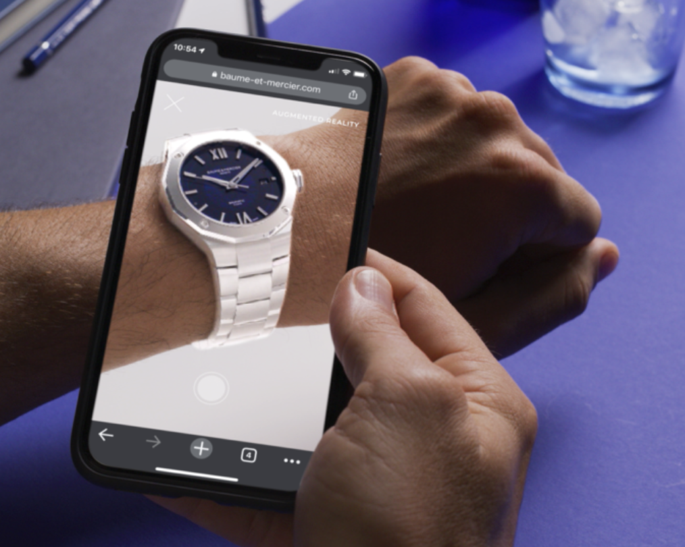
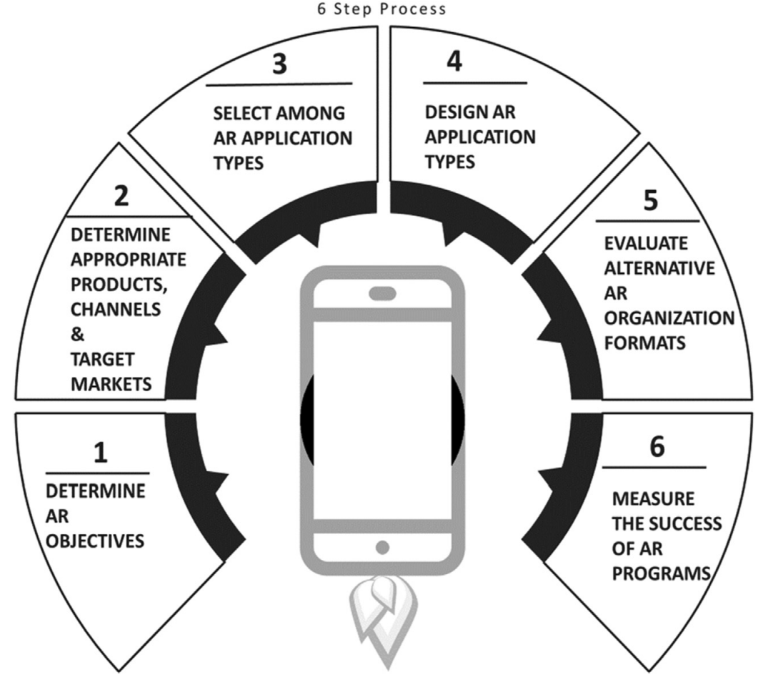
AR 101
Literature Review
Artifact Design
Artifact Demonstration
Artifact Evaluation
Artifact Revision
Conclusion
Existing Literature on AR Implementation Methodology
Three papers were selected.
Paper: Strategies for the successful implementation of augmented reality (Berman et al.)
Paper: Evaluating human factors in augmented reality systems (Livingston.)
Paper: A Review and Implementation Framework of Industrial Augmented Reality (Mühlan et al.)
Photo credit: https://www.drip.com/blog/virtual-try-on-examples

Slide 50
AR 101
Literature Review
Artifact Design
Artifact Demonstration
Artifact Evaluation
Artifact Revision
Conclusion
Existing Literature on AR Implementation Methodology
Three papers were selected.
Task
E.g., stranded militant to reunite with their troop
Paper: Strategies for the successful implementation of augmented reality (Berman et al.)
decomposed into
Perceptual task 1
Perceptual task N
Paper: Evaluating human factors in augmented reality systems (Livingston.)
E.g., Able to visually locate themselves
enhanced with
Paper: A Review and Implementation Framework of Industrial Augmented Reality (Mühlan et al.)
AR solution
E.g., “X-Ray” vision goggles

Slide 51
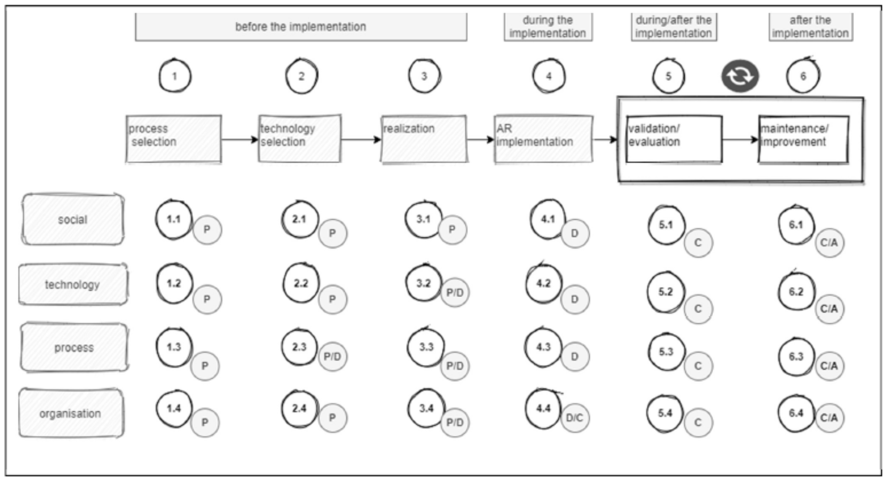
AR 101
Literature Review
Artifact Design
Artifact Demonstration
Artifact Evaluation
Artifact Revision
Conclusion
Existing Literature on AR Implementation Methodology
Three papers were selected.
Paper: Strategies for the successful implementation of augmented reality (Berman et al.)
Paper: Evaluating human factors in augmented reality systems (Livingston.)
Paper: A Review and Implementation Framework of Industrial Augmented Reality (Mühlan et al.)

Slide 52
AR 101
Literature Review
Artifact Design
Artifact Demonstration
Artifact Evaluation
Artifact Revision
Conclusion
Key Research Gaps from Existing Literature
Translated to Research Questions.
PROCESS SUITABILITY FOR AR
AR PLATFORM SUITABILITY
AR DEV. TOOL SUITABILITY
Can a business process be enhanced with the use of AR?
Which AR platform (WebAR v. native AR v. AR headset) is most suitable for the process?
Which tracking + rendering engines are suitable for the select process and AR platform?
Notes:
Desired outcome/ Goal vs. value drivers vs. KPIs:
Desired outcome = operational excellence
Value driver = worker productivity (under “talent”)
KPI = time it takes for workers to complete a task
Desired outcome = help potential investors/ professionals/ future residents explore and invest in NEOM
Value driver = an engaging way to immersively experience what the future of living at The Line is like
---from Accenture 360degree value meter: financial, experience (customer, ee, partner), sustainability, talent, inclusion & diversity, custom (e.g., innovation)
KPI = user feedback on the VR experience; how many investment potentials NEOM’s received.

Slide 53
AR 101
Literature Review
Artifact Design
Artifact Demonstration
Artifact Evaluation
Artifact Revision
Conclusion
Key Research Gaps from Existing Literature
Translated to Research Questions.
PROCESS SUITABILITY FOR AR
AR PLATFORM SUITABILITY
AR DEV. TOOL SUITABILITY
Can a business process be enhanced with the use of AR?
Which AR platform (WebAR v. native AR v. AR headset) is most suitable for the process?
Which tracking + rendering engines are suitable for the select process and AR platform?
Notes:
Desired outcome/ Goal vs. value drivers vs. KPIs:
Desired outcome = operational excellence
Value driver = worker productivity (under “talent”)
KPI = time it takes for workers to complete a task
Desired outcome = help potential investors/ professionals/ future residents explore and invest in NEOM
Value driver = an engaging way to immersively experience what the future of living at The Line is like
---from Accenture 360degree value meter: financial, experience (customer, ee, partner), sustainability, talent, inclusion & diversity, custom (e.g., innovation)
KPI = user feedback on the VR experience; how many investment potentials NEOM’s received.

Slide 54
AR 101
Literature Review
Artifact Design
Artifact Demonstration
Artifact Evaluation
Artifact Revision
Conclusion
Key Research Gaps from Existing Literature
Translated to Research Questions.
PROCESS SUITABILITY FOR AR
AR PLATFORM SUITABILITY
AR DEV. TOOL SUITABILITY
Can a business process be enhanced with the use of AR?
Which AR platform (WebAR v. native AR v. AR headset) is most suitable for the select process?
Which tracking + rendering engines are suitable for the select process and AR platform?
Notes:
Desired outcome/ Goal vs. value drivers vs. KPIs:
Desired outcome = operational excellence
Value driver = worker productivity (under “talent”)
KPI = time it takes for workers to complete a task
Desired outcome = help potential investors/ professionals/ future residents explore and invest in NEOM
Value driver = an engaging way to immersively experience what the future of living at The Line is like
---from Accenture 360degree value meter: financial, experience (customer, ee, partner), sustainability, talent, inclusion & diversity, custom (e.g., innovation)
KPI = user feedback on the VR experience; how many investment potentials NEOM’s received.

Slide 55
AR 101
Literature Review
Artifact Design
Artifact Demonstration
Artifact Evaluation
Artifact Revision
Conclusion
Key Research Gaps from Existing Literature
Translated to Research Questions.
PROCESS SUITABILITY FOR AR
AR PLATFORM SUITABILITY
AR DEV. TOOL SUITABILITY
Can a business process be enhanced with the use of AR?
Which AR platform (WebAR v. native AR v. AR headset) is most suitable for the process?
Which tracking + rendering engines are suitable for the select process and AR platform?
Notes:
Desired outcome/ Goal vs. value drivers vs. KPIs:
Desired outcome = operational excellence
Value driver = worker productivity (under “talent”)
KPI = time it takes for workers to complete a task
Desired outcome = help potential investors/ professionals/ future residents explore and invest in NEOM
Value driver = an engaging way to immersively experience what the future of living at The Line is like
---from Accenture 360degree value meter: financial, experience (customer, ee, partner), sustainability, talent, inclusion & diversity, custom (e.g., innovation)
KPI = user feedback on the VR experience; how many investment potentials NEOM’s received.

Slide 56
Research Question:
What does an industry-agnostic, tool-agnostic AR Implementation Methodology look like?
What makes a process a good candidate for AR?
How to choose between AR platform?
How to choose between AR development tools (tracking + rendering engines)?

Slide 57
AR 101
Literature Review
Artifact Design
Artifact Demonstration
Artifact Evaluation
Artifact Revision
Conclusion
Key Inputs for the Proposed ARIM
Software Development Lifecycle
Design Thinking
Success Factors for AR Adoption
Which tracking + rendering engines are suitable for the select process and AR platform?
Notes:
Desired outcome/ Goal vs. value drivers vs. KPIs:
Desired outcome = operational excellence
Value driver = worker productivity (under “talent”)
KPI = time it takes for workers to complete a task
Desired outcome = help potential investors/ professionals/ future residents explore and invest in NEOM
Value driver = an engaging way to immersively experience what the future of living at The Line is like
---from Accenture 360degree value meter: financial, experience (customer, ee, partner), sustainability, talent, inclusion & diversity, custom (e.g., innovation)
KPI = user feedback on the VR experience; how many investment potentials NEOM’s received.

Slide 58
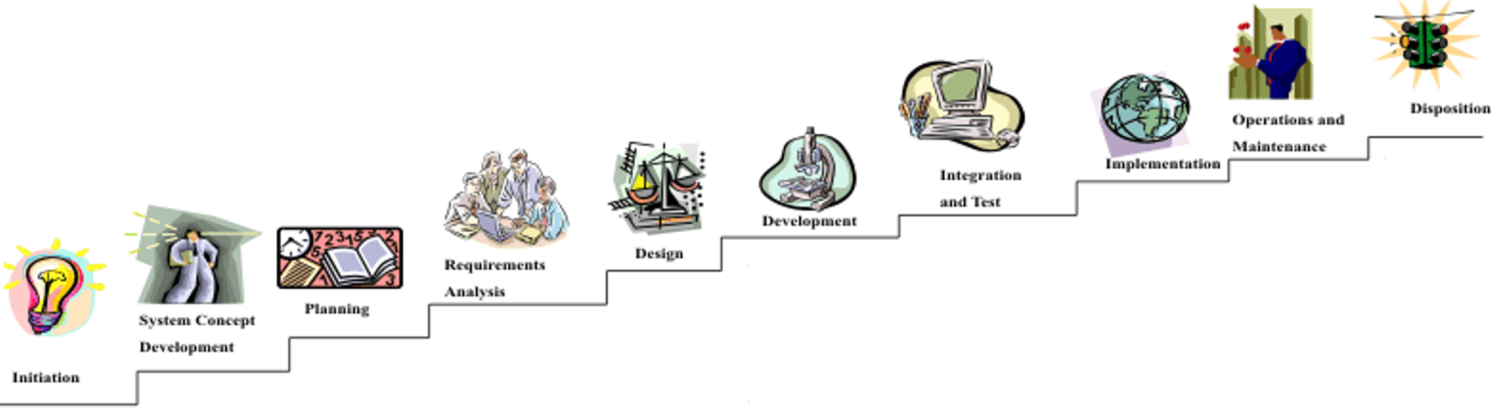
AR 101
Literature Review
Artifact Design
Artifact Demonstration
Artifact Evaluation
Artifact Revision
Conclusion
Key Inputs for the Proposed ARIM
Software Development Lifecycle
Design Thinking
Success Factors for AR Adoption
Photo credit: https://www.justice.gov/archive/jmd/irm/lifecycle/ch1.htm#para1.2
Notes:
Desired outcome/ Goal vs. value drivers vs. KPIs:
Desired outcome = operational excellence
Value driver = worker productivity (under “talent”)
KPI = time it takes for workers to complete a task
Desired outcome = help potential investors/ professionals/ future residents explore and invest in NEOM
Value driver = an engaging way to immersively experience what the future of living at The Line is like
---from Accenture 360degree value meter: financial, experience (customer, ee, partner), sustainability, talent, inclusion & diversity, custom (e.g., innovation)
KPI = user feedback on the VR experience; how many investment potentials NEOM’s received.

Slide 59
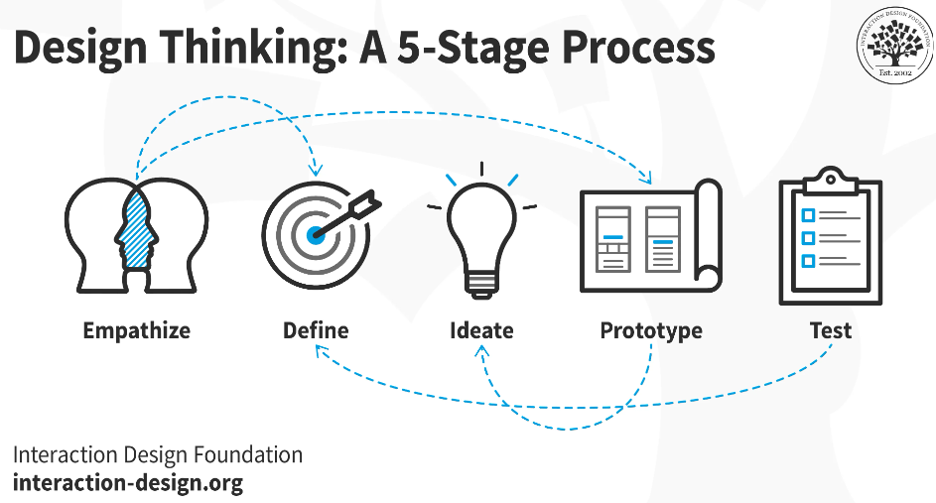
AR 101
Literature Review
Artifact Design
Artifact Demonstration
Artifact Evaluation
Artifact Revision
Conclusion
Key Inputs for the Proposed ARIM
Software Development Lifecycle
Design Thinking
Success Factors for AR Adoption
Which tracking + rendering engines are suitable for the select process and AR platform?
Photo credit: https://www.interaction-design.org/literature/topics/design-thinking
Notes:
Desired outcome/ Goal vs. value drivers vs. KPIs:
Desired outcome = operational excellence
Value driver = worker productivity (under “talent”)
KPI = time it takes for workers to complete a task
Desired outcome = help potential investors/ professionals/ future residents explore and invest in NEOM
Value driver = an engaging way to immersively experience what the future of living at The Line is like
---from Accenture 360degree value meter: financial, experience (customer, ee, partner), sustainability, talent, inclusion & diversity, custom (e.g., innovation)
KPI = user feedback on the VR experience; how many investment potentials NEOM’s received.

Slide 60
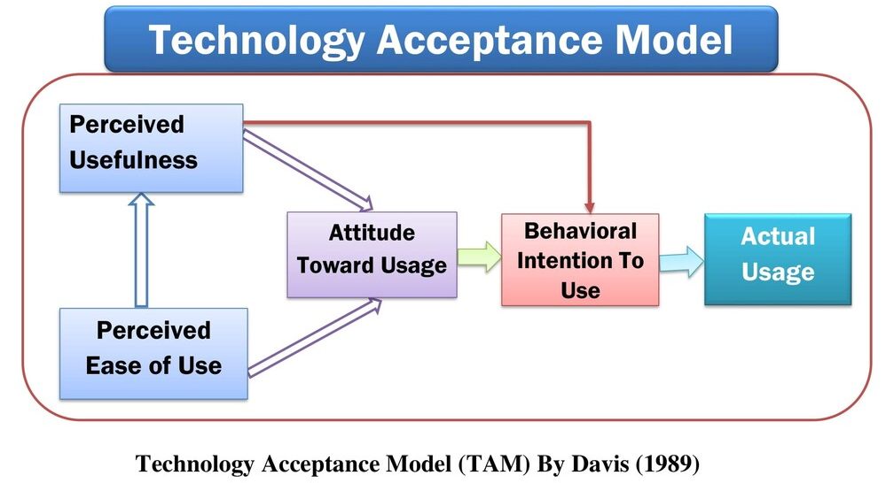
AR 101
Literature Review
Artifact Design
Artifact Demonstration
Artifact Evaluation
Artifact Revision
Conclusion
Key Inputs for the Proposed ARIM
Software Development Lifecycle
Design Thinking
Success Factors for AR Adoption
Photo credit: https://globalassistant.info/technology-acceptance-model-davis-1989-pdf-download-link-free/
Notes:
Desired outcome/ Goal vs. value drivers vs. KPIs:
Desired outcome = operational excellence
Value driver = worker productivity (under “talent”)
KPI = time it takes for workers to complete a task
Desired outcome = help potential investors/ professionals/ future residents explore and invest in NEOM
Value driver = an engaging way to immersively experience what the future of living at The Line is like
---from Accenture 360degree value meter: financial, experience (customer, ee, partner), sustainability, talent, inclusion & diversity, custom (e.g., innovation)
KPI = user feedback on the VR experience; how many investment potentials NEOM’s received.

Slide 61
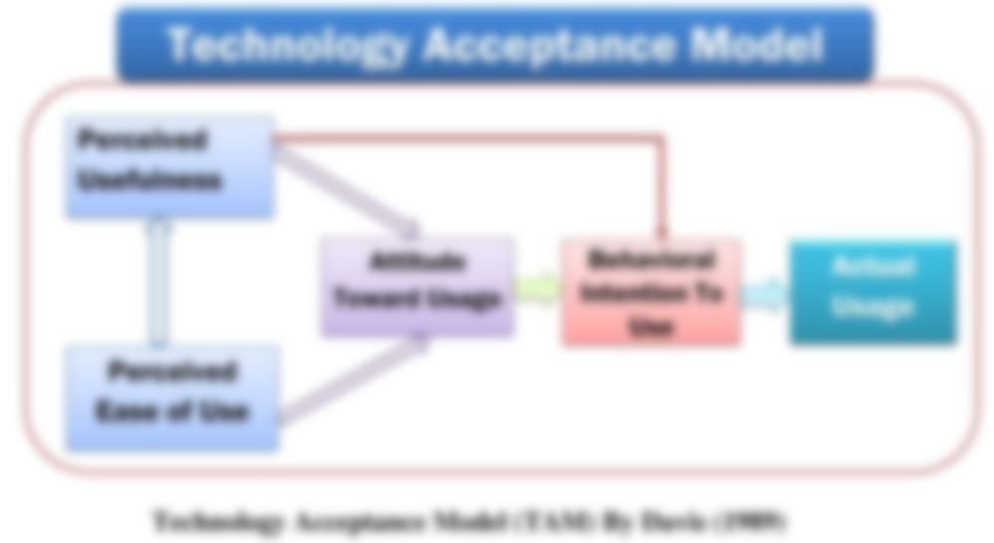
AR 101
Literature Review
Artifact Design
Artifact Demonstration
Artifact Evaluation
Artifact Revision
Conclusion
Key Inputs for the Proposed ARIM
Software Development Lifecycle
Design Thinking
Success Factors for AR Adoption
❌
✅
E.g., head fatigue from prolonged usage of AR headset (as heavy as 1kg)
Photo credit: https://globalassistant.info/technology-acceptance-model-davis-1989-pdf-download-link-free/
Notes:
Desired outcome/ Goal vs. value drivers vs. KPIs:
Desired outcome = operational excellence
Value driver = worker productivity (under “talent”)
KPI = time it takes for workers to complete a task
Desired outcome = help potential investors/ professionals/ future residents explore and invest in NEOM
Value driver = an engaging way to immersively experience what the future of living at The Line is like
---from Accenture 360degree value meter: financial, experience (customer, ee, partner), sustainability, talent, inclusion & diversity, custom (e.g., innovation)
KPI = user feedback on the VR experience; how many investment potentials NEOM’s received.

Slide 62
AR 101
Literature Review
Artifact Design
Artifact Demonstration
Artifact Evaluation
Artifact Revision
Conclusion
ARIM: High-Level Design
Iterative
DISCOVER
DESIGN
DEVELOP
DEPLOY
VALIDATE
ACTIVITY
AR DEV. TOOL SUITABILITY
Which tracking + rendering engines are suitable for the select process and AR platform?
ACTIVITY GUIDANCE
OUTCOME
Notes:
Desired outcome/ Goal vs. value drivers vs. KPIs:
Desired outcome = operational excellence
Value driver = worker productivity (under “talent”)
KPI = time it takes for workers to complete a task
Desired outcome = help potential investors/ professionals/ future residents explore and invest in NEOM
Value driver = an engaging way to immersively experience what the future of living at The Line is like
---from Accenture 360degree value meter: financial, experience (customer, ee, partner), sustainability, talent, inclusion & diversity, custom (e.g., innovation)
KPI = user feedback on the VR experience; how many investment potentials NEOM’s received.

Slide 63
AR 101
Literature Review
Artifact Design
Artifact Demonstration
Artifact Evaluation
Artifact Revision
Conclusion
ARIM: High-Level Design
Iterative
DISCOVER
DESIGN
DEVELOP
DEPLOY
VALIDATE
ACTIVITY
Identify opportunity
Assess process suitability for AR
Assess AR platform suitability:
WebAR vs. Native AR vs. AR-on-headset
Assess AR dev. tool suitability
Refine process requirements
Develop
AR app
Deploy AR app
Test AR app with users
Sub-activities:
1. Define user personas + map user journey to identify desired outcomes and value drivers
2. Define KPIs (CR3)
> How to measure the value drivers?
3. Collect process requirements (CR1)
> Ergonomics, data and privacy, health and safety regulations, etc.
4. Conduct a risk assessment
> (Non)-psychological risk factors e.g., user’s fear of job loss, inadequate training
Sub-activities:
1. Refine process requirements collected from Discovery phase
> Functional requirements are captured as user stories
> Non-functional requirements are used as part of acceptance criteria for relevant user stories
Requirements:
1. Flexible architecture for maintainability, agility, and time-to-market
> Microservice architecture
> Agile development
Requirements:
1. CI/CD
2. Design for cost optimization
E.g., Serverless architecture, auto-scaling
3. Design for performance
E.g., Multi-zone availability, auto-scaling
4. Design for security
E.g., Least-privilege, zero-trust zone, infra-as-code
Sub-activities:
1. Collect user feedback
2. Validate value drivers + measure KPIs
3. Create training materials
AR DEV. TOOL SUITABILITY
Which tracking + rendering engines are suitable for the select process and AR platform?
ACTIVITY GUIDANCE
1. Stakeholder needs + expectations
2. User personas + user journeys
3. Prioritized use cases + value drivers + KPIs
4. Use case requirements
5. Risk assessment
1. AR platform(s) selection
2. AR development tools selection
3. Detailed functional/ non-functional requirements
4. High-level roadmap of prioritized AR use cases
1. Product backlog
2. Test cases
3. Working MVP
1. CI/CD pipelines
2. Cloud infrastructure configurations
1. Sprint review
2. Training materials
3. Validated value drivers/ KPIs
OUTCOME
Notes:
Desired outcome/ Goal vs. value drivers vs. KPIs:
Desired outcome = operational excellence
Value driver = worker productivity (under “talent”)
KPI = time it takes for workers to complete a task
Desired outcome = help potential investors/ professionals/ future residents explore and invest in NEOM
Value driver = an engaging way to immersively experience what the future of living at The Line is like
---from Accenture 360degree value meter: financial, experience (customer, ee, partner), sustainability, talent, inclusion & diversity, custom (e.g., innovation)
KPI = user feedback on the VR experience; how many investment potentials NEOM’s received.

Slide 64
AR 101
Literature Review
Artifact Design
Artifact Demonstration
Artifact Evaluation
Artifact Revision
Conclusion
What Makes a Process a Good Candidate For AR?
Analyzes 39 AR use cases from academic + industry literature across multiple industries and synthesizes 6 common characteristics.
1. Content enriching
2. Work instructions
AR DEV. TOOL SUITABILITY
3. Hands-free access to content
Which tracking + rendering engines are suitable for the select process and AR platform?
4. Hard-to-simulate environment
5. Navigation
6. Collaboration
Notes:
Desired outcome/ Goal vs. value drivers vs. KPIs:
Desired outcome = operational excellence
Value driver = worker productivity (under “talent”)
KPI = time it takes for workers to complete a task
Desired outcome = help potential investors/ professionals/ future residents explore and invest in NEOM
Value driver = an engaging way to immersively experience what the future of living at The Line is like
---from Accenture 360degree value meter: financial, experience (customer, ee, partner), sustainability, talent, inclusion & diversity, custom (e.g., innovation)
KPI = user feedback on the VR experience; how many investment potentials NEOM’s received.

Slide 65
AR 101
Literature Review
Artifact Design
Artifact Demonstration
Artifact Evaluation
Artifact Revision
Conclusion
What Makes a Process a Good Candidate For AR?
Analyzes 39 AR use cases from academic + industry literature across multiple industries and synthesizes 6 common characteristics.
1. Content enriching
2. Work instructions
AR DEV. TOOL SUITABILITY
3. Hands-free access to content
Which tracking + rendering engines are suitable for the select process and AR platform?
4. Hard-to-simulate environment
5. Navigation
6. Collaboration
Photo credit: https://www.youtube.com/watch?v=4Vjajj7ZggA
Notes:
Desired outcome/ Goal vs. value drivers vs. KPIs:
Desired outcome = operational excellence
Value driver = worker productivity (under “talent”)
KPI = time it takes for workers to complete a task
Desired outcome = help potential investors/ professionals/ future residents explore and invest in NEOM
Value driver = an engaging way to immersively experience what the future of living at The Line is like
---from Accenture 360degree value meter: financial, experience (customer, ee, partner), sustainability, talent, inclusion & diversity, custom (e.g., innovation)
KPI = user feedback on the VR experience; how many investment potentials NEOM’s received.

Slide 66
AR 101
Literature Review
Artifact Design
Artifact Demonstration
Artifact Evaluation
Artifact Revision
Conclusion
What Makes a Process a Good Candidate For AR?
Analyzes 39 AR use cases from academic + industry literature across multiple industries and synthesizes 6 common characteristics.
1. Content enriching
2. Work instructions
AR DEV. TOOL SUITABILITY
3. Hands-free access to content
4. Hard-to-simulate environment
5. Navigation
6. Collaboration
Photo credit: https://www.terrauniversal.com/smart-gas-purged-glove-boxes.html
Notes:
Desired outcome/ Goal vs. value drivers vs. KPIs:
Desired outcome = operational excellence
Value driver = worker productivity (under “talent”)
KPI = time it takes for workers to complete a task
Desired outcome = help potential investors/ professionals/ future residents explore and invest in NEOM
Value driver = an engaging way to immersively experience what the future of living at The Line is like
---from Accenture 360degree value meter: financial, experience (customer, ee, partner), sustainability, talent, inclusion & diversity, custom (e.g., innovation)
KPI = user feedback on the VR experience; how many investment potentials NEOM’s received.

Slide 67
AR 101
Literature Review
Artifact Design
Artifact Demonstration
Artifact Evaluation
Artifact Revision
Conclusion
What Makes a Process a Good Candidate For AR?
Analyzes 39 AR use cases from academic + industry literature across multiple industries and synthesizes 6 common characteristics.
1. Content enriching
2. Work instructions
AR DEV. TOOL SUITABILITY
3. Hands-free access to content
Which tracking + rendering engines are suitable for the select process and AR platform?
4. Hard-to-simulate environment
5. Navigation
6. Collaboration
Notes:
Desired outcome/ Goal vs. value drivers vs. KPIs:
Desired outcome = operational excellence
Value driver = worker productivity (under “talent”)
KPI = time it takes for workers to complete a task
Desired outcome = help potential investors/ professionals/ future residents explore and invest in NEOM
Value driver = an engaging way to immersively experience what the future of living at The Line is like
---from Accenture 360degree value meter: financial, experience (customer, ee, partner), sustainability, talent, inclusion & diversity, custom (e.g., innovation)
KPI = user feedback on the VR experience; how many investment potentials NEOM’s received.

Slide 68
AR 101
Literature Review
Artifact Design
Artifact Demonstration
Artifact Evaluation
Artifact Revision
Conclusion
What Makes a Process a Good Candidate For AR?
Analyzes 39 AR use cases from academic + industry literature across multiple industries and synthesizes 6 common characteristics.
1. Content enriching
2. Work instructions
AR DEV. TOOL SUITABILITY
3. Hands-free access to content
Which tracking + rendering engines are suitable for the select process and AR platform?
4. Hard-to-simulate environment
5. Navigation
6. Collaboration
Photo credit: https://techcrunch.com/2020/10/01/google-maps-gets-improved-live-view-ar-directions
Notes:
Desired outcome/ Goal vs. value drivers vs. KPIs:
Desired outcome = operational excellence
Value driver = worker productivity (under “talent”)
KPI = time it takes for workers to complete a task
Desired outcome = help potential investors/ professionals/ future residents explore and invest in NEOM
Value driver = an engaging way to immersively experience what the future of living at The Line is like
---from Accenture 360degree value meter: financial, experience (customer, ee, partner), sustainability, talent, inclusion & diversity, custom (e.g., innovation)
KPI = user feedback on the VR experience; how many investment potentials NEOM’s received.

Slide 69
AR 101
Literature Review
Artifact Design
Artifact Demonstration
Artifact Evaluation
Artifact Revision
Conclusion
What Makes a Process a Good Candidate For AR?
Analyzes 39 AR use cases from academic + industry literature across multiple industries and synthesizes 6 common characteristics.
1. Content enriching
2. Work instructions
AR DEV. TOOL SUITABILITY
3. Hands-free access to content
Which tracking + rendering engines are suitable for the select process and AR platform?
4. Hard-to-simulate environment
5. Navigation
6. Collaboration
Photo credit: https://www.ptc.com/en/products/vuforia/vuforia-chalk
Notes:
Desired outcome/ Goal vs. value drivers vs. KPIs:
Desired outcome = operational excellence
Value driver = worker productivity (under “talent”)
KPI = time it takes for workers to complete a task
Desired outcome = help potential investors/ professionals/ future residents explore and invest in NEOM
Value driver = an engaging way to immersively experience what the future of living at The Line is like
---from Accenture 360degree value meter: financial, experience (customer, ee, partner), sustainability, talent, inclusion & diversity, custom (e.g., innovation)
KPI = user feedback on the VR experience; how many investment potentials NEOM’s received.

Slide 70
AR 101
Literature Review
Artifact Design
Artifact Demonstration
Artifact Evaluation
Artifact Revision
Conclusion
How to Choose Between AR Platforms + AR Dev. Tools?
In order to keep the methodology tool-agnostic, need to formulate a set of selection criteria for AR platforms + tools.
❌
Technical specs of AR platforms/ tools → Selection criteria (SC)
✅
AR adoption success factors → SC
AR Success Factor
mapped to
High-level SC
contextualized into
Low-level SC
SF1: AR solution should accommodate
working conditions
Usage conditions-specific
Network connectivity: offline mode support
SF2: Ergonomics
Hardware-specific
Device weight
Notes:
Desired outcome/ Goal vs. value drivers vs. KPIs:
Desired outcome = operational excellence
Value driver = worker productivity (under “talent”)
KPI = time it takes for workers to complete a task
Desired outcome = help potential investors/ professionals/ future residents explore and invest in NEOM
Value driver = an engaging way to immersively experience what the future of living at The Line is like
---from Accenture 360degree value meter: financial, experience (customer, ee, partner), sustainability, talent, inclusion & diversity, custom (e.g., innovation)
KPI = user feedback on the VR experience; how many investment potentials NEOM’s received.

Slide 71
AR 101
Literature Review
Artifact Design
Artifact Demonstration
Artifact Evaluation
Artifact Revision
Conclusion
How to Choose Between AR Platforms?
23 selection criteria categorized into 1) Usage conditions-specific 2) Hardware-specific
1. Usage conditions-specific:
1. Lighting conditions
2. Network connectivity: offline mode support
3. Noise
4-5. Temperature + humidity
6-7. Drop-safe + water/dust-proof
8. Compliance with health/ safety standards
9. Hand usage: hands-free yes/ no
10. User interactions: hand, eye, headset tracking; voice commands
11. Movement restrictions
2. Hardware-specific:
1. Battery life
2. Device weight
3. Field-of-view
4-5. Camera + display resolution
6. Refresh rate
7-9. Storage + computation + remote rendering
10. Cross-device development
11. App download required
12. Cost: hardware + subscription
AR DEV. TOOL SUITABILITY
Which tracking + rendering engines are suitable for the select process and AR platform?
Photo credit: https://kguttag.com/2021/10/13/magic-leap-2-for-enterprise-really-plus-another-500m/
Notes:
Desired outcome/ Goal vs. value drivers vs. KPIs:
Desired outcome = operational excellence
Value driver = worker productivity (under “talent”)
KPI = time it takes for workers to complete a task
Desired outcome = help potential investors/ professionals/ future residents explore and invest in NEOM
Value driver = an engaging way to immersively experience what the future of living at The Line is like
---from Accenture 360degree value meter: financial, experience (customer, ee, partner), sustainability, talent, inclusion & diversity, custom (e.g., innovation)
KPI = user feedback on the VR experience; how many investment potentials NEOM’s received.

Slide 72
AR 101
Literature Review
Artifact Design
Artifact Demonstration
Artifact Evaluation
Artifact Revision
Conclusion
How to Choose Between AR Dev. Tools (Tracking + Rendering Engine)?
18 selection criteria categorized into 1) Tracking capabilities 2) Rendering capabilities 3) Ease of development 4) Licensing costs
1. Tracking capabilities
1-2. Fiducial + image tracking
3. Object tracking
4. Face tracking
5. Location tracking
6. Surface tracking
7. Spatial tracking
8. Other tracking techniques
9. Multi-marker tracking
10. Multi-user AR session
11. Depth tracking
12. Light effects
2. Rendering capabilities
1. Light estimation
2. Occlusion
3. Ease of development
1. Integration with other AR dev. tools
2. Simulation testing
3. No-code/ low-code development
4. Licensing cost
1. Open-source: yes/ no
AR DEV. TOOL SUITABILITY
Which tracking + rendering engines are suitable for the select process and AR platform?
Photo credit: https://www.youtube.com/watch?v=4Vjajj7ZggA
Notes:
Desired outcome/ Goal vs. value drivers vs. KPIs:
Desired outcome = operational excellence
Value driver = worker productivity (under “talent”)
KPI = time it takes for workers to complete a task
Desired outcome = help potential investors/ professionals/ future residents explore and invest in NEOM
Value driver = an engaging way to immersively experience what the future of living at The Line is like
---from Accenture 360degree value meter: financial, experience (customer, ee, partner), sustainability, talent, inclusion & diversity, custom (e.g., innovation)
KPI = user feedback on the VR experience; how many investment potentials NEOM’s received.

Slide 73
AR 101
Literature Review
Artifact Design
Artifact Demonstration
Artifact Evaluation
Artifact Revision
Conclusion
ARIM: Final Design
Iterative
DISCOVER
DESIGN
DEVELOP
DEPLOY
VALIDATE
ACTIVITY
Identify opportunity
Assess process suitability for AR
Assess AR platform suitability:
WebAR vs. Native AR vs. AR-on-headset
Assess AR dev. tool suitability
Refine process requirements
Develop
AR app
Deploy AR app
Test AR app with users
Sub-activities:
1. Define user personas + map user journey to identify desired outcomes and value drivers
2. Define KPIs
> How to measure the value drivers?
3. Collect process requirements
> Ergonomics, data and privacy, health and safety regulations, etc.
4. Conduct a risk assessment
> (Non)-psychological risk factors e.g., user’s fear of job loss, inadequate training
Characteristics which make a
process ideal for AR:
1. Content enriching
E.g., AR monitoring dashboard anchored to a physical machine, AR artbook
2. Work instructions
E.g., AR-guided work instructions
3. Hard-to-simulate
environment
E.g., 3D mesh of crime scene, 3D patient anatomy
4. Hands-free access to contents
E.g., surgeons viewing patient data during surgery
5. Navigation
E.g., AR-guided emergency & rescue
6. Collaboration
E.g., remote assist
Selection criteria:
1. Usage conditions-specific:
1. Lighting conditions
2. Network connectivity: offline mode support yes/ no
3. Noise
4-5. Temperature + humidity
6-7. Drop-safe + water/dust-proof
8. Compliance with health/ safety standards
9. Hand usage: hands-free yes/ no
10. User interactions: hand, eye, headset tracking; voice commands
11. Movement restrictions
2. Hardware-specific:
1-2. Battery life + device weight
3. Field-of-view
4-5. Camera + display resolution
6. Refresh rate
7-9. Storage + computation + remote rendering
10. Cross-device development
11. App download required
12. Cost: hardware + subscription
Selection criteria:
1. Tracking capability
1-2. Fiducial+image tracking
3. Object tracking
4. Face tracking
5. Location tracking
6. Surface tracking
7. Spatial tracking
8. Other tracking techniques
9. Multi-marker tracking
10. Multi-user AR session
11. Depth tracking
12. Light effects
2. Rendering capability
1. Light estimation
2. Occlusion
3. Ease of development
1. Integration with other AR dev. tools
2. Simulation testing
3. No-code/ low-code dev.
4. Licensing cost
1. Open-source: yes/ no
Sub-activities:
1. Refine process requirements collected from Discovery phase
> Functional requirements are captured as user stories
> Non-functional requirements are used as part of acceptance criteria for relevant user stories
Requirements:
1. Flexible architecture for maintainability, agility, and time-to-market
> Microservice architecture
> Agile development
Requirements:
1. CI/CD
2. Design for cost optimization
E.g., Serverless architecture, auto-scaling
3. Design for performance
E.g., Multi-zone availability, auto-scaling
4. Design for security
E.g., Least-privilege, zero-trust zone, infra-as-code
Sub-activities:
1. Collect user feedback
2. Validate value drivers + measure KPIs
3. Create training materials
AR DEV. TOOL SUITABILITY
Which tracking + rendering engines are suitable for the select process and AR platform?
ACTIVITY GUIDANCE
1. Stakeholder needs + expectations
2. User personas + user journeys
3. Prioritized use cases + value drivers + KPIs
4. Use case requirements
5. Risk assessment
1. AR platform(s) selection
2. AR development tools selection
3. Detailed functional/ non-functional requirements
4. High-level roadmap of prioritized AR use cases
1. Product backlog
2. Test cases
3. Working MVP
1. CI/CD pipelines
2. Cloud infrastructure configurations
1. Sprint review
2. Training materials
3. Validated value drivers/ KPIs
OUTCOME
Notes:
Desired outcome/ Goal vs. value drivers vs. KPIs:
Desired outcome = operational excellence
Value driver = worker productivity (under “talent”)
KPI = time it takes for workers to complete a task
Desired outcome = help potential investors/ professionals/ future residents explore and invest in NEOM
Value driver = an engaging way to immersively experience what the future of living at The Line is like
---from Accenture 360degree value meter: financial, experience (customer, ee, partner), sustainability, talent, inclusion & diversity, custom (e.g., innovation)
KPI = user feedback on the VR experience; how many investment potentials NEOM’s received.

Slide 74
AR 101
Literature Review
Artifact Design
Artifact Demonstration
Artifact Evaluation
Artifact Revision
Conclusion
WebAR Prototype: Use Case Introduction
AR DEV. TOOL SUITABILITY
Which tracking + rendering engines are suitable for the select process and AR platform?
Before
Now: Dead
Notes:
I have a plant. It’s now dead. possibly due to overwatering or underwatering. who knows.
want to use AR to solve this problem.

Slide 75
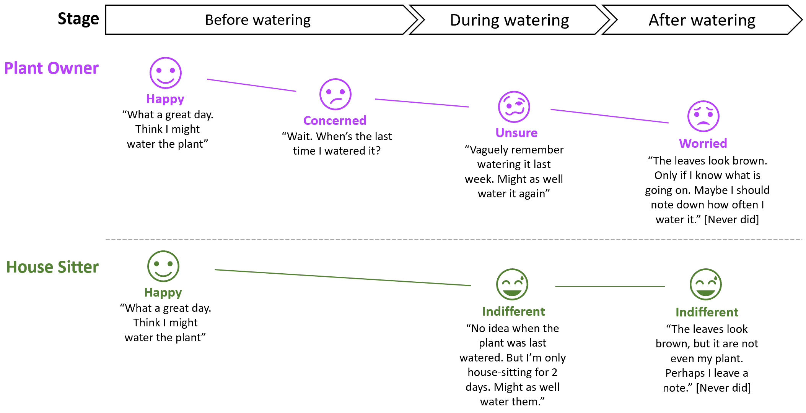
AR 101
Literature Review
Artifact Design
Artifact Demonstration
Artifact Evaluation
Artifact Revision
Conclusion
WebAR Prototype: Discover Phase
Mapping user personas and user journeys to uncover problem/ opportunity
AR DEV. TOOL SUITABILITY
Which tracking + rendering engines are suitable for the select process and AR platform?
Notes:
in the ARIM, we have 5 phases. starting with a Discovery phase where we can map user personas and user journeys to uncover problem/ opportunity.
As a plant owner, I’m usually concerned and unsure if my plant needs water now and how much. After watering the plant, it’s still challenging to keep a record of when I watered it last or how the plant was doing at the same.
my friends who come over to help take care of the plant go to similar journey but they prob couldn’t care less since they only there for a few days.
If I build an AR dashboard, I can view real-time soil moisture level to decide if the plant needs water now. Record that the plant was watered on that day/ time and if it was doing good so that I can continue monitoring the plant.

Slide 76
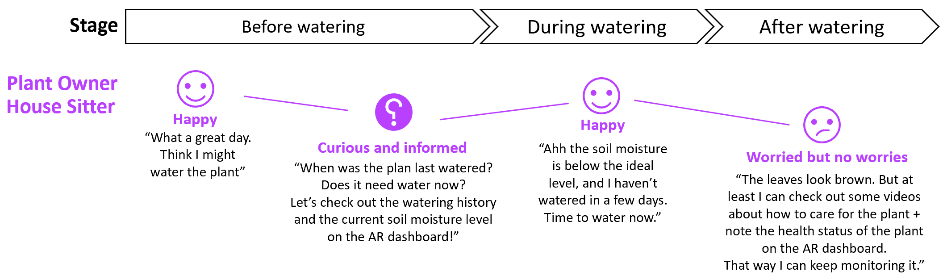
AR 101
Literature Review
Artifact Design
Artifact Demonstration
Artifact Evaluation
Artifact Revision
Conclusion
WebAR Prototype: Discover Phase
Mapping user personas and user journeys to uncover problem/ opportunity
AR DEV. TOOL SUITABILITY
Which tracking + rendering engines are suitable for the select process and AR platform?

Slide 77


AR 101
Literature Review
Artifact Design
Artifact Demonstration
Artifact Evaluation
Artifact Revision
Conclusion
WebAR Prototype: Design Phase
Choose 1) AR Platform 2) Tracking engine 3) Rendering engine
AR PLATFORM
TRACKING ENGINE
RENDERING ENGINE
AR DEV. TOOL SUITABILITY
WebAR
Which tracking + rendering engines are suitable for the select process and AR platform?
No app download/ install required
Image tracking; open-source
Open-source; wide community support
Notes:
Desired outcome/ Goal vs. value drivers vs. KPIs:
Desired outcome = operational excellence
Value driver = worker productivity (under “talent”)
KPI = time it takes for workers to complete a task
Desired outcome = help potential investors/ professionals/ future residents explore and invest in NEOM
Value driver = an engaging way to immersively experience what the future of living at The Line is like
---from Accenture 360degree value meter: financial, experience (customer, ee, partner), sustainability, talent, inclusion & diversity, custom (e.g., innovation)
KPI = user feedback on the VR experience; how many investment potentials NEOM’s received.

Slide 78
AR 101
Literature Review
Artifact Design
Artifact Demonstration
Artifact Evaluation
Artifact Revision
Conclusion
WebAR Prototype: Design Phase
Choose 1) AR Platform 2) Tracking engine 3) Rendering engine
AR PLATFORM
TRACKING ENGINE
RENDERING ENGINE
AR DEV. TOOL SUITABILITY
WebAR
Which tracking + rendering engines are suitable for the select process and AR platform?
No app download/ install required
Image tracking; open-source
Open-source; wide community support
Notes:
Desired outcome/ Goal vs. value drivers vs. KPIs:
Desired outcome = operational excellence
Value driver = worker productivity (under “talent”)
KPI = time it takes for workers to complete a task
Desired outcome = help potential investors/ professionals/ future residents explore and invest in NEOM
Value driver = an engaging way to immersively experience what the future of living at The Line is like
---from Accenture 360degree value meter: financial, experience (customer, ee, partner), sustainability, talent, inclusion & diversity, custom (e.g., innovation)
KPI = user feedback on the VR experience; how many investment potentials NEOM’s received.

Slide 79
AR 101
Literature Review
Artifact Design
Artifact Demonstration
Artifact Evaluation
Artifact Revision
Conclusion
WebAR Prototype: Design Phase
Choose 1) AR Platform 2) Tracking engine 3) Rendering engine
AR PLATFORM
TRACKING ENGINE
RENDERING ENGINE
AR DEV. TOOL SUITABILITY
WebAR
Which tracking + rendering engines are suitable for the select process and AR platform?
No app download/ install required
Image tracking; open-source
Open-source; wide community support
Notes:
Desired outcome/ Goal vs. value drivers vs. KPIs:
Desired outcome = operational excellence
Value driver = worker productivity (under “talent”)
KPI = time it takes for workers to complete a task
Desired outcome = help potential investors/ professionals/ future residents explore and invest in NEOM
Value driver = an engaging way to immersively experience what the future of living at The Line is like
---from Accenture 360degree value meter: financial, experience (customer, ee, partner), sustainability, talent, inclusion & diversity, custom (e.g., innovation)
KPI = user feedback on the VR experience; how many investment potentials NEOM’s received.

Slide 80
AR 101
Literature Review
Artifact Design
Artifact Demonstration
Artifact Evaluation
Artifact Revision
Conclusion
WebAR Prototype: Design Phase
Choose 1) AR Platform 2) Tracking engine 3) Rendering engine
AR PLATFORM
TRACKING ENGINE
RENDERING ENGINE
AR DEV. TOOL SUITABILITY
WebAR
Which tracking + rendering engines are suitable for the select process and AR platform?
No app download/ install required
Image tracking; open-source
Open-source; wide community support
Notes:
Desired outcome/ Goal vs. value drivers vs. KPIs:
Desired outcome = operational excellence
Value driver = worker productivity (under “talent”)
KPI = time it takes for workers to complete a task
Desired outcome = help potential investors/ professionals/ future residents explore and invest in NEOM
Value driver = an engaging way to immersively experience what the future of living at The Line is like
---from Accenture 360degree value meter: financial, experience (customer, ee, partner), sustainability, talent, inclusion & diversity, custom (e.g., innovation)
KPI = user feedback on the VR experience; how many investment potentials NEOM’s received.

Slide 81
AR 101
Literature Review
Artifact Design
Artifact Demonstration
Artifact Evaluation
Artifact Revision
Conclusion
WebAR Prototype: Develop + Deploy + Validate Phase
Image marker
AR DEV. TOOL SUITABILITY
Soil moisture sensor
Microcontroller connected to sensor
Notes:
Desired outcome/ Goal vs. value drivers vs. KPIs:
Desired outcome = operational excellence
Value driver = worker productivity (under “talent”)
KPI = time it takes for workers to complete a task
Desired outcome = help potential investors/ professionals/ future residents explore and invest in NEOM
Value driver = an engaging way to immersively experience what the future of living at The Line is like
---from Accenture 360degree value meter: financial, experience (customer, ee, partner), sustainability, talent, inclusion & diversity, custom (e.g., innovation)
KPI = user feedback on the VR experience; how many investment potentials NEOM’s received.

Slide 82
AR 101
Literature Review
Artifact Design
Artifact Demonstration
Artifact Evaluation
Artifact Revision
Conclusion
WebAR Prototype: Develop + Deploy + Validate Phase
AWS Virtual Private Cloud (VPC)
Sends sensor readings
Uses sensor’s device certificate to authenticate + publish to AWS IoT’s MQTTS broker
Writes sensor data
Device gateway
Sensor mgmt
& sensor data ingestion
Physical plant
Browser hits CloudFront’s endpoint. CloudFront returns static assets via HTTPS
Queries front-end assets (HTML, CSS, JS, media) and cache them at edge nodes
AR DEV. TOOL SUITABILITY
CDN
Front-end
static asset hosting
Which tracking + rendering engines are suitable for the select process and AR platform?
Browser invokes AWS Lambda function URL (isolating read/ write traffic)
Reads sensor data
User’s browser
Serverless function
Sensor data
(NoSQL database)
Writes watering record
Developer’s device
CI/ CD
Build artifacts storage
Serverless function
Infra-as-Code (IaC)
Watering history
WebAR dev. tools
Reads watering record
Deploys AWS resources
Serverless function
Notes:
Desired outcome/ Goal vs. value drivers vs. KPIs:
Desired outcome = operational excellence
Value driver = worker productivity (under “talent”)
KPI = time it takes for workers to complete a task
Desired outcome = help potential investors/ professionals/ future residents explore and invest in NEOM
Value driver = an engaging way to immersively experience what the future of living at The Line is like
---from Accenture 360degree value meter: financial, experience (customer, ee, partner), sustainability, talent, inclusion & diversity, custom (e.g., innovation)
KPI = user feedback on the VR experience; how many investment potentials NEOM’s received.

Slide 83
AR 101
Literature Review
Artifact Design
Artifact Demonstration
Artifact Evaluation
Artifact Revision
Conclusion
Interviews with 3 Accenture Domain Experts
4,3
Iterative
DISCOVER
DESIGN
DEVELOP
DEPLOY
VALIDATE
2,7
3,7
5
4
2,7
2,7
2,7
2,7
ACTIVITY
Identify opportunity
Assess process suitability for AR
Assess AR platform suitability:
WebAR vs. Native AR vs. AR-on-headset
Assess AR dev. tool suitability
Refine process requirements
Develop
AR app
Deploy AR app
Test AR app with users
Sub-activities:
1. Define user personas + map user journey to identify desired outcomes and value drivers
2. Define KPIs (CR3)
> How to measure the value drivers?
3. Collect process requirements (CR1)
> Ergonomics, data and privacy, health and safety regulations, etc.
4. Conduct a risk assessment
> (Non)-psychological risk factors e.g., user’s fear of job loss, inadequate training
Characteristics which make a
process ideal for AR:
1. Content enriching
E.g., AR monitoring dashboard anchored to a physical machine, AR artbook
2. Work instructions
E.g., AR-guided work instructions
3. Hard-to-simulate
environment
E.g., 3D mesh of crime scene, 3D patient anatomy
4. Hands-free access to contents
E.g., surgeons viewing patient data during surgery
5. Navigation
E.g., AR-guided emergency & rescue
6. Collaboration
E.g., remote assist
Selection criteria:
1. Usage conditions-specific:
1. Lighting conditions
2. Network connectivity: offline mode support yes/ no
3. Noise
4-5. Temperature + humidity
6-7. Drop-safe + water/dust-proof
8. Compliance with health/ safety standards
9. Hand usage: hands-free yes/ no
10. User interactions: hand, eye, headset tracking; voice commands
11. Movement restrictions
2. Hardware-specific:
1-2. Battery life + device weight
3. Field-of-view
4-5. Camera + display resolution
6. Refresh rate
7-9. Storage + computation + remote rendering
10. Cross-device development
11. App download required
12. Cost: hardware + subscription
Selection criteria:
1. Tracking capability
1-2. Fiducial+image tracking
3. Object tracking
4. Face tracking
5. Location tracking
6. Surface tracking
7. Spatial tracking
8. Other tracking techniques
9. Multi-marker tracking
10. Multi-user AR session
11. Depth tracking
12. Light effects
2. Rendering capability
1. Light estimation
2. Occlusion
3. Ease of development
1. Integration with other AR dev. tools
2. Simulation testing
3. No-code/ low-code dev.
4. Licensing cost
1. Open-source: yes/ no
Sub-activities:
1. Refine process requirements collected from Discovery phase
> Functional requirements are captured as user stories
> Non-functional requirements are used as part of acceptance criteria for relevant user stories
Requirements:
1. Flexible architecture for maintainability, agility, and time-to-market (CR8)
> Microservice architecture
> Agile development
Requirements:
1. CI/CD (CR9)
2. Design for cost optimization (CR10)
E.g., Serverless architecture, auto-scaling
3. Design for performance (CR12)
E.g., Multi-zone availability, auto-scaling
4. Design for security (CR13)
E.g., Least-privilege, zero-trust zone, infra-as-code
Sub-activities:
1. Collect user feedback (CR15)
2. Validate value drivers + measure KPIs (CR4)
3. Create training materials (CR11)
AR DEV. TOOL SUITABILITY
Which tracking + rendering engines are suitable for the select process and AR platform?
ACTIVITY GUIDANCE
1. Stakeholder needs + expectations
2. User personas + user journeys
3. Prioritized use cases + value drivers + KPIs
4. Use case requirements
5. Risk assessment
1. AR platform(s) selection
2. AR development tools selection
3. Detailed functional/ non-functional requirements
4. High-level roadmap of prioritized AR use cases
1. Product backlog
2. Test cases
3. Working MVP
1. CI/CD pipelines
2. Cloud infrastructure configurations
1. Sprint review
2. Training materials
3. Validated value drivers/ KPIs
OUTCOME
Notes:
Desired outcome/ Goal vs. value drivers vs. KPIs:
Desired outcome = operational excellence
Value driver = worker productivity (under “talent”)
KPI = time it takes for workers to complete a task
Desired outcome = help potential investors/ professionals/ future residents explore and invest in NEOM
Value driver = an engaging way to immersively experience what the future of living at The Line is like
---from Accenture 360degree value meter: financial, experience (customer, ee, partner), sustainability, talent, inclusion & diversity, custom (e.g., innovation)
KPI = user feedback on the VR experience; how many investment potentials NEOM’s received.

Slide 84
AR 101
Literature Review
Artifact Design
Artifact Demonstration
Artifact Evaluation
Artifact Revision
Conclusion
Revised AR Implementation Methodology
AR IMPLEMENTATION METHODOLOGY: GUIDING AR USE CASE ASSESSMENT
ACTIVITY
Assess process suitability
for AR
Assess AR platform suitability**:
WebAR vs. Native AR vs. AR-on-headset
Assess AR dev. tool suitability**:
Tracking + Rendering Engine
Refine process requirements
Characteristics which make a process ideal for AR:
1. Location-based context
E.g., AR dashboard for machine status monitoring, AR-guided work instructions anchored to a machine
2. Hard-to-simulate environment
E.g., 3D mesh of crime scene, 3D patient anatomy for pre-surgical planning, virtual product prototyping
3. Hands-free access to content
E.g., surgeons viewing patient data during surgery, nuclear power plant workers can access contents hands-free while operating a glovebox
4. Remote assist
E.g., Remote workers visually guide and collaborate with local workers without geographical constraints.
5. Navigation
E.g., AR-guided emergency & rescue
Selection criteria:
1. Usage conditions-specific:
1. Lighting conditions
2. Network connectivity: offline mode support yes/ no
3. Noise
4-5. Temperature + humidity
6-7. Drop-safe + water/dust-proof
8. Health/ safety compliance
9. Hand usage
10. User interactions: hand, eye, headset tracking; voice commands
11. Movement restrictions: e.g., tethered AR headsets cause more restrictions than a phone/ tablet/ non-tethered AR headsets
2. Hardware-specific:
1-2. Battery life + device weight
3. Field-of-view
4-5. Camera + display resolution
6. Refresh rate
7-9. Storage + computation + remote rendering
10. Cross-device development
11. App download required
12. Heat distribution
13. Cost: hardware + subscription
Tracking and rendering engines are benchmarked using the following criteria.
1. Tracking capabilities: Different use cases require different tracking capabilities
1-2. Fiducial + image tracking
3. Object tracking
4. Face tracking
5. Location tracking
6. Surface tracking
7. Spatial tracking
8. Other tracking techniques
9. Multi-marker tracking
10. Multi-user AR session
11. Depth tracking
12. Light effects
2. Rendering capabilities: Rendering speed is affected by network connection + rendering engine’s design + hardware capabilities, and therefore not assessed here.
1. Light estimation: more realistic rendering
2. Occlusion: more realistic rendering
3. Ease of development:
1. Integration with other AR dev. tools: checks which tracking engine integrates with which rendering engine
2. Simulation/ remote testing:
3. No-code/ low-code development
4. Licensing cost
1. Open-source: yes/ no
Activities:
1. Refine process requirements collected from Discovery phase
> Functional requirements are captured as user stories
> Non-functional requirements are used as part of acceptance criteria for relevant user stories
DISCOVERY*
AGILE*:
DESIGN > DEVELOP > DEPLOY > VALIDATE
Produces ARIF’s inputs:
User personas
User journeys
List of potential AR use cases to be validated using ARIF
Preliminary process requirements (i.e., use case requirements): incl. ergonomics, health and safety standards, privacy and data protection
Risk assessment: (non)-psychological risks
Receives ARIF’s outputs:
Validation if AR is suitable for target use cases
If yes, AR platform selection, AR development tools selection, refined process requirements, and a high-level roadmap of prioritized AR use cases
ACTIVITY GUIDANCE
* Accenture’s existing frameworks
** Supplemented with Definition Tables + Decision Matrices
Notes:
Non-functional = ergonomics; can’t wear hololens of 600 grams for 8 hour shift.

Slide 85
AR 101
Literature Review
Artifact Design
Artifact Demonstration
Artifact Evaluation
Artifact Revision
Conclusion
Academic and Practical Contributions
Academic contributions:
Process suitability for AR assessment: 5 process characteristics
AR platform suitability assessment: 24 selection criteria
AR development tool suitability assessment: 18 selection criteria
Practical contributions:
Industry-agnostic, tool-agnostic AR Implementation Methodology (tailored for Accenture)
AR Platform Decision Matrix (Appendix)
AR Development Tool Decision Matrix (Appendix)
Reference cloud architecture for WebAR application
AR DEV. TOOL SUITABILITY
Notes:
Desired outcome/ Goal vs. value drivers vs. KPIs:
Desired outcome = operational excellence
Value driver = worker productivity (under “talent”)
KPI = time it takes for workers to complete a task
Desired outcome = help potential investors/ professionals/ future residents explore and invest in NEOM
Value driver = an engaging way to immersively experience what the future of living at The Line is like
---from Accenture 360degree value meter: financial, experience (customer, ee, partner), sustainability, talent, inclusion & diversity, custom (e.g., innovation)
KPI = user feedback on the VR experience; how many investment potentials NEOM’s received.

Slide 86
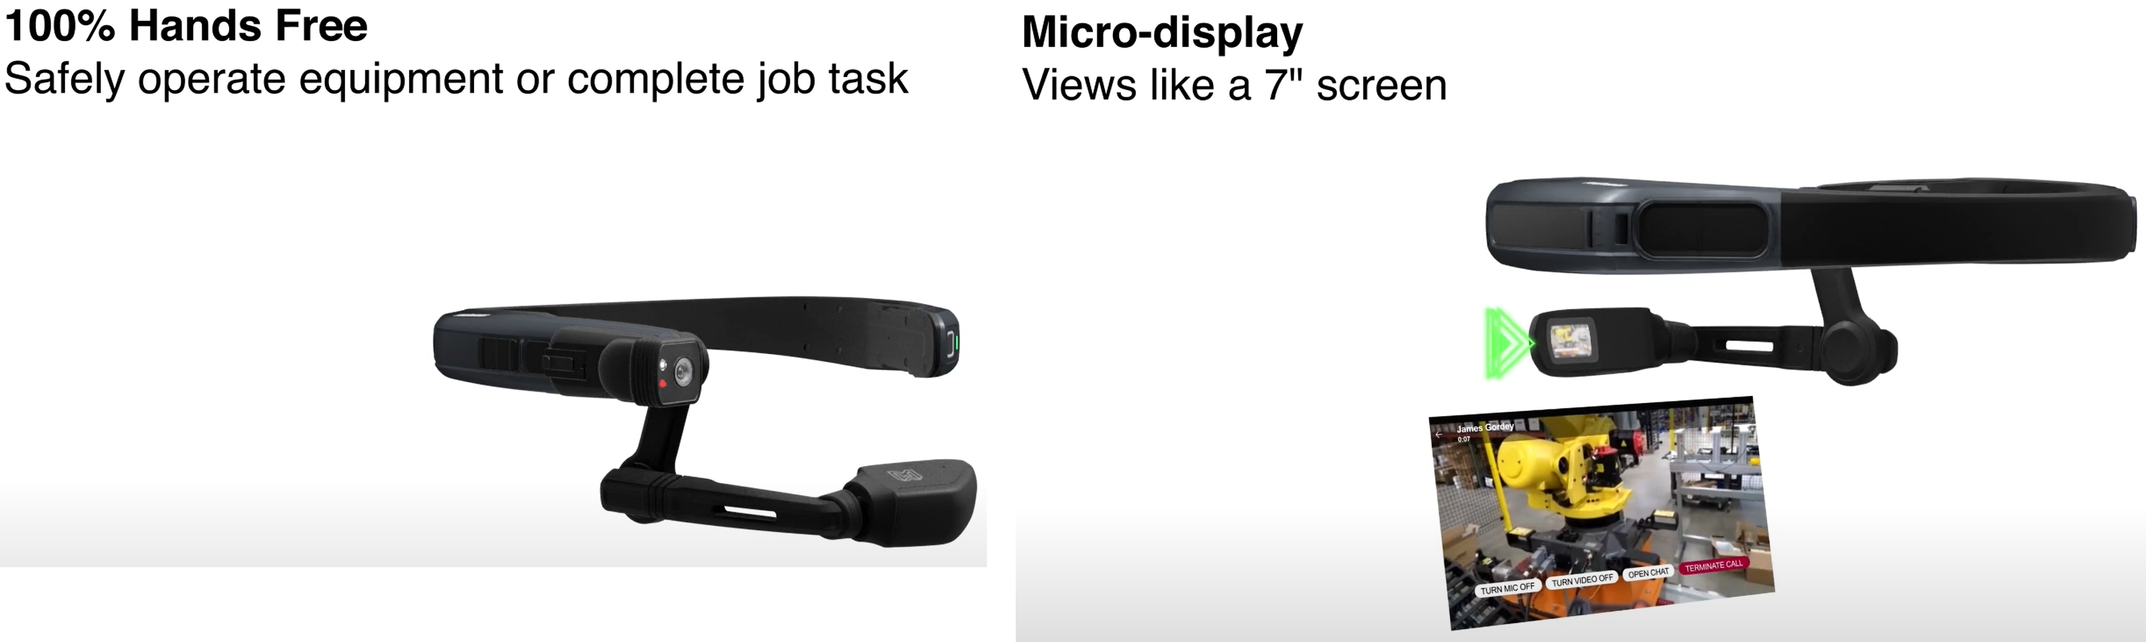
AR 101
Literature Review
Artifact Design
Artifact Demonstration
Artifact Evaluation
Artifact Revision
Conclusion
Limitations, Recommendations & Future Works
Limitations + Recommendations:
Proposed process characteristics serve as “positive indicators”: define “negative indicators”
Non-exhaustive AR Platform/ AR Development Tool Decision Matrices: active maintenance
AR technology evolves, there might be new success factors which are not yet incorporated in the ARIM: active maintenance
Only 3 Accenture experts were interviewed: more (non)-Accenture interviews
Future Works:
Addressing known limitations
Expand to Virtual Reality (VR)
Expand to Assisted Reality
AR DEV. TOOL SUITABILITY
Which tracking + rendering engines are suitable for the select process and AR platform?
Photo credit: https://youtu.be/7yjQ5LYT9ok
Notes:
Desired outcome/ Goal vs. value drivers vs. KPIs:
Desired outcome = operational excellence
Value driver = worker productivity (under “talent”)
KPI = time it takes for workers to complete a task
Desired outcome = help potential investors/ professionals/ future residents explore and invest in NEOM
Value driver = an engaging way to immersively experience what the future of living at The Line is like
---from Accenture 360degree value meter: financial, experience (customer, ee, partner), sustainability, talent, inclusion & diversity, custom (e.g., innovation)
KPI = user feedback on the VR experience; how many investment potentials NEOM’s received.

Slide 87
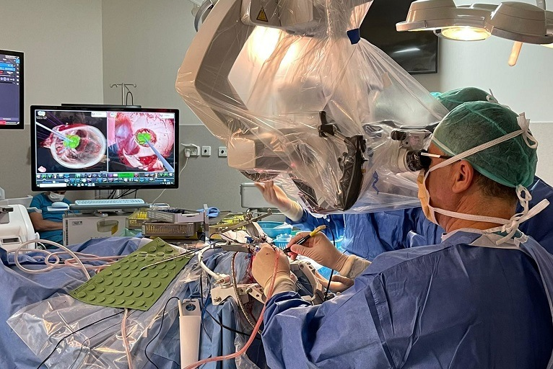
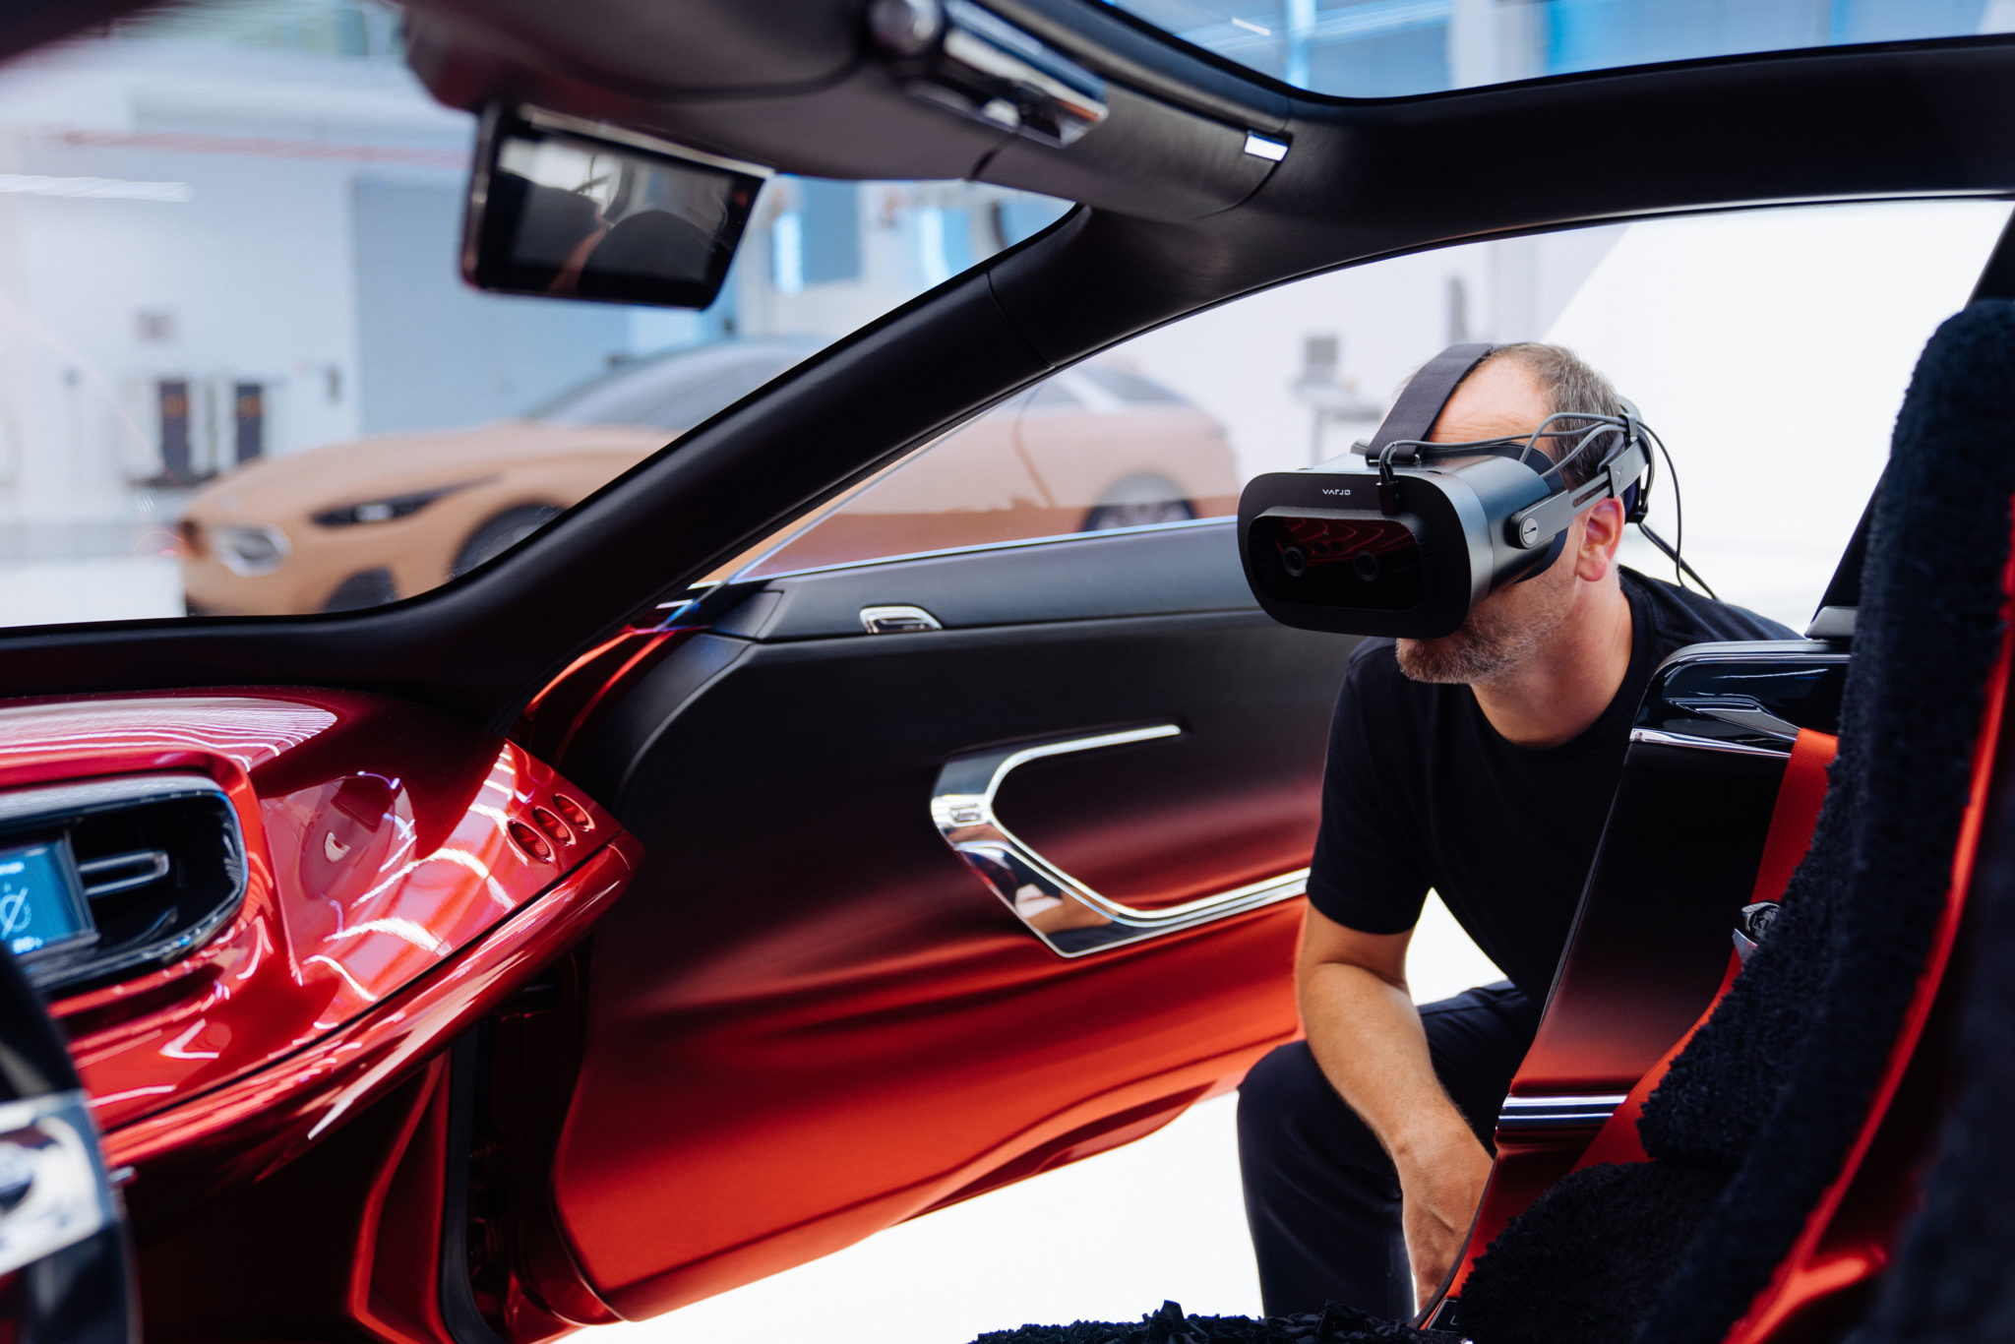
AR 101
Literature Review
Artifact Design
Artifact Demonstration
Artifact Evaluation
Artifact Revision
Conclusion
Current State and Future State of AR Technology
Based on author’s observations; not backed by empirical evidence
1. Addressing existing hardware limitations:
CPU/ GPU + heat distribution
Remote rendering + 5G
Cost
2. Addressing existing software limitations:
More accurate tracking
More realistic rendering
3. Augmenting for complex human senses:
Today’s AR: primarily vision + hearing
Tomorrow’s AR: touch, taste, smell
AR DEV. TOOL SUITABILITY
Photo credit: https://neuronewsinternational.com/surgical-theater-ar-vr-neurosurgery-technologies-israel/
Notes:
Desired outcome/ Goal vs. value drivers vs. KPIs:
Desired outcome = operational excellence
Value driver = worker productivity (under “talent”)
KPI = time it takes for workers to complete a task
Desired outcome = help potential investors/ professionals/ future residents explore and invest in NEOM
Value driver = an engaging way to immersively experience what the future of living at The Line is like
---from Accenture 360degree value meter: financial, experience (customer, ee, partner), sustainability, talent, inclusion & diversity, custom (e.g., innovation)
KPI = user feedback on the VR experience; how many investment potentials NEOM’s received.

Slide 88
Thank You

Slide 89
Appendix: Definition Table of Characteristics of Ideal Process for AR
# | Process Characteristic | Definition
1 | Location-based context | A process is ideal for AR when worker productivity is improved when provided location-based context i.e., (real-time) information as anchored to a physical object or environment. For example, a shopfloor manager can view an AR dashboard with real-time sensor data as anchored to a physical equipment to quickly inspect the current status of the equipment. Another example is an AR-guided work instructions anchored to a physical machine which allows workers to approach the machine and access the work instructions on demand as the worker carry out a complex task (video).
2 | Hard-to-simulate environment | A process is ideal for AR when worker productivity is improved when allowed to interact with AR contents which are hard to be simulated otherwise in real life. For example, instead of relying on 2D medical scan images, surgeons can view a 3D model of a patient anatomy for pre-surgical planning. In this case, patient anatomy is considered a hard-to-simulate environment. Additional examples are AR-enabled product prototyping (experimenting with different design before actual product fabrication), 3D mesh of a crime scene (video), construction planning (video), layout planning (video), and bridge inspection (video).
3 | Hands-free access to content | A process is ideal for AR when worker productivity is improved when provided access to content without having to use their hands. For example, surgeons can view patient’s medical records during surgeries using voice commands (video).
4 | Remote assist | A process is ideal for AR when worker productivity is improved when remote workers can guide and collaborate without geographical constraints. For example, through live camera streaming, a remote worker can share the same view as the local worker and makes live, virtual annotations on the view to guide the local worker through a task (video).
5 | Navigation | A process is ideal when worker productivity is improved when guided to a target destination by virtual AR contents. For example, a traveler can be guided to their gate at an unfamiliar airport by following virtual arrows for directions (photo).

Slide 90
Appendix: Definition Table of AR Platform Selection Criteria 1/2
# | Category | Selection Criteria | Definition
1 | Usage conditions-specific | Lighting conditions | Harsh lighting conditions (too dim or too bright) will require AR platforms whose tracking engine must be robust enough to process live camera feed of degrading quality and detect a marker.
2 |  | Network connectivity | When deployed in environments without stable internet connection like shopfloors, ideal AR platforms are the ones with offline mode support.
3 |  | Noise | When deployed in loud environments like shopfloors, ideal AR platforms are those with noise-cancelling microphones.
4-7 |  | Temperature + Humidity + Drop-safe + Water/dust-proof | When deployed in rugged conditions, ideal AR platforms are those built for extreme temperature, humidity, drop-safe, waterproof, and dustproof.
8 |  | Health/ safety compliance | Some use cases will require AR platforms to comply with specific health and safety standards e.g., hardhat integration, medical certifications for clean room usage, eye safety.
9 |  | Hand usage | Some tasks require users to use both of their hands e.g., surgeons carrying out a surgery (making AR headsets most ideal) while some tasks occupy only one hand, allowing users to use their other hand to hold a mobile device (making it possible to use webAR or native AR).
10 |  | 10. User interactions | Different AR platforms support different built-in user interactions e.g., voice/ gesture/ gaze controls for an intuitive and enhanced user experience.
11 |  | 11. Movement restrictions | Some tasks require users to have a full range of movement (e.g., shopfloor operators), making non-tethered AR headsets, webAR, and native AR ideal options. Some other tasks require only a limited range of movements, making tethered AR headsets an acceptable option in exchange for better tracking and rendering performance and lower latency since the tethered headset usually is connected to a powerful computer.

Slide 91
Appendix: Definition Table of AR Platform Selection Criteria 2/2
# | Category | Selection Criteria | Definition
1 | Hardware-specific | Battery life | The longer the battery life, the fewer charges are required between usage.
2 |  | Device weight | The heavier the device, the more fatigue it causes, especially head fatigue when using AR headsets.
3 |  | Field-of-view (FoV) | The wider the FoV, the bigger virtual contents users can view and the more immersive the AR experience feels. For virtual product prototyping, a big FOV is preferable while for other use cases such as an AR monitoring dashboard for factory equipment, an average sized FoV might be acceptable.
4 |  | Camera resolution | The higher the camera resolution, the higher quality video the camera can capture. It is valuable, for example, when the live camera is streamed to a remote worker for the use case of AR-guided remote assistance.
5 |  | Display resolution | The higher the display resolution, the higher fidelity the virtual contents are.
6 |  | Refresh rate | The higher refresh rate, the smoother the virtual contents appear.
7-9 |  | Storage + computation + remote rendering | Storage, computation, and remote rendering dictate how much tracking and rendering can be performed locally on the AR device (no latency) or remotely in the cloud (requiring less powerful AR devices but results in higher latency).
10 |  | Cross-device development | Allows developers to develop a WebAR, native AR, and AR-on-headset application once and deploy the application on multiple browsers, Android/ iOS devices, and AR headsets, respectively.
11 |  | App download required | Refers to if a user needs to download and install the AR app to their device. WebAR is the only platform that does not require users to download and install WebAR apps since WebAR runs directly from a browser, giving it an advantage over native AR and AR headsets.
12 |  | Heat distribution | Refers to how much heat an AR device produces while running and how fast the heat can dissipate because of the thermal model of the AR device. This factor is important because heating AR devices, especially AR headsets, can cause skin burns and affect user experience.
13 |  | Cost: hardware + subscription | Refers to the cost of using the AR platforms (hardware cost + subscription cost).

Slide 92
Appendix: Definition Table of AR Dev. Tool Selection Criteria 1/2
# | Category | Selection Criteria | Definition
1-7 | Tracking capabilities | Fiducial tracking; Image tracking; Face tracking; Location tracking; Object tracking; Surface tracking; Spatial tracking | Different use cases require different tracking techniques. In the example of an art book in here, the art book is implemented using an image tracking engine which allows users to scan an image of a sculpture in the artbook and view a 3D model of the sculpture rendered on top of the image. On the other hand, spatial tracking is more appropriate for implementing, say, an AR-guided evacuation route for an underground mine since it would not be feasible to attach image markers to rock faces and make sure the image markers stay put.
8 |  | Depth tracking | Depth tracking is an additional capability of tracking engines to understand the physical environment. With depth knowledge, tracking engines can instruct rendering engines to occlude virtual objects if they are behind physical objects for a more realistic experience.
9 |  | Other tracking | As more computer vision technology evolves, more tracking techniques are being developed. This criterion serves as a catch-all for those techniques.
10 |  | Multi-marker tracking | Refers to a capability of tracking engines to detect and track multiple markers in a single video frame, creating a richer experience (picture).
11 |  | Multi-user tracking | Refers to the ability of tracking engines to synchronize across multiple devices and allow multiple users to join a single AR session. For example, an AR-guided remote assistance solution requires the use of multi-user tracking (video).
12 |  | Lighting effects | Refers to additional capabilities of tracking engines such as light estimate i.e., predicting the lighting conditions of the physical environment (picture).

Slide 93
Appendix: Definition Table of AR Dev. Tool Selection Criteria 2/2
# | Category | Selection Criteria | Definition
1 | Rendering capabilities | Light estimates | Using the light estimate data from tracking engines, rendering engines can shade the virtual contents to match the lighting conditions of the physical environment for more realistic virtual contents (picture).
2 |  | Occlusion | Using the depth data from tracking engines, rendering engines can occlude virtual objects which stand behind physical objects for more realistic virtual contents (picture).
1 | Ease of develop-ment | Integration with other AR development tools | Cross-references which tracking engines integrate with which rendering engines. Refresher: an AR application requires both tracking and rendering engines, and the two engines need to integrate with each other.
2 |  | Simulation/ remote testing | Allows developers to test and debug AR applications more quickly.
3 |  | Low-code/ no-code development | Allows business users with little to no programming knowledge to create new AR experiences e.g., allowing shopfloor operators to create new AR-guided work instructions.
1 | Licensing cost | Open-source | Checks if the tracking/ rendering engines are open-source or not.

Slide 94
Appendix: AR Platform Suitability Decision Matrix 1/4
Selection criteria for AR platforms (web AR vs. native AR vs. AR-on-headset) are categorized by: 1) Usage condition-specific 2) Hardware
 | Selection Criteria | WebAR (web browser) | Native AR (Android, iOS) | Varjo XR-3 (2020) | HoloLens 2 (2019) | Magic Leap 2 (2022) | Meta Quest Pro (2022) | Vuzix Blade 2 (2022) | Vuzix M400 (2020) | Google Glass 2 (2019)
1. Usage conditions-specific selection criteria | 1. Lighting conditions | Irrespective of AR platforms, their tracking engine performs better or worse in different light conditions due to the fluctuating quality of video frames being captured in different light conditions, making it easy or hard for the tracking engine’s computer vision algorithms to detect a marker in those video frames. In order to choose an AR platform that best accommodates the target lighting conditions: Test different candidate AR platforms in different lighting conditions and choose the most performant one Or: customize the tracking engine’s computer vision algorithms Or: customize the camera’s properties to improve the quality of the captured video frames e.g., reduce the camera’s exposure level in an overly bright environment (source)
 | 2. Network connectivity | Offline mode supported when implementing Service Worker | Offline mode supported | Offline mode supported with offline subscription | Work instructions in Dynamics 365 Guides support offline mode with limitations (e.g., no video calls) | No info about offline mode support | No info about offline mode support | Offline mode supported | Offline mode supported | No info about offline mode support
 | 3. Noise | Device-specific | Device-specific | No info | 5 noise cancelling microphones | No info | No info | 2 noise-cancelling microphones | 3 noise-cancelling microphones | 3 noise cancelling microphones
 | 4. Operating temperature | Device-specific | Device-specific | No info | 10°C to 35°C | 10°C to 30°C | No info | 0°C to 35°C | -20°C to 45°C | 0°C to 35°C
 | 5. Operating humidity | Device-specific | Device-specific | No info | No info | No info | No info | 0% to 95% | 0% to 95% | 5% to 95%
 | 6. Drop-safe | Device-specific | Device-specific | No info | No info | No info | No info | No info | MIL-STD-810G certification | No info
 | 7. Water/ Dustproof | Device-specific | Device-specific | No info | IP50 Dust proof | No info | No info | No info | IP67 Dust + water protection certification | IP53 (Resistant to water spray and limited dust ingression)

Slide 95
Appendix: AR Platform Suitability Decision Matrix 2/4
Selection criteria for AR platforms (web AR vs. native AR vs. AR-on-headset) are categorized by: 1) Usage condition-specific 2) Hardware
 | Selection Criteria | WebAR (web browser) | Native AR (Android, iOS) | Varjo XR-3 (2020) | HoloLens 2 (2019) | Magic Leap 2 (2022) | Meta Quest Pro (2022) | Vuzix Blade 2 (2022) | Vuzix M400 (2020) | Google Glass 2 (2019)
1. Usage conditions-specific selection criteria | 8. Compliance with health/ safety standards | Device-specific | Device-specific | No info | ANSI Z87.1, CSA Z94.3 and EN 166 certifications for eye safety. Hardhat-integrated; Compliant with regulated environments e.g., clean rooms; | IEC 60601 certifications for medical use | No info | UV protection lens; ANSI Z87.1 for eye safety.; | IEC 60601 certifications for medical use Comes with hardhat mount; | No info
 | 9. Hand usage | One hand occupied to hold mobile device. | One hand occupied | Hands-free | Hands-free | Hands-free with one hand-held controller | Hands-free with two hand-held controllers | Hands-free | Hands-free | Hands-free
 | 10. User interactions | Hand tracking possible when implementing hand tracking engines like Ultraleap and Handtrack.js; Voice commands are possible using speech recognition APIs like Web Speech API (for web AR) or Cordova Speech Recognition API (native AR Android/ iOS); | Hand tracking possible when implementing hand tracking engines like Ultraleap and Handtrack.js | Eye tracking; Headset and controller tracking; | Voice command; Eye tracking; Headset tracking; Hand tracking; | Eye tracking; Hand tracking; Voice commands; Controller tracking | Eye tracking; Controller tracking; Hand tracking; | Touchpad gestures; Voice control; | Voice control; | Touchpad gestures; voice commands;
 | 11. Movement restrictions | Non-tethered | Non-tethered | Tethered | Non-tethered | Non-tethered but comes with a wired, pocket-size external processor called Compute Pack | Non-tethered | Non-tethered | Non-tethered | Non-tethered
Notes:
https://learn.microsoft.com/en-us/windows/mixed-reality/design/gaze-and-dwell-head
https://learn.microsoft.com/en-us/windows/mixed-reality/design/eye-tracking
Hand tracking = impossible when hands are occupied with tools or parts; HoloLens has some built-in gestures by using a pre-trained ML model. If wanting to use custom hand gestures, need to use an external tracking engine(?) or train your own ML model (https://www.notion.so/Gestures-Hand-Tracking-in-HoloLens-2-b14713225a544affb348c2c3bc3f96af)
Voice commands = impossible in noisy environment;
Headset tracking = can be more fatiguing than eye tracking; to synchronize your movements in the real world with those in the virtual environment (https://varjo.com/use-center/get-started/varjo-headsets/setting-up-tracking/steamvr-tracking/)
Eye tracking = more precise than headset tracking + can be used for biometric authentication + performs actions like page scroll-down

Slide 96
Appendix: AR Platform Suitability Decision Matrix 3/4
Selection criteria for AR platforms (web AR vs. native AR vs. AR-on-headset) are categorized by: 1) Usage condition-specific 2) Hardware
 | Selection Criteria | WebAR (web browser) | Native AR (Android, iOS) | Varjo XR-3 (2020) | HoloLens 2 (2019) | Magic Leap 2 (2022) | Meta Quest Pro (2022) | Vuzix Blade 2 (2022) | Vuzix M400 (2020) | Google Glass 2 (2019)
2. Hardware-specific selection criteria | 1. Battery life | Device-specific | Device-specific | No info | 2-3 hours | 3.5 hours | 1-2 hours | No info | 2 hours with external battery possible | 8 hours
 | 2. Device weight | Device-specific | Device-specific | 594 g + headband 386 g | 566 g | 260 g | 722 g | No info | 182 g | 51 g
 | 3. Field of view (horizontal) | N/A |  | 115° | 43° | 70° | 106° | 20° | 16.8° | 83°
 | 4. Camera resolution | Device-specific | Device-specific | 12 MP | 8 MP | 12.6 MP | No info | 8 MP | 12.8 MP | 8 MP
 | 5. Display resolution (per eye) | Device-specific | Device-specific | Focus area (27° x 27°) at 1920 x 1920 pixel; Peripheral area at 2880 x 2720 pixel; | 1440 x 936 pixel | 1440 x 1760 pixel | 1800 x 1920 pixel | 480 x 480 pixel | 854 x 480 pixel | 640 x 360 pixel
 | 6. Refresh rate | Depending on the tracking and rendering engine |  | 90 Hz | 60 Hz | 120 Hz | 90 Hz | No info | No info | No info
 | 7. Storage capacity | Device-specific | Device-specific | No info | 4GB RAM; 64GB storage; | 16GB RAM; 256GB storage; | 12GB RAM; 256GB storage; | 40GB storage | 6GB RAM; 64GB storage | 3GB RAM; 32GB storage
 | 8. Computation capacity | Device-specific | Device-specific | No info | CPU: Octa-core Kryo 385; GPU: Adreno 630 | CPU: AMD 7nm Quad-core Zen2 X86 core; GPU: AMD GFX10.2 | CPU: Octa-core Kryo 585; GPU: Adreno 650 | CPU: Quad Core ARM | CPU: 8 Core 2.52Ghz Qualcomm XR1 | CPU: Octa-core Kryo; GPU: Adreno 615
 | 9. Remote rendering | No native integration | No native integration | Yes – Varjo Reality Cloud | Yes – Azure Remote rendering | Yes – Integrates with NVIDIA CloudXR | No info | No info | No info | No info
Notes:
https://www.researchgate.net/publication/359838603_Wireless_communication_research_challenges_for_Extended_Reality_XRBasics of XR parameters
Field of view
FoV = the angle of the maximum area that we can observe.
Each human eye can cover nearly 130∘ . With two eyes, we can observe nearly 180∘ .
In VR, a widely used term is 360∘ video which records every direction at the same time
Pixel-per-degree (PPD)
PPD = the number of pixels that are in view for each degree [26].
A large PPD means there are more pixels and the video is sharp and clear, and vice versa.
Resolution
Resolution = measurement of a video frame’s width and height in pixels
Note that, resolution, FoV, and PPD are related,
resolution = horizontal FoV × PPD × vertical FoV × PPD
Thus, for a given resolution, a large FoV results in a small PPD.
Exist‑ ing AR and MR glasses have a small FoV, i.e., 20∘ to 50∘ , but their PPD is high - above 30. This provides the user with clear virtual content in the presence of real environments.
On the contrary, VR displays have a large FoV, i.e., 100∘ ‑ 150∘ , to provide users with immersive experiences. As a result, given the similar resolution as AR and MR, the PPD of existing VR displays is relatively small which is around 10 to 15.
Refresh rate
Refresh rate = the number of video frames that can be displayed in one second.
A low refresh rate for XR may result in headaches or nausea. Usually, a 90 Hz or higher refresh rate is suggested for XR devices
Data rate
Data rate can be obtained based on the KPIs of XR videos:
Refresh rate
Resolution = horizontal FoV x PPD x vertical FoV x PPD
Bit depth aka. Color depth aka. Bits per color = # of bits to represent the color of a pixel
Date rates = refresh rate × resolution × bits of color × 3 × 2.
Example:
Resolution = 1440 × 1700 pixel (per eye)
Refresh rate = 90 Hz
Bits of color = 8 bits
The required data rate without compression = 10.6 Gbps = 90 (refresh rate) x 1440 × 1700 (resolution) x 8 (bits of color per pixel) × 2 (2 eyes) × 3 (why 3?) = 10.575.360.000 bit per sec
Using standard video lossy com‑ pression techniques with a 300:1 rate, the required data rate can be reduced from 10.6 Gbps to 35.3 Mbps.
Intel WiGig wireless adapter can support 8 Gbps data rates which are sufϐicient to provide reliable wireless connections. However, this is only an entry‑level VR that has relatively low PPD, refresh rate, and bit of color
Latency
The Latency is the response time of XR devices when there is a change caused by the real environment or user.
The latency that can be tolerated is the time from displaying frame A to displaying rendered frame B. De‑ pending on the refresh rate, the latency tolerance can be as low as several milliseconds.
Currently, a 90 Hz refresh rate is widely used, which requires a latency smaller than 11 ms. As shown in Table 2, some low‑interactive VR can toler‑ ate around 1000 ms latency. This is because the HMD can use a buffer to save multiple frames and play them with a certain delay
Based on the refresh rate of ultimate XR, the latency should be smaller than 8.3 ms. Note that, the la‑ tency consists of wireless communication, sensing data fusion, computing, access to edge or cloud servers, and display response time. Since the latency caused by each party is highly stochastic, the communication and net‑ working latency should be much smaller than 8.3 ms to provide a high QoE.

Slide 97
Appendix: AR Platform Suitability Decision Matrix 4/4
Selection criteria for AR platforms (web AR vs. native AR vs. AR-on-headset) are categorized by: 1) Usage condition-specific 2) Hardware
 | Selection Criteria | Selection criteria description | WebAR (web browser) | Native AR (Android, iOS) | Varjo XR-3 (2020) | HoloLens 2 (2019) | Magic Leap 2 (2022) | Meta Quest Pro (2022) | Vuzix Blade 2 (2022) | Vuzix M400 (2020) | Google Glass 2 (2019)
2. Hardware-specific selection criteria | 10. Cross-device develop-ment | Allows developers to develop a webAR, native AR, and AR-on-headset application once and deploy the application on multiple browsers, Android/ iOS devices, and AR headsets, respectively. | Likely – Most webAR tracking and rendering engines are built upon browser’s natively supported features such as WebGL – see example of browser requirements for 8th Wall tracking engine | Likely – Some tracking engines like Vuforia support build for both Android and iOS. ARCore only supports Android. ARKit only supports iOS – see AR Development Tool Decision Matrix for details | Yes – integrates with OpenXR*; | Yes – integrates with OpenXR; | Yes – integrates with OpenXR; | No info | No integration with OpenXR (yet) | No integration with OpenXR (yet) | No integration with OpenXR (yet)
 | 11. App download required | Refers to if a user needs to download and install the AR app to their device. | No | Yes | Yes | Yes | Yes | Yes | Yes | Yes | Yes
 | 12. Heat distribution | Refers to how much heat an AR device produces while running and how fast the heat dissipates according to the thermal design of the AR device. Note heating AR devices, especially AR headsets, can cause skin burns and affect user experience. | It appears that there is no standard measure for benchmarking the thermal model of different AR devices. Heat distribution is primarily a hardware problem with the chips being one of the main heat-generating components (source). Therefore, it is recommended to experiment with different AR devices for the target usage conditions and select the most comfortable headset.
 | 13. Cost | Refers to the cost of using the AR platforms. | Device-specific | Device-specific | €6.495 + mandatory XR Subscription | € 3.849,00+ + optional HoloLens subscription | ~€3,167+ ($3.299+) | €1.799,99 | €1,669.80 | €2.311,10 | ~€1,090 ($1,144)
Notes:
About OpenXR for AR headsets: https://www.khronos.org/api/index_2017/openxr

Slide 98
Appendix: AR Dev. Tool Suitability Decision Matrix 1/3
Selection criteria for AR platforms (web AR vs. native AR vs. AR-on-headset) are categorized by:
1) Tracking capabilities 2) Rendering capabilities 3) Ease of development 4) Licensing cost
Tracking engine
Rendering engine
Tracking + Rendering
 | Selection Criteria (SC) | MindAR | AR.js | WebXR | 8th Wall | Lightship ARDK (2021) | Vuforia (2011) | Azure Spatial Anchors | ARCore (2018) | ARKit (2017) | Manifest (2017) | Three.js | A-frame | Unity | Unreal | RealityKit | Adobe Aero (2019) | Meta Spark Studio (2017)
 | AR platforms supported | WebAR | WebAR | WebAR | WebAR | Native AR (Android, iOS) | Native AR, AR headset (HoloLens 2, Magic Leap 2, Vuzix, RealWear) | Native AR (Android, iOS), AR headset (HoloLens) | Native AR (Android) | Native AR (iOS) | Native AR, AR headset (HoloLens, Magic Leap, Realwear) | WebAR | WebAR | Native AR, AR headset | Native AR, AR headset | Native AR (iOS) | WebAR (Aero URL); Native AR (Android, iOS) | Native AR ( Android, iOS), AR headset (Meta Quest Pro)
1. Tracking capabilities | 1. Fiducial tracking |  | X |  |  |  | X (VuMark) |  |  |  | No info | N/A | N/A | N/A | N/A | N/A
 | 2. Image tracking | X | X | X | X | X | X (Image, cylinder, multi targets) |  | X | X | No info | N/A | N/A | N/A | N/A | N/A | X (Image anchor) | X (target tracking)
 | 3. Face tracking | X |  |  | X |  |  |  | X | X | No info | N/A | N/A | N/A | N/A | N/A |  | X
 | 4. Location tracking |  | X |  | X | X |  |  | X | X | No info | N/A | N/A | N/A | N/A | N/A
 | 5. Object tracking |  |  |  |  |  | X (Model targets) |  |  | X (Physical objects) | No info | N/A | N/A | N/A | N/A | N/A
 | 6. Surface tracking |  |  | X (Hit test) | X | X | X (Ground plane) |  | X (Hit test) | X (Surface detection) | No info | N/A | N/A | N/A | N/A | N/A | X (Surface anchor) | X (plane tracking)

Slide 99
Appendix: AR Dev. Tool Suitability Decision Matrix 2/3
Selection criteria for AR platforms (web AR vs. native AR vs. AR-on-headset) are categorized by:
1) Tracking capabilities 2) Rendering capabilities 3) Ease of development 4) Licensing cost
Tracking engine
Rendering engine
Tracking + Rendering
 | Selection Criteria (SC) | MindAR | AR.js | WebXR | 8th Wall | Lightship ARDK (2021) | Vuforia (2011) | Azure Spatial Anchors | ARCore (2018) | ARKit (2017) | Manifest (2017) | Three.js | A-frame | Unity | Unreal | RealityKit | Adobe Aero (2019) | Meta Spark Studio (2017)
1. Tracking capabilities | 7. Spatial tracking |  |  |  |  | X | X (Area targets) | X (Spatial anchors) |  |  | No info | N/A | N/A | N/A | N/A | N/A
 | 8. Other tracking |  |  |  |  |  |  |  |  | Body tracking; | No info | N/A | N/A | N/A | N/A | N/A |  | Iris tracking; body tracking; Hand tracking;
 | 9. Multi-marker tracking | X | X |  | X (image tracking) |  | X |  | X (image tracking) | X (image tracking) | No info | N/A | N/A | N/A | N/A | N/A |  | X (image tracking; plane tracking)
 | 10. Multi-user AR session |  |  | Possible with tools like Wrapper.js |  | X | X (Vuforia Chalk remote assist) | X | X (Cloud anchors) | X | No info | N/A | N/A | N/A | N/A | N/A
 | 11. Depth tracking |  |  | X |  | X |  |  | X | X | No info | N/A | N/A | N/A | N/A | N/A
 | 12. Lighting effects |  |  | Light estimate; | Light estimate; | Light estimate; |  |  |  | Light estimate; realistic reflection; | No info | N/A | N/A | N/A | N/A | N/A
Notes:
Multi player stellarx: https://www.stellarx.ai/faq

Slide 100
Appendix: AR Dev. Tool Suitability Decision Matrix 3/3
Selection criteria for AR platforms (web AR vs. native AR vs. AR-on-headset) are categorized by:
1) Tracking capabilities 2) Rendering capabilities 3) Ease of development 4) Licensing cost
Tracking engine
Rendering engine
Tracking + Rendering
 | Selection Criteria (SC) | MindAR | AR.js | WebXR | 8th Wall | Lightship ARDK (2021) | Vuforia (2011) | Azure Spatial Anchors | ARCore (2018) | ARKit (2017) | Manifest (2017) | Three.js | A-frame | Unity | Unreal | RealityKit | Adobe Aero (2019) | Meta Spark Studio (2017)
2. Rendering engine | 1. Light estimation | N/A | N/A | N/A | N/A | N/A | N/A | N/A | N/A | N/A | N/A | X (WebXR) | X (WebXR) | X (ARCore, ARKit) | X (ARCore; ARKit) | X (ARKit)
 | 2. Occlusion | N/A | N/A | N/A | N/A | N/A | N/A | N/A | N/A | N/A | N/A |  |  | X (ARCore, ARKit) | X (ARCore;ARKit) | X (ARKit)
3. Ease of develop-ment | 1. Integration with other AR dev. tools | Three.js; A-frame; | Three.js; A-frame; | Three.js; A-frame; | Three.js; A-frame; | Unity; | MRTK; Magic Leap OS; ARCore/ARKit; | Unity; ARCore; | Vuforia; Unity; Unreal; WebXR; | Vuforia; Unity; Unreal; | Unity; | WebXR; | WebXR; | OpenXR; MRTK; ARCore; ARKit; | OpenXR; MRTK; ARCore; ARKit; | ARKit
 | 2. Simulation/ remote testing |  |  | X (WebXR API Emulator) |  | X (Mock mode) | X (Play mode) |  | X (Android emulator) |  | No info |  |  | X (AR Foundation Remote for ARCore+ARKit) | X (In-editor testing) |  |  | X (simulator)
 | 3. Low-code/ no-code development |  |  |  |  |  | X (Vuforia Chalk, Expert Capture, Instruct, Studio) |  |  |  | X (Manifest Maker) |  |  |  |  |  | X | X
4. Licensing cost | 1. Open-source | X | X | X |  |  |  |  |  |  |  | X | X
Notes:
Multi player stellarx: https://www.stellarx.ai/faq

